Slide 1
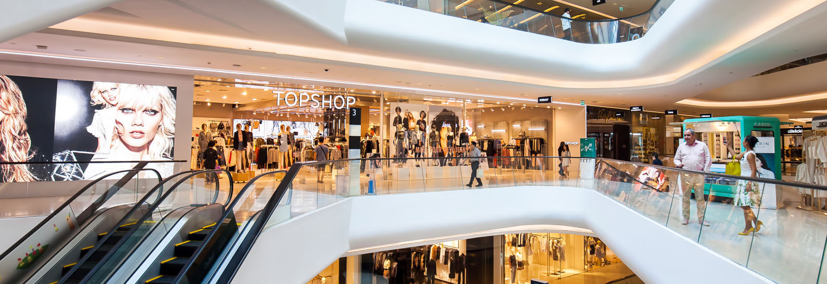

FootfallCam People Counter
People Counting Solution for Shopping Malls
©2018 Footfall counter is trademark application of FootfallCam in various jurisdictions. We reserve the right to introduce modifications without notice. All other company names and products are trademarks of their respective companies.

Slide 2

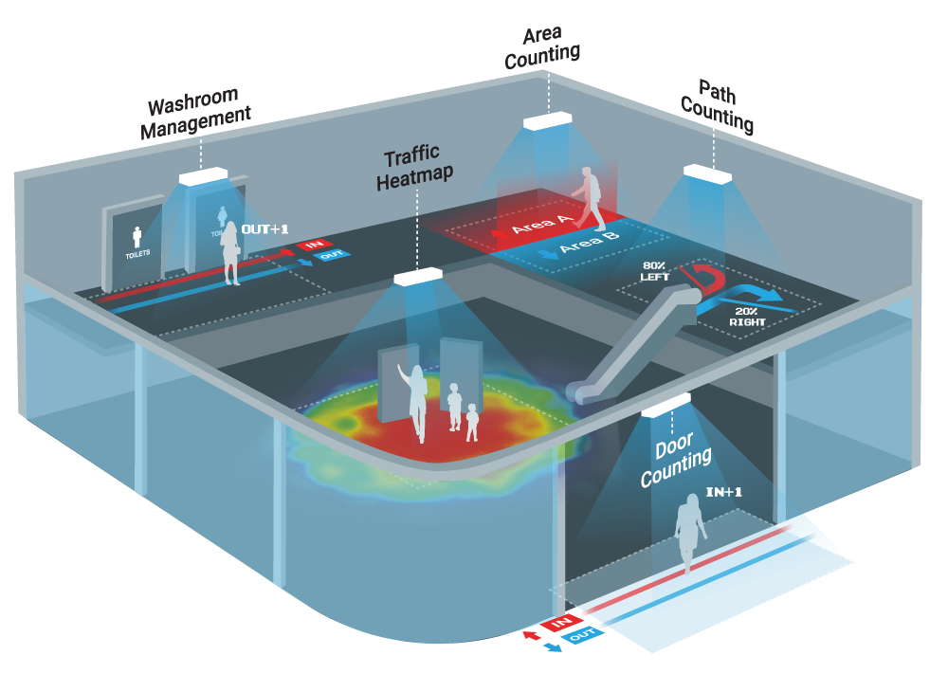
Why Do Shopping Malls Need People Counting Solution?
  Use traffic data to benchmark shopping mall performance
  Determine the effectiveness of marketing campaigns
  Substantiate the value of retail spaces
  Track customer journey through the mall
  Maximize marketing by strategically placing advertisements

Slide 3
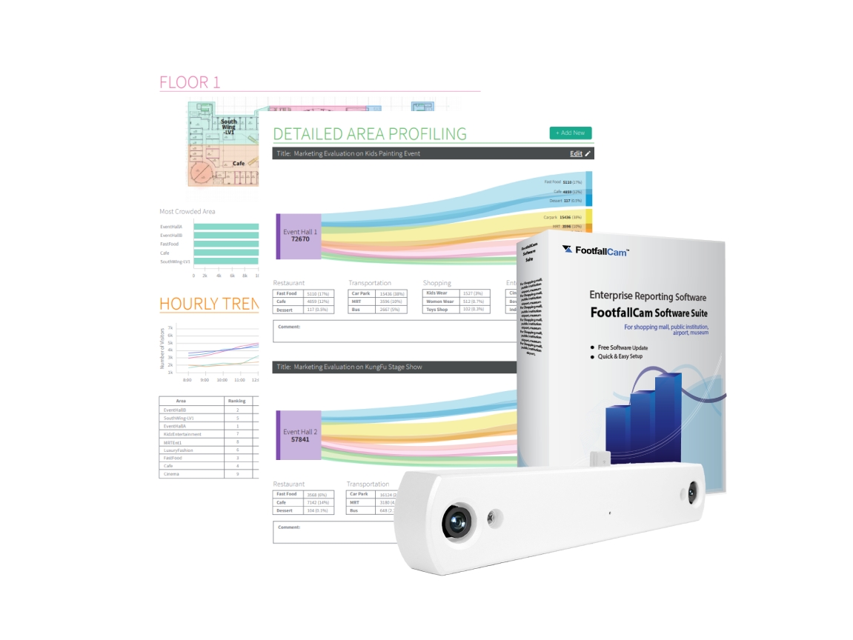
Shopping Mall System Package
All-in-one package: Hardware comes with integrated software
Hardware: FootfallCam 3D MAXTM
  98% and above accuracy
  Mean time to failure of 25 years
  Widest coverage
  Wi-Fi Analytic
  One-cable installation
Software: FootfallCam Analytic Manager V8TM
  Centralized Data Management
  Management Report
  Email Scheduler
  Automated Health Check
  Ready Made Integration
  User Account Management
Quick and Easy Installation

Slide 4
Key
Features

Slide 5
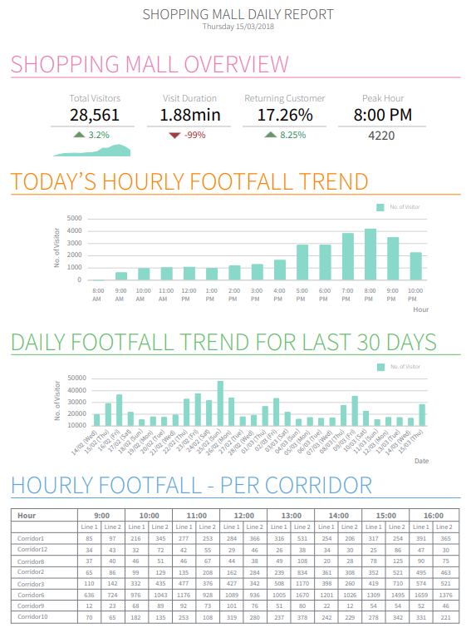
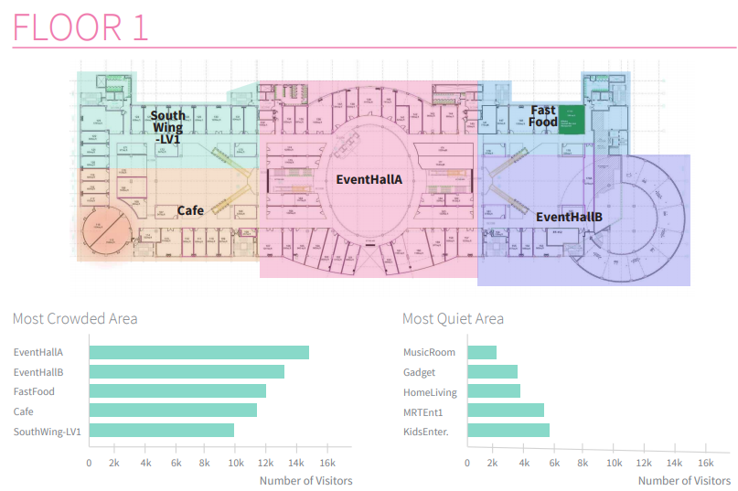
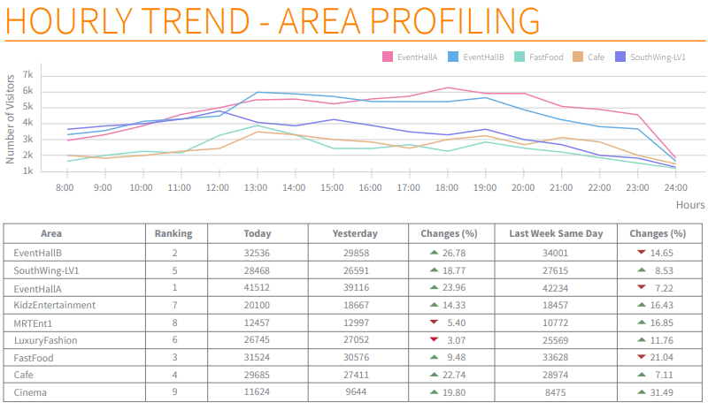
1. People Counting at Your Entrances
Video Zone Counting
Overview of Traffic Visibility
Count the number of people entering and exiting your shopping malls with 98% accuracy, then compare weekend traffic with weekdays or of previous time to visualize visitor trend.
Understand Customer Behavior
Understand how your shoppers enter the mall and which entrances gain the most usage, so you can set up advertisements along these entrances to gain the most exposure.
Identify Peak Hours
Discover your power hours in which your mall generates the most traffic and manage marketing campaigns during these time accordingly.
Gain the Most Exposure in Your Campaigns
Arrange marketing campaigns during peak hours for maximum exposure in the event, and to captivate the audience.

Slide 6
2. Area Counting
Video Area Counting
Real Time Traffic Visibility
Count the number of people entering and exiting your shopping malls in real time with 98% accuracy, then compare weekend traffic with weekdays or of previous time to visualize visitor trend.
Justify Retail Tenant Rents
With area counting, optimize the estate value of key spaces with insights into the number of visitors in each zone and adjust for tenant rental rates accordingly.
Measure Anchors’ Occupancy
Track how attractive your anchor tenants are, measure the number of visitors that visit your food courts, cinema, hypermarkets, so you can allocate rents of nearby stores accordingly.

Slide 7
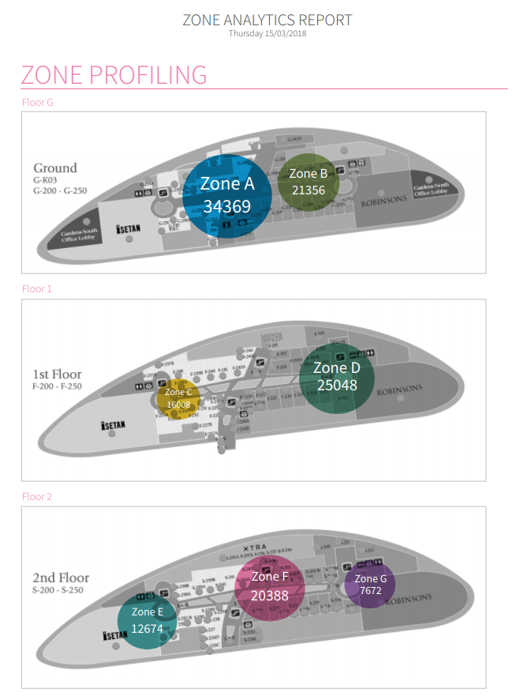
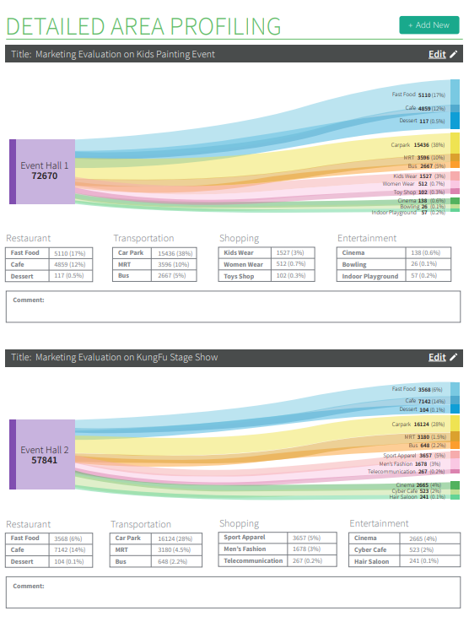
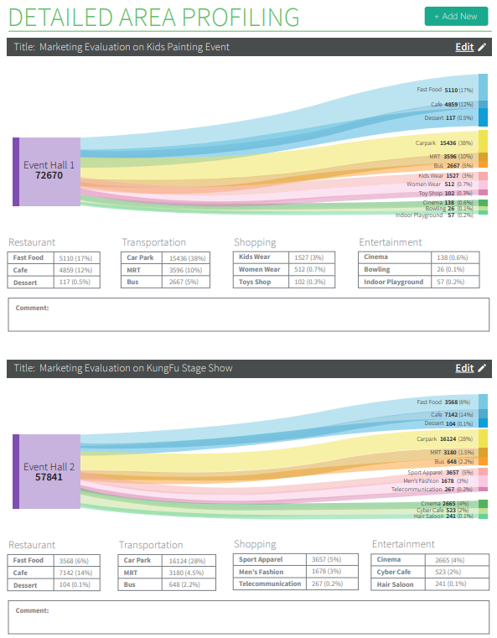
3. Zone Analytics
Wi-Fi Flow Analytics
Visualise Traffic Flow
Determine which pathway are mostly used by shoppers by visualising the traffic flow patterns of visitors, to plan display placement to attract shoppers into specific pathway.
Shopper Profiling per Zone
Showcases where visitors go after visiting a promotional event, to offer objective evidence on retail opportunities available to retail tenants.
Gain the Most Exposure in Your Campaigns
Arrange marketing campaigns in the places with the highest traffic flow for maximum exposure in the event, and to captivate the audience.

Slide 8

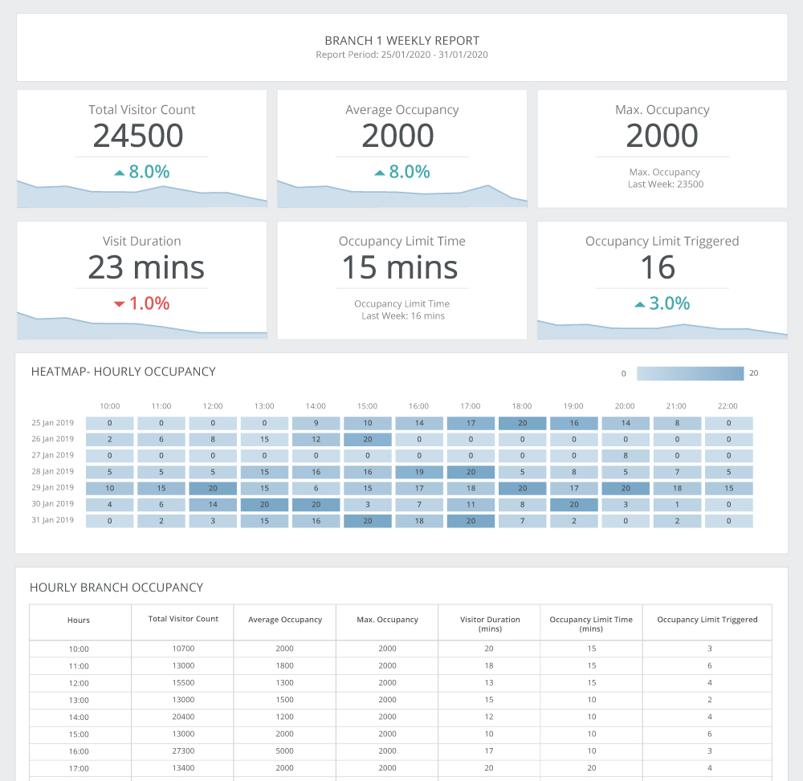
Click here to view the showcase for SpaceOccupanctyTM in Shopping Mall.
Occupancy Report for Mall Management
Keep track of store occupancy level:
Ensure that each store is operating in compliance with social distancing guidelines
Clear insight into the occupancy trend based on historical data
Assign more staff on duty during high occupancy periods
Overview of the occupancy limit
Monitor the staff’s performance based on how long the occupancy limit is breached
Keep an eye on the number of times the occupancy limit is triggered
Managements can view the occupancy reports on site-level and company-level
FootfallCam - Shopping Mall

Slide 9
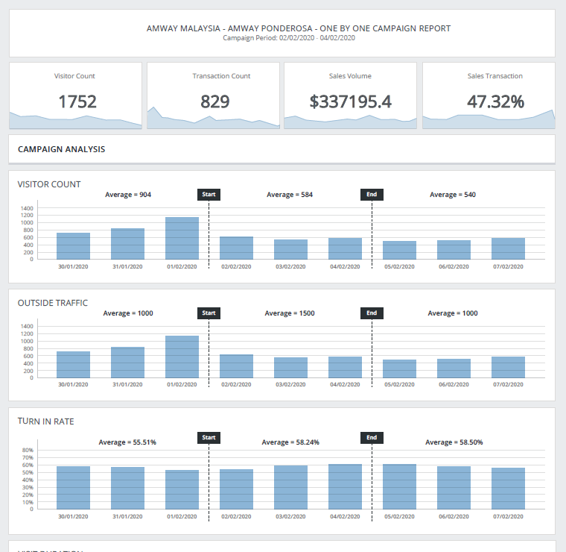
Download the sample report here.
Marketing Effectiveness Report
Purpose
Monitor the campaign effectiveness with the measurement for
  Visitor Count.
  Outside Traffic.
  Turn In Rate.
  Visit Duration.
  Transaction Count.
Campaign configuration is available.

Slide 10
Additional
Functions

Slide 11
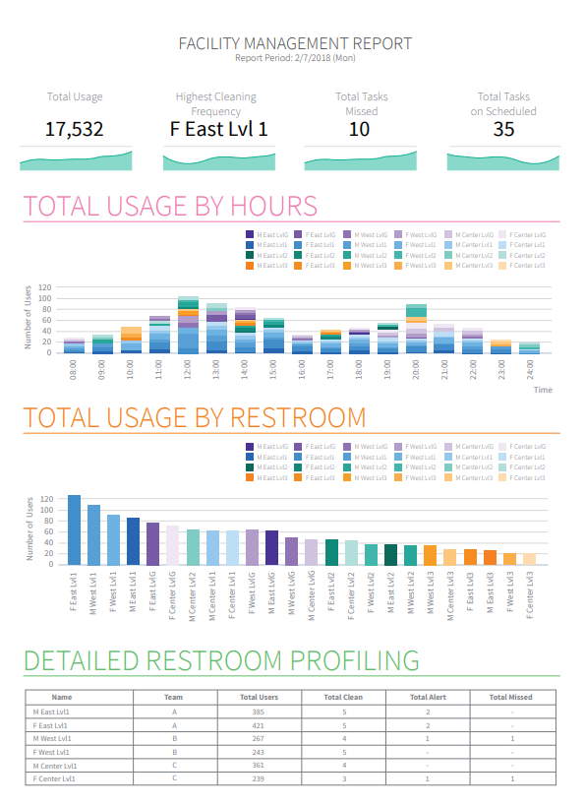
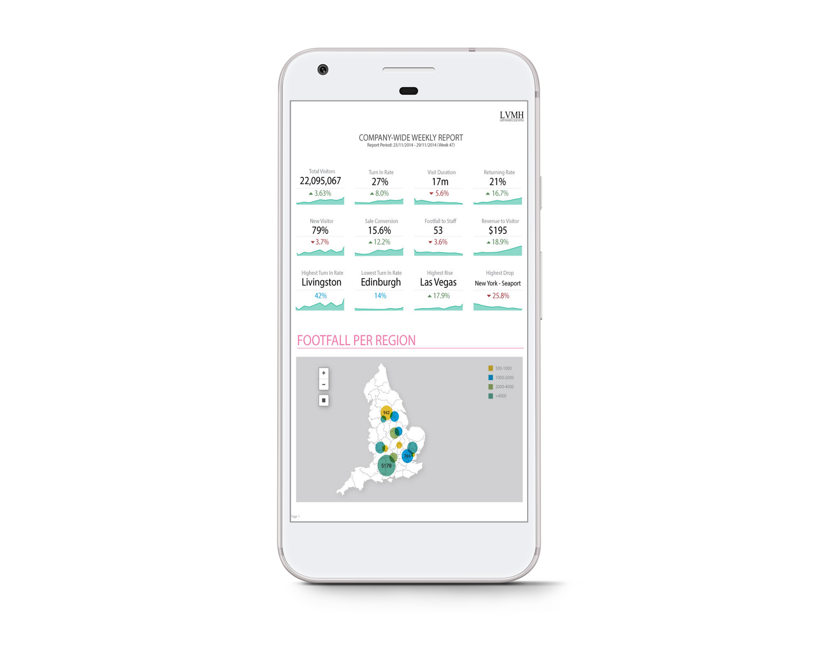
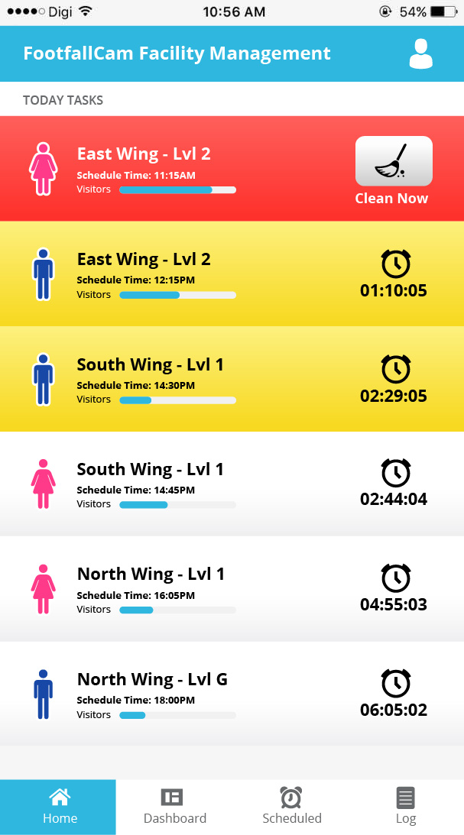
1. Smart Washroom Management
Restroom Management
Cleanliness Reassurance
People counters can be placed at entrances to restrooms, to provide a clear view of how resources are being used. Management will be able to identify which restrooms are being underutilized or over-flowing with people. With this knowledge, management level can ensure cleaning staff perform their duties according to as scheduled and the restroom cleanliness are maintained at a satisfactory level. This will create a better experience for shopper.
Cleaning Staff Optimization
By measuring the usage of facilities in the shopping mall, management can create staff schedules that accurately reflect the condition of the restroom with busier areas receiving more attention. By reducing the workload staff spends on areas they are not needed, management can make cost savings decision and reduce the burden of the management in manually creating the schedules.

Slide 12
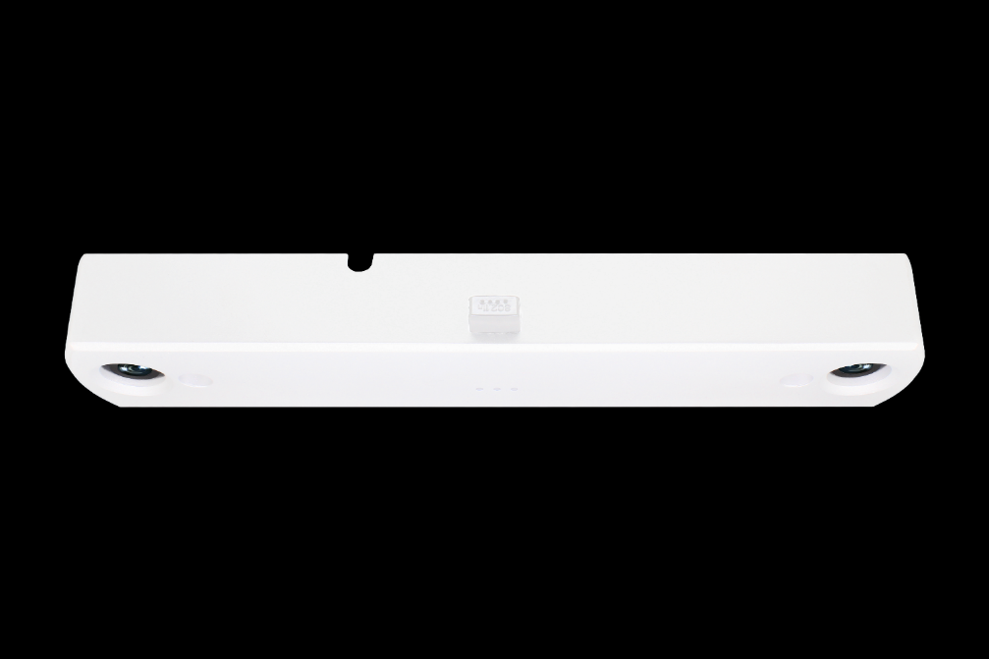


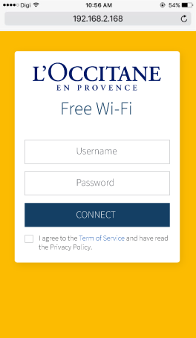
2. Wi-Fi Hotspot
FootfallCam Max TM
Wi-Fi Hotspot
Double up as Free Wi-Fi hotspot area with no additional hardware required
Our people counter serves as a Wi-Fi hotspot for shoppers to connect and surf the Internet during their waiting time. Further increasing the Wi-Fi hotspot areas throughout the mall, shoppers have more access to the Internet and this will create better shopper experience. Free upgrade of the counter is available to use the Wi-Fi hotspot function.
Place the pre-defined ads to engage your customer and gauge their interest in addition to obtaining customer data. This would give understanding into shopper demographic and boosting customer satisfaction.
Wi-Fi Hotspot

Slide 13
Services
Our expert team will support you in all parts of the product lifecycle, from planning to installation, from operation and maintenance to modernization and product replacement.

Slide 14

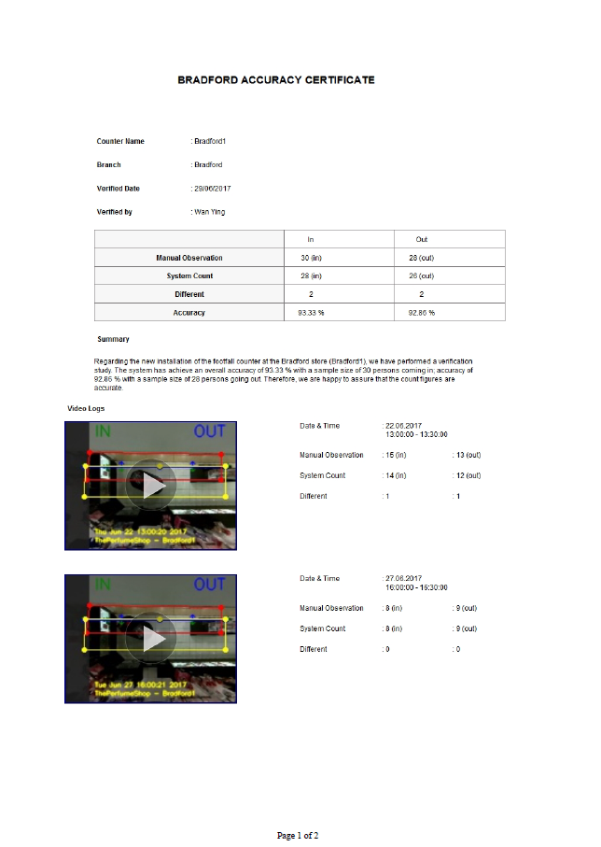
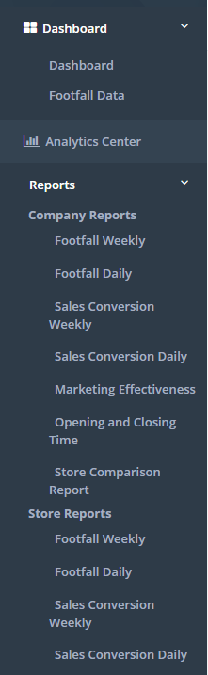
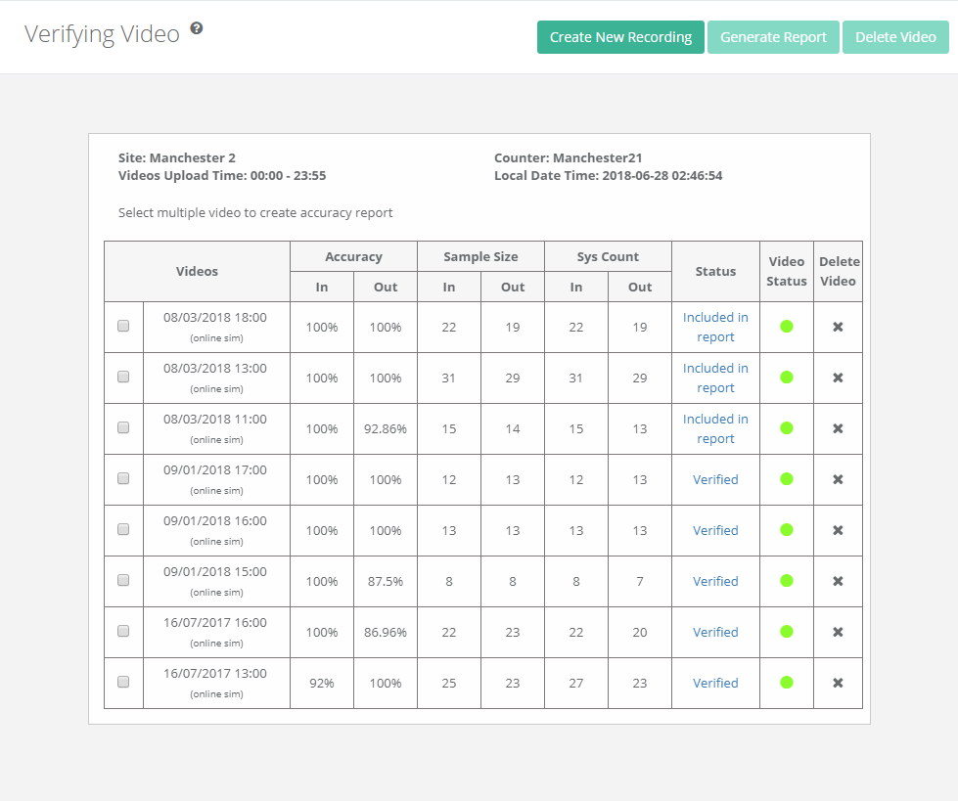
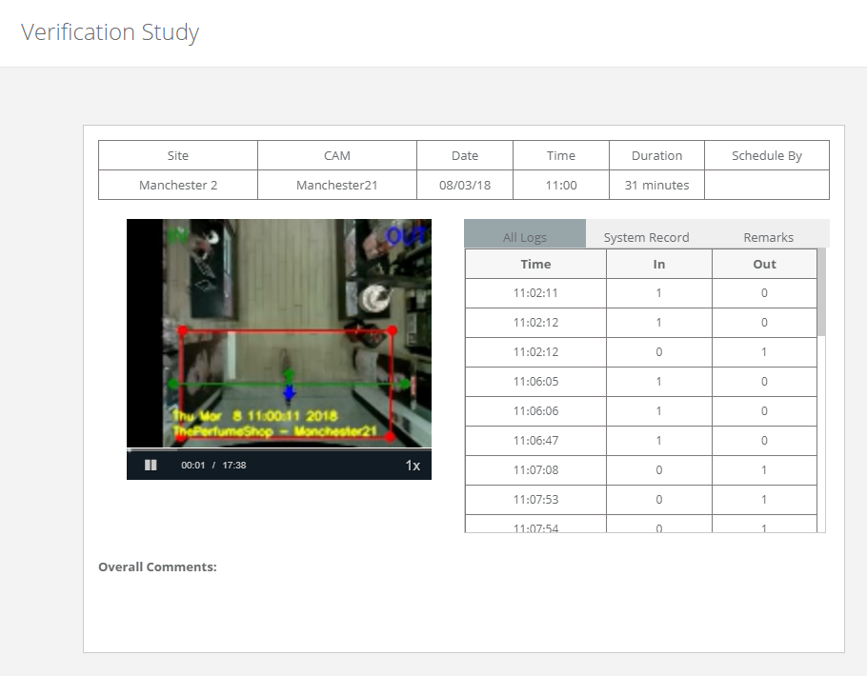
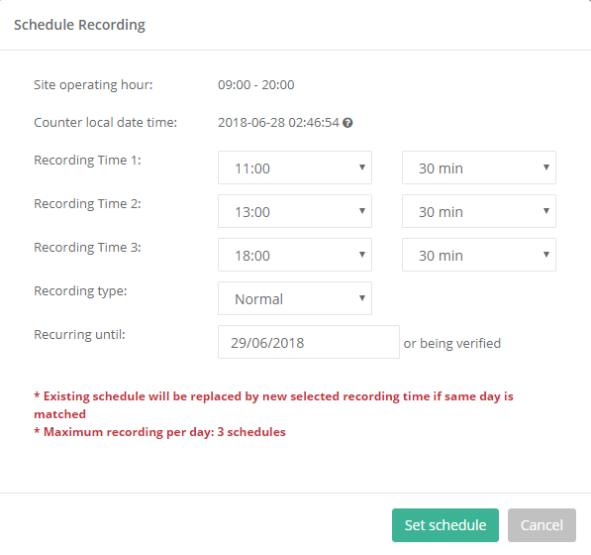
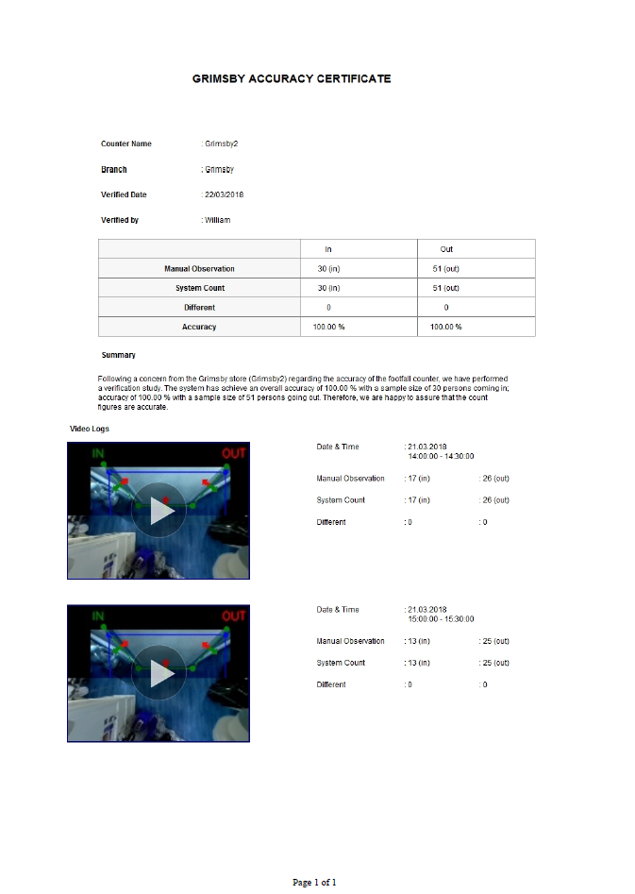
Accuracy Audit
How do we audit the accuracy?
Schedule video recordings
2
Compare system count and manual count
1
3
Generate verification report
Schedule video recordings of peak hours to ensure there is sufficient sample size for to audit the accuracy of the counter.
Compare the system count generated by the FootfallCam device against manual observations to determine the accuracy of the FootfallCam.
Once there is sufficient sample size and the accuracy is satisfactory, a verification report with the video proof used in manual observation can be generated.

Slide 15
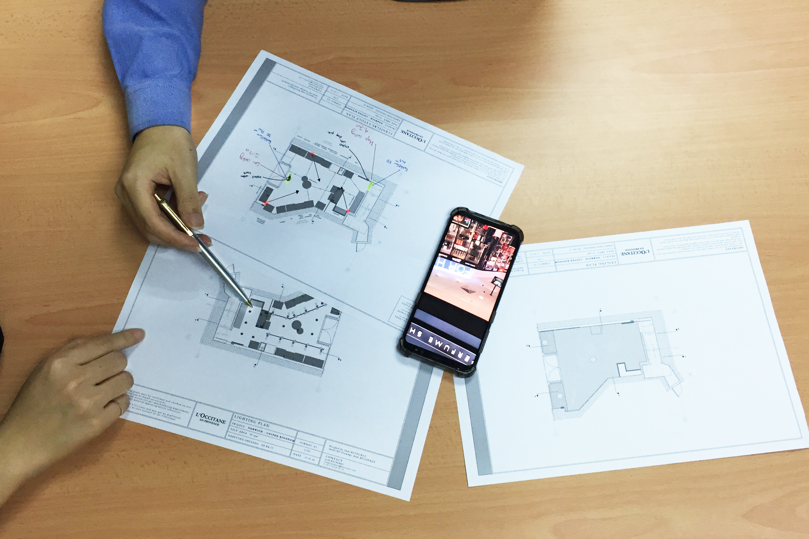
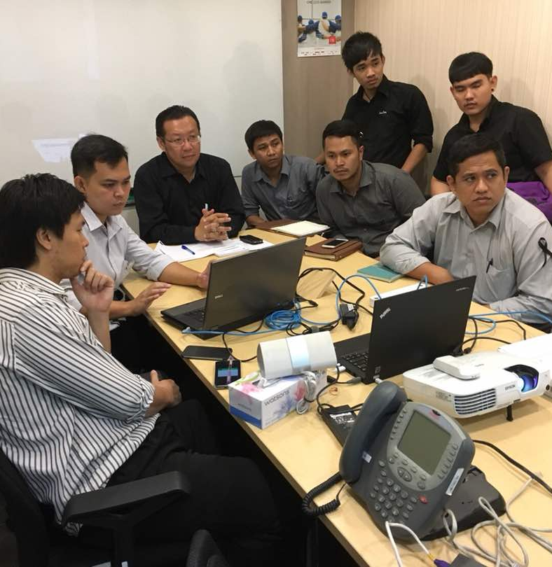
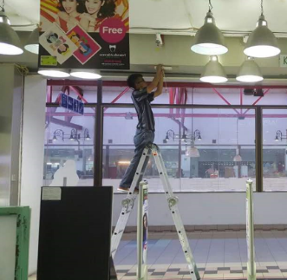
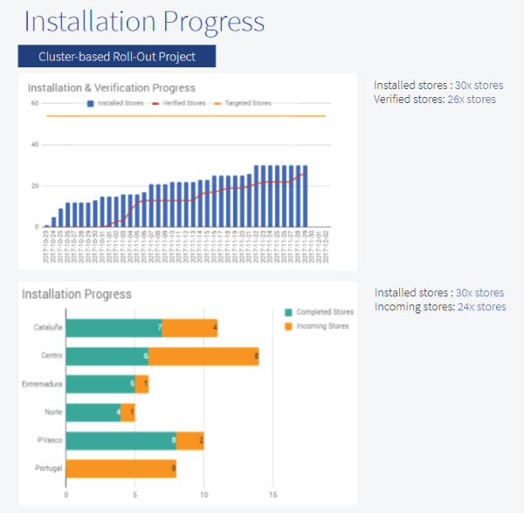
Project Management
With a network of resellers situated throughout the globe, finding a person to talk to about FootfallCam is never an issue. We ensure that you can be confident that the FootfallCam is working in excellent working order.
Floor Plan Design
The core of FootfallCam planning support by analysing how many, and where to install the people counter, along with planning guidelines to expedite installation process.
Work with your IT team and contractors
Image 3
We can work with both your installation engineer and IT team to coordinate the installation and setup of all counters while also providing training through webinars
Dedicated Account Manager
Each customer will get their own dedicated account manager with FootfallCam to address all sales or support concerns to get the support when they need it
Training installers at Watson Thailand

Slide 16
Hardware
FootfallCam 3D PlusTM is engineered for reliability and efficiency in every granularity of data with the aim of enhancing user’s experience by delivering high quality product.

Slide 17
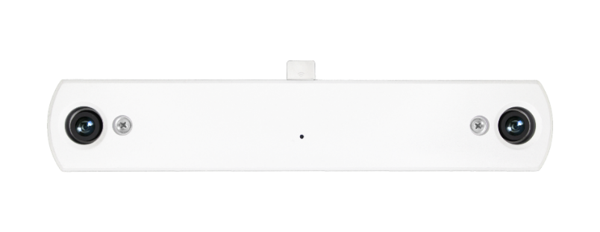
Hardware overview
Most reliable
Most stable
FootfallCam expertise in the field of autonomy and contributes to operational efficiency with automated recovery when a device is down
By utilising aluminum alloy 6063, FootfallCam can dissipate heat similar to laptop casings to prolong the life of electronic components with a life span of 25 years.
Most accurate
Most powerful
FootfallCam 3D is a mini computer, powered by quad core processor to run computational intensive algorithm for the most accurate counting sensor ever.
FootfallCam the most powerful chipset clocking at 1GHz to run complex algorithm and the widest angled lens for superiority in coverage and accuracy.

Slide 18
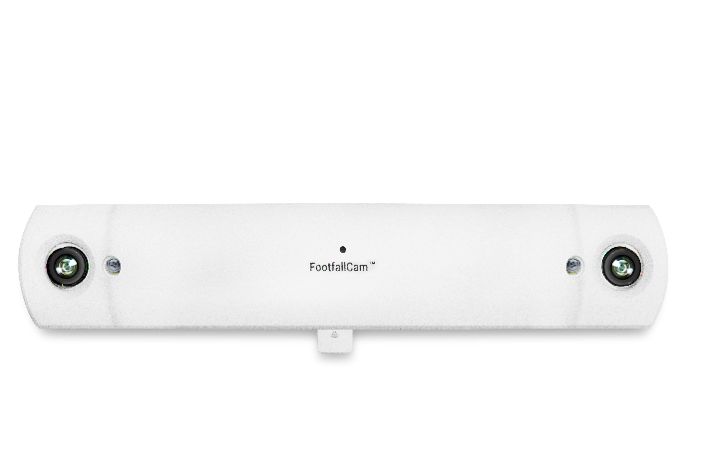
FootfallCam 3D MAX
Hardware Specifications
Device Dimensions | (WxDxH): 246mm x 46mm x 28mm Weight: 0.6kg
Lens | 160° (2.5m - 4.5m ceiling height)
IP Rating | IP 31
Casing | Aluminium Oxide Alloy
Minimum Lux | 300 Lux
Power | Power over Ethernet: 47V DC, 0.12A (6W)
Output | 5PM Omni vision; 5647 Camera Module
Frame Rate | 15 FPS
CPU | 900 MHZ
Storage | Micro SD, 8 GB Memory, 128 GB (CCTV)
Cabling | Cat5, Cat6
Firmware Features | Dual Operating System, Hardware Watchdog, Multicore Processor
Origin | Made in UK
1
Prolonged Lifespan with Aluminium Casing
By utilising aluminum alloy 6063, FootfallCam can dissipate heat similar to laptop casings to prolong the life of electronic components with a life span of 25 years.
2
Highly Accurate using powerful processor
FootfallCam the most powerful chipset clocking at 1GHz to run complex algorithm for superiority in accuracy.
3
Widest Coverage using less devices
Utilize fish eye lens for widest coverage. Less counters are required to provide maximum coverage
3

Slide 19
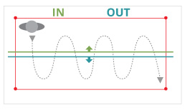
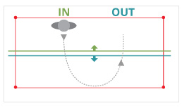
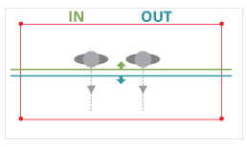
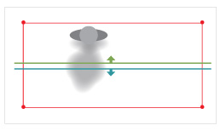
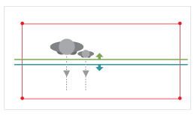
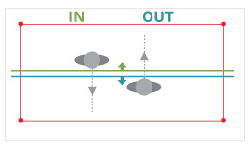
Accuracy overview
Random pattern
3D Count: 1
U-turn
3D Count: 1
Multiple people
3D Count: 2
Strong shadow
3D Count: 1
Exclude children
3D Count: 1
Bi-directional count
3D Count: 1

Slide 20
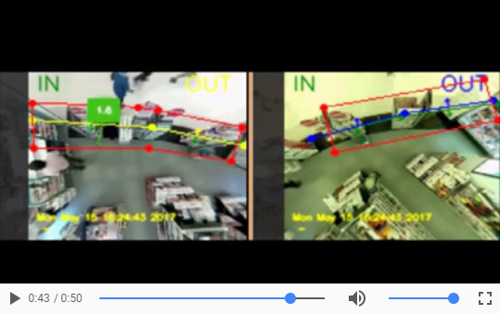
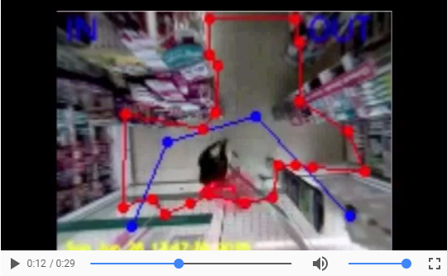
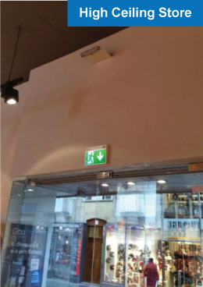
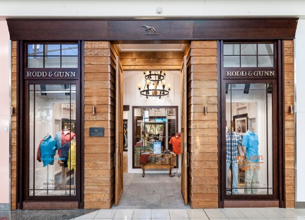

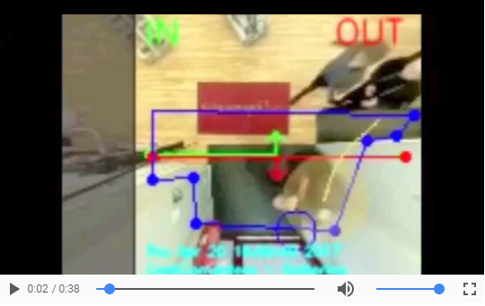
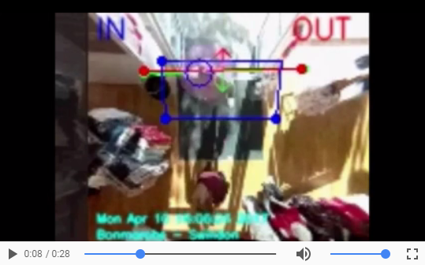
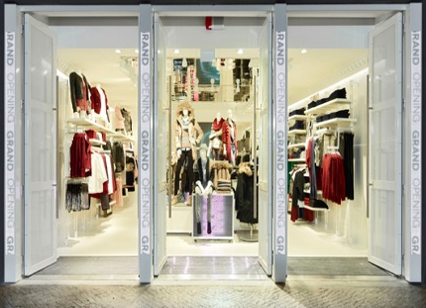
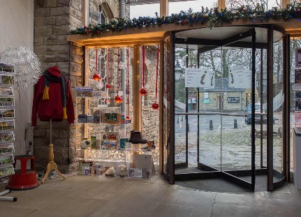
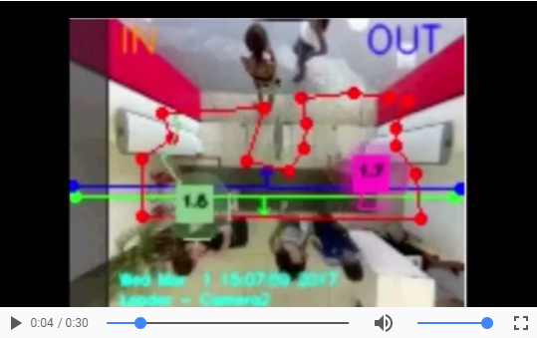
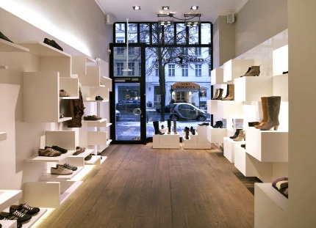
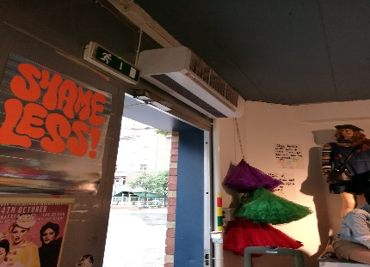
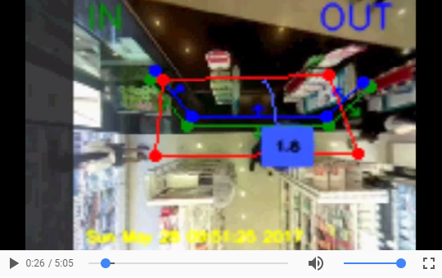
View more sample videos of different environment here.
Consistent accuracy
Accurate in all store environment
Multiple entrances
Stores with multiple entrances may install multiple counters and assign the counters under the same branch in the Analytic Manager.
Swinging Door
With the use of custom line, start/end zone, floor space masking, and accurate 3D counting, it can count accurately with a swinging door at the entrance.
Low ceiling
3D counting can work well in low ceiling height, such as the one in the video where the ceiling height was 2.2 metres.
Strong Shadow
3D Stereo Vision can overcome strong shadowing effect; which would otherwise mistaken as a visitor in 2D video counting.
High Traffic
3D imaging allow accurate people tracking, and maintain high accuracy even in high traffic stores.
Crowded Area
The use of start/end zone and person tracking would ensure shopper within the store would not trigger the in/out lines.

Slide 21
Software
Enterprise web based control panel that manages all FootfallCam devices by storing the data of all counters in a centrally managed system.

Slide 22
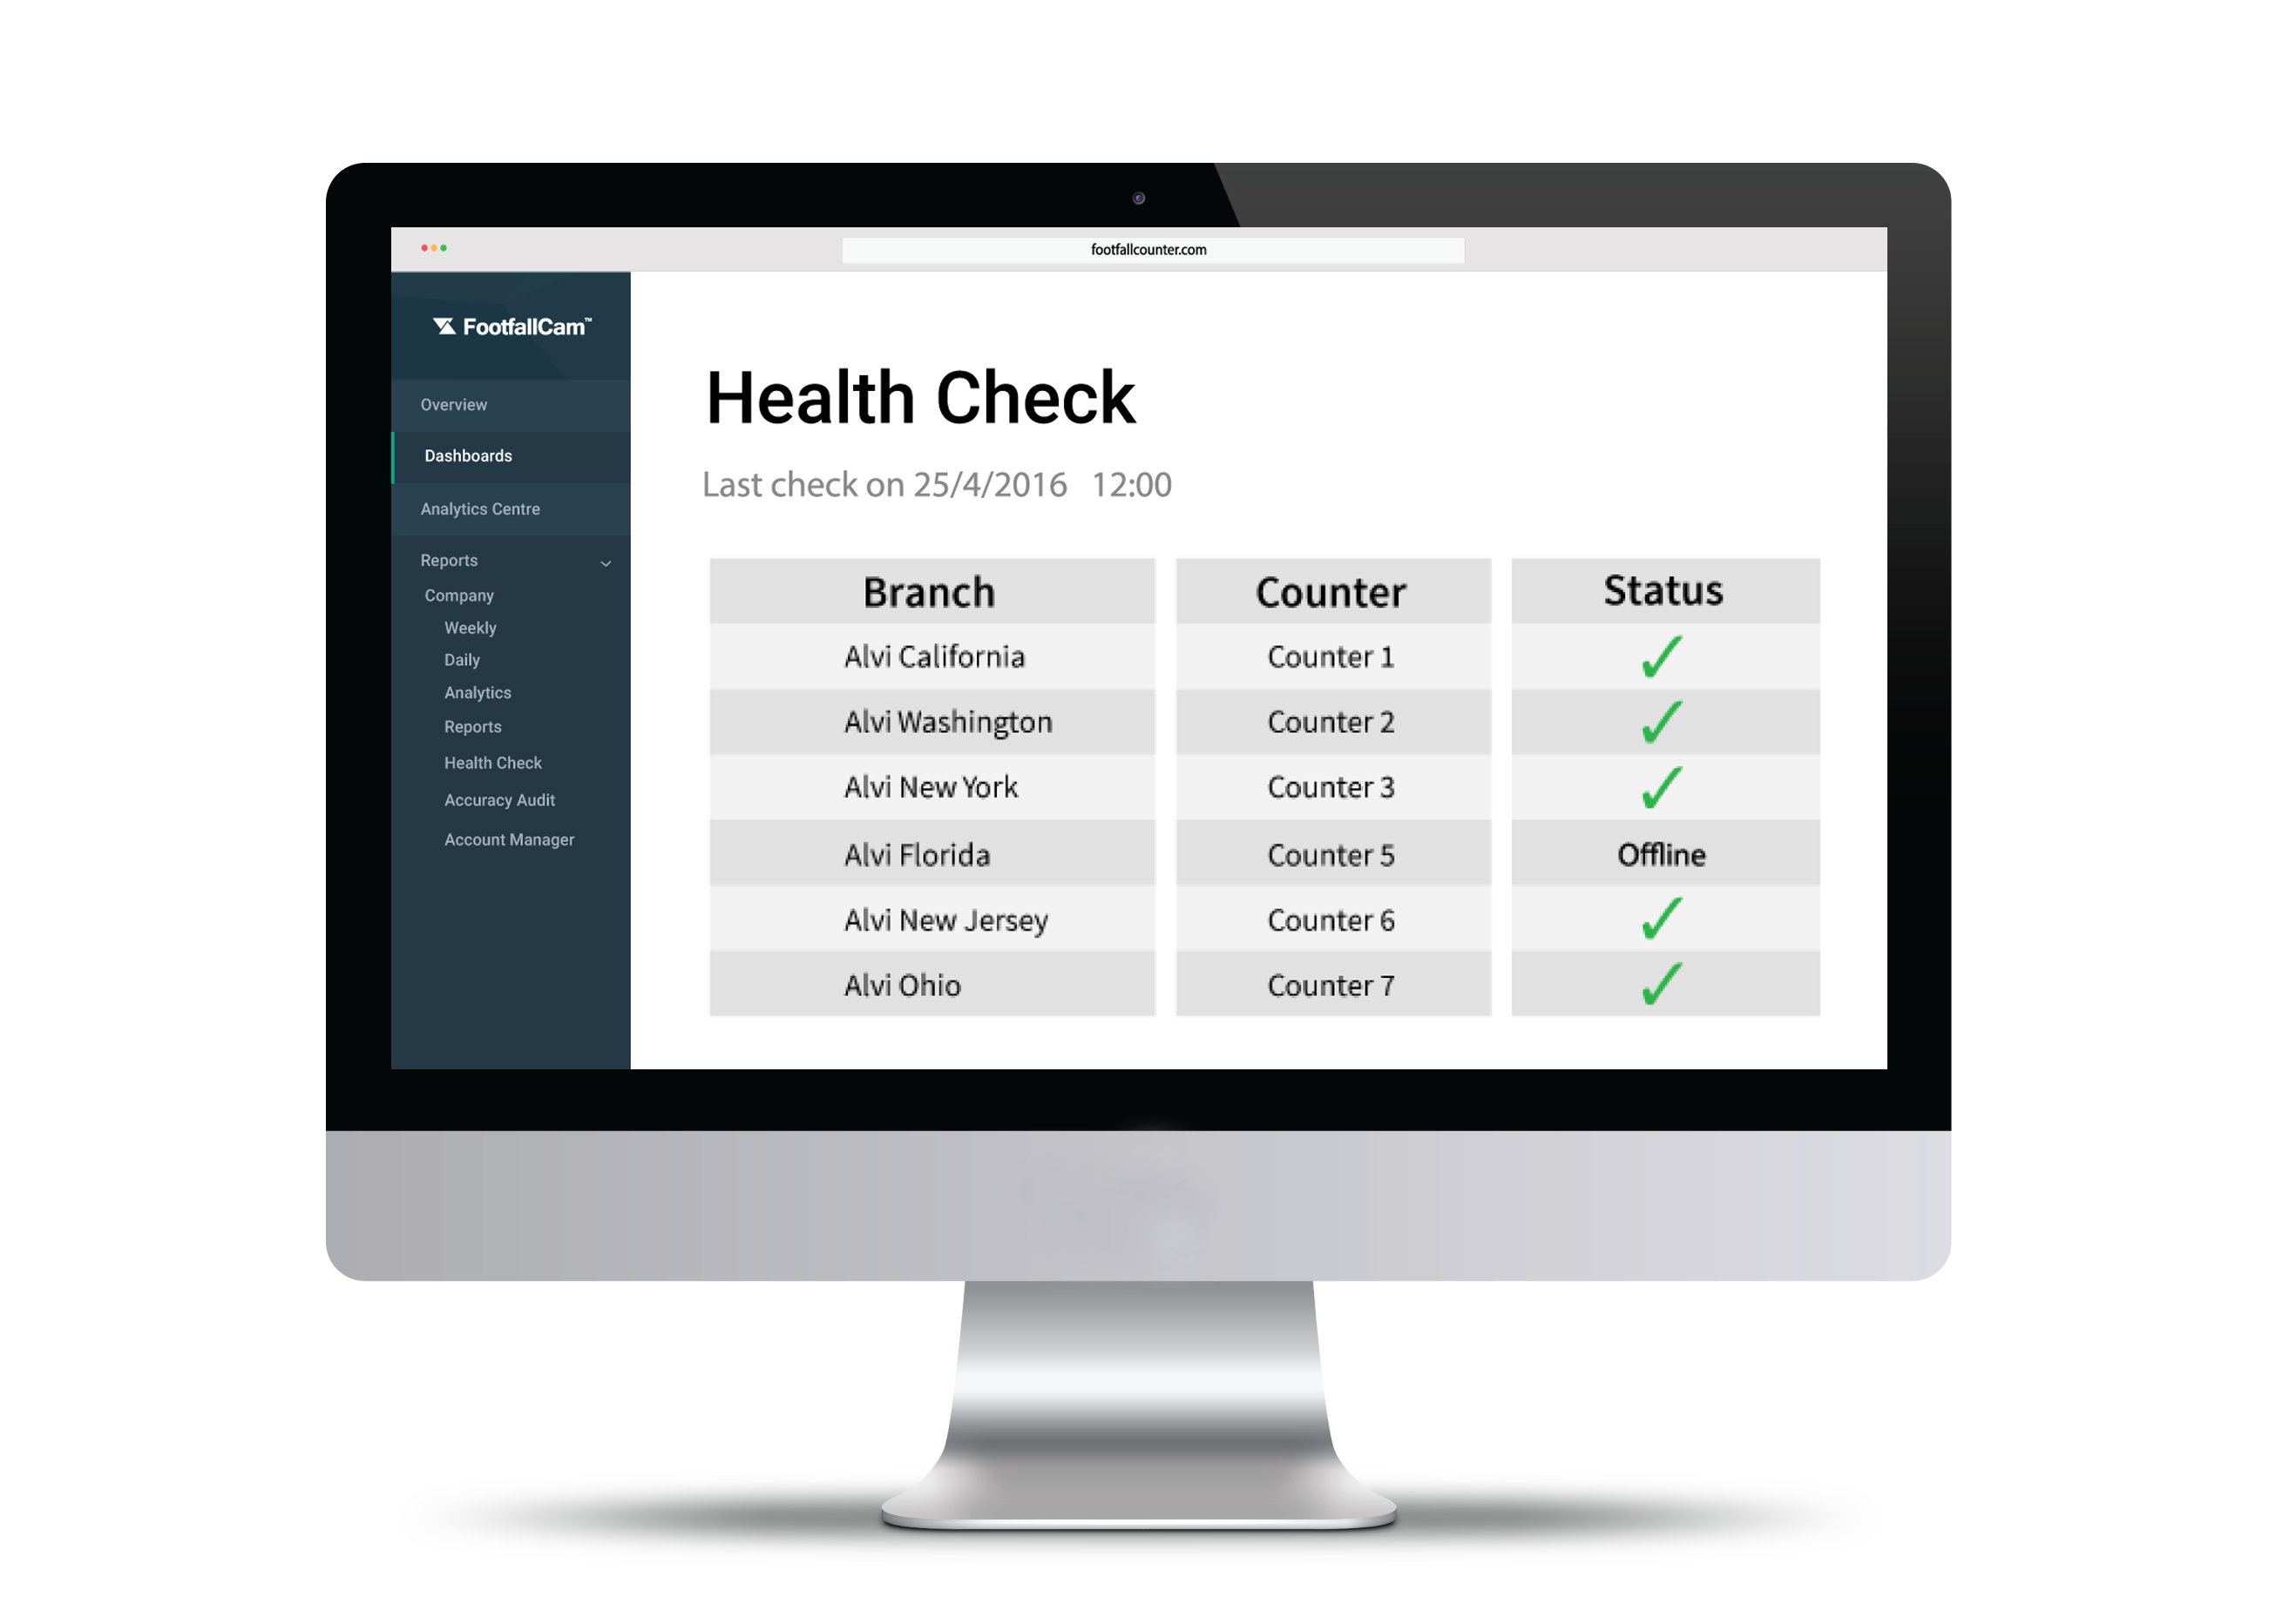
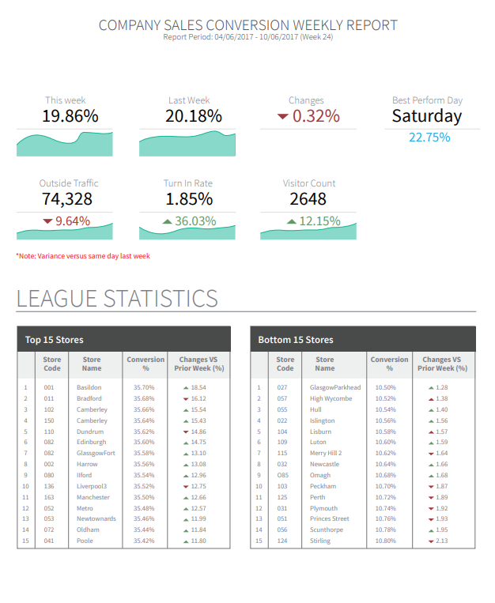
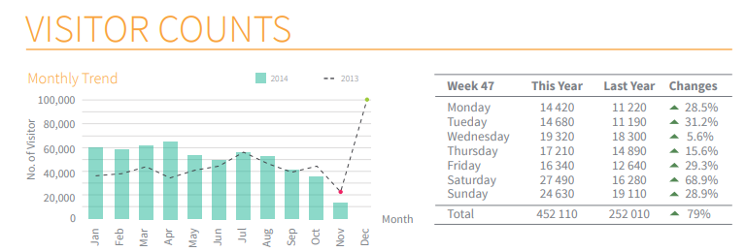

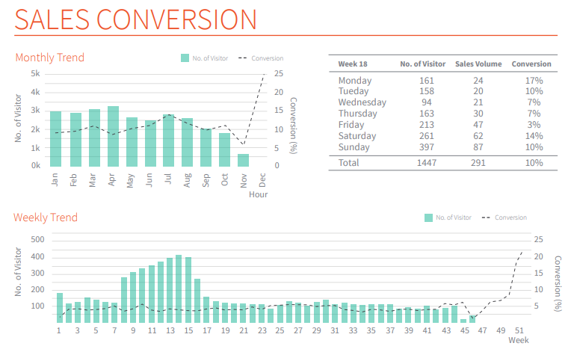





Analytics Manager V8
1
Centrally managed system with Data Analytics
Centralised system that enables users to view all the counters they have installed across all stores anytime, anywhere.
2
Business Reports
With over sixty different ready made reports, users will be able to have better visibility in their store performance that provides managerial executives deeper insights.
3
Autonomous Health Check
Autonomous and instantaneous management tool that notifies users when a counter is not working to minimise loss of data with a rapid response time
4
Ready Made Integration
Integrate sales data into the FootfallCam Analytic ManagerTM through FTP or API, then export to your business intelligence system through FTP or API.
5
User Account Management
Two user levels up for configuration. Manage unlimited user accounts in one place.

Slide 23
Case study
FootfallCam is a proven solution installed in over 10,000 locations throughout the world and have garnered the satisfactions of thousands of customers.
3
Key Features of FootfallCam 3D Counter

Slide 24

1 Utama (Malaysia)
Since the usage of people counters in the 1 Utama mall was a relatively new concept, 1 Utama management broken down the installation into three phases each with a different goal in mind. The first aim of 1 Utama was to know overall traffic volume, the second was to improve the effectiveness of marketing campaign, while the third is to increase revenue stream from tenants.
Understanding where the shoppers come from
During the trial stage, 1 Utama mainly wanted to know where their visitors is coming from, and how many people enter from the train station, and how many enter from car park. At this stage, 1 Utama only installed in all entrances to find out which area is most often used.
Analysing the flow of traffic
At the second stage with the inclusion of corridor installation, 1 Utama had insight into traffic analytics to understand how people move within the mall. With this knowledge, footfall trend were produced to identify the most popular pathway to place advertisements.
Justify the rental value of tenants
With the insight into the popular area in the mall, 1 Utama have knowledge into which department area their mall is most popular and gauge whether the tenant rental cost should be increased or decreased based on traffic volume.
Shopping mall

Slide 25

Marina Mall (Kuwait)
With the large inflow of shoppers, it becomes critical for Marina Mall to maximize customer experience being one of the Middle east’s most elegant urban shopping center. Marina Mall aims to understand how customer moves inside the mall and the frequent zones shoppers like to visit. Getting these visibility helps Marina Mall to plan their promotional activities in the mall.
Measure Marketing Effectiveness
Marina Mall holds events in their mall especially during festive seasons. However, the management is unable to tell whether the events had any impact or the visitor counts that visited the event. There is no evidence to show. FootfallCam has a specialized report to show the marketing effectiveness.
Identify Customer Journey
Marina Mall had insight into traffic analytics to understand how people move within the mall. With this knowledge, footfall trend were produced to identify the most popular pathway to place advertisements. They are able to decide which path is least favorite and implement strategies to attract shoppers to the path.
Staff Planning
Marina Mall is concerned on their staff allocation and scheduling, they do not have the visibility to have the right placement at the right time. The management is able to implement better personnel allocation e.g. more security staff at crowded zones.
Shopping mall

Slide 26

A.S Watsons (Globally)
FootfallCam dealt with over 30 business units during the project rollout with AS Watsons. AS Watsons wanted visibility of all commercial event that occurred in their stores. FootfallCam had strung all the data back to the HQ, by setting up an FTP connection in every business unit to point all data back to the centralised GIT.
Centrally managed system
A.S Watsons initially installed Brickstream 3D counters in all their store but swapped over to FootfallCam when they needed to data in one centralised location. As opposed to the previous solution when A.S Watsons needed to enter the network of each store to grab data on a daily basis.
Regional comparison of sales conversion
With all counting data in one centralised location, A.S Watsons compared the conversion data of their stores against another country to determine which market they are underperforming in and to identify areas to improve.
Manually optimise each counter to environment
Being a large international business, A.S Watsons had many different type of store environment ranging in entrance types, width, and height. Each counter installed in Watsons is manually calibrated to each specific location for the highest accuracy possible.
Retail chain

Slide 27



Our Customers

Slide 28

About FootfallCam™
Global Leader in People Counting System
FootfallCam is the global leader in people counting solutions. Headquartered in the United Kingdom, FootfallCam started with a team of experienced engineers with the vision of creating the most advanced people counting system in the market. We are the manufacturer of both hardware and software; all the design and development are 100% in-house made.
FootfallCam is continuously reinvesting more than 24% revenue into research and development
In-house R&D team dedicated to the development of both hardware and software of FootfallCam
Combined over 100 years industry experiences in developing people counting solution
Serving multiple sectors varying from retail, fast food, restaurants, museums to smart buildings and airports.
Prior to the Covid-19 scenario, our research team predicted the demand for this solution ahead live occupancy we activated our R&D team to develop our Live Occupancy Control System
Notes:
Serve many industries
Many technologies – continuous investment in R&D
Latest focus is this solution to specifically cater for covid-19 occupancy control market demands, easy to install, economical to own the system

Slide 29
Contact Us
You need further information or have a question?
Please visit:
www.footfallcam.com
Headquarters
2 Stanhope Gate, Stanhope Road, Camberley,
GU15 3DW,
United Kingdom
Asia Office
51-2, Jalan SL ¼,
Bandar Sungai Long,
43000 Kajang, Selangor Darul Ehsan, Malaysia
©2018 Footfall counter is trademark application of FootfallCam in various jurisdictions. We reserve the right to introduce modifications without notice. All other company names and products are trademarks of their respective companies.

