Slide 1

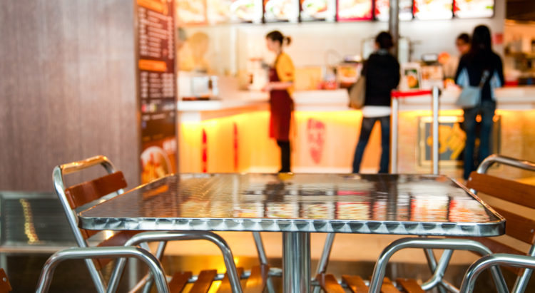
Fast Food Restaurant Solution
Optimise your restaurant operation
©2002-2020 Footfall counter is trademark application of FootfallCam in various jurisdictions. We reserve the right to introduce modifications without notice. All other company names and products are trademarks of their respective companies.

Slide 2

About FootfallCam™
Global Leader in People Counting System
FootfallCam is the global leader in people counting solutions. Headquartered in the United Kingdom, FootfallCam started with a team of experienced engineers with the vision of creating the most advanced people counting system in the market. We are the manufacturer of both hardware and software; all the design and development are 100% in-house made.
FootfallCam is continuously reinvesting more than 24% revenue into research and development
In-house R&D team dedicated to the development of both hardware and software of FootfallCam
Combined over 100 years industry experiences in developing people counting solution
Serving multiple sectors varying from retail, fast food, restaurants, museums to smart buildings and airports.
Prior to the Covid-19 scenario, our research team predicted the demand for this solution ahead live occupancy we activated our R&D team to develop our Live Occupancy Control System

Slide 3
Agenda
  About FootfallCam
  FootfallCam Products
  Use Cases
    Use Case #1 Queue Counting
    Use Case #2 Washroom Management
    Use Case #3 Seat Occupancy and Desk Clearance
    Use Case #4 Drive Thru SLA Tracker
  FootfallCam Analytic Manager V9TM
  Project Deployment
  Case Studies
About Speaker
DR. MELISSA KAO BSc (Hons), PhD
Director of International Sales, FootfallCam UK Limited.
Connect on Linkedin

Slide 4
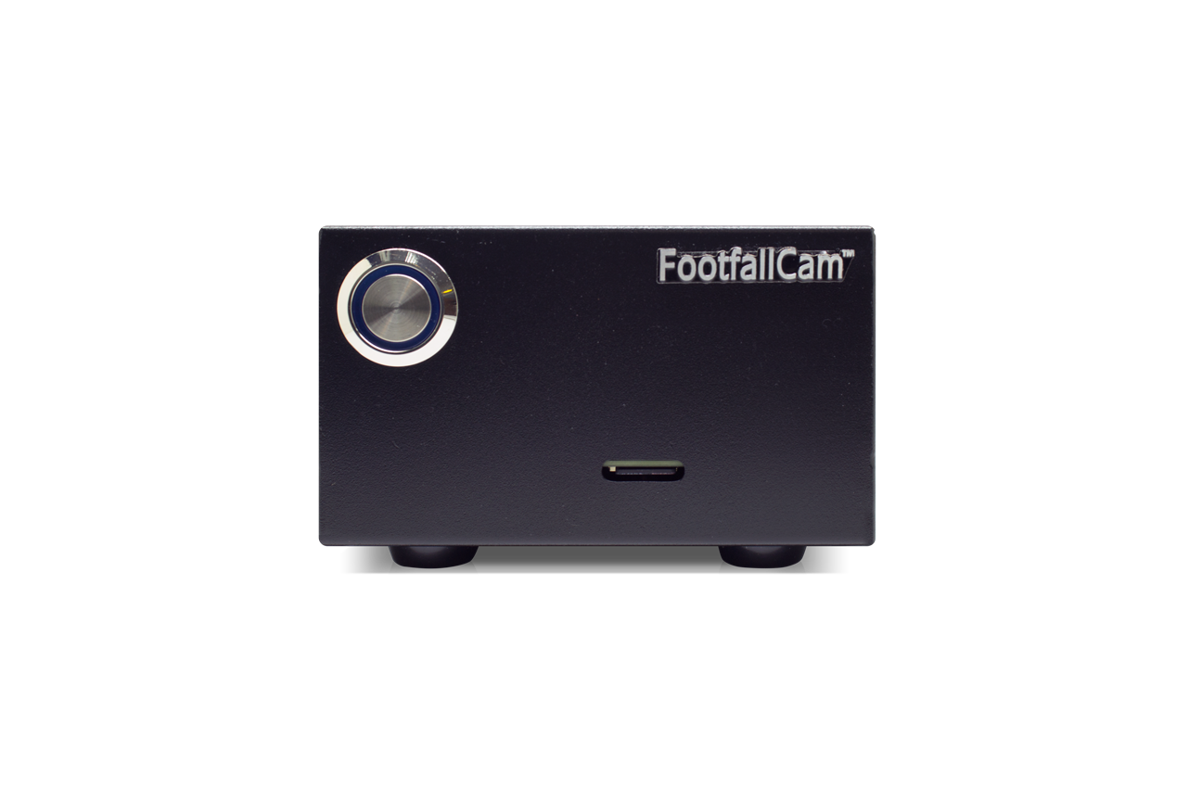
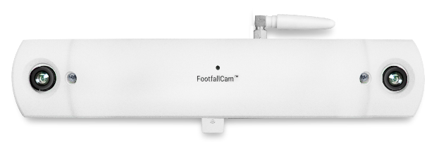
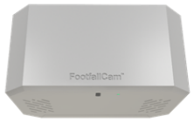
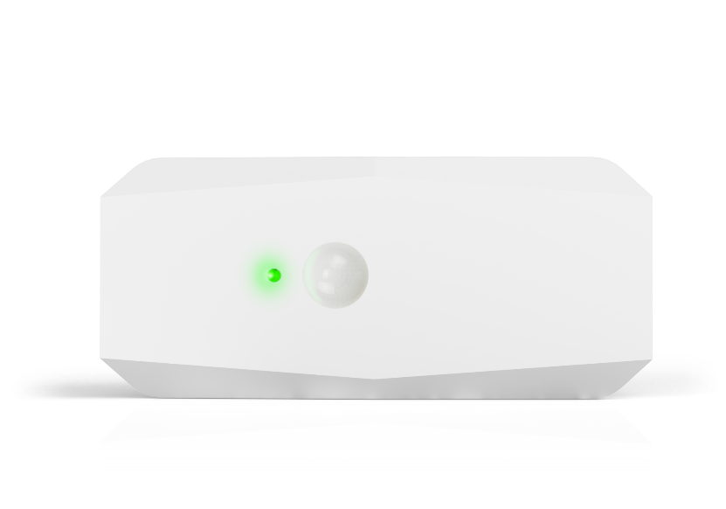
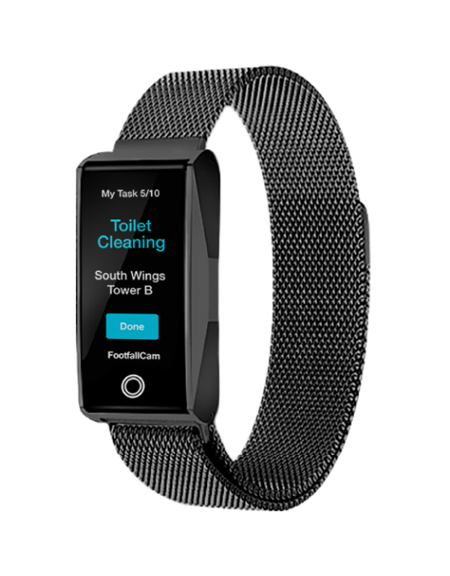
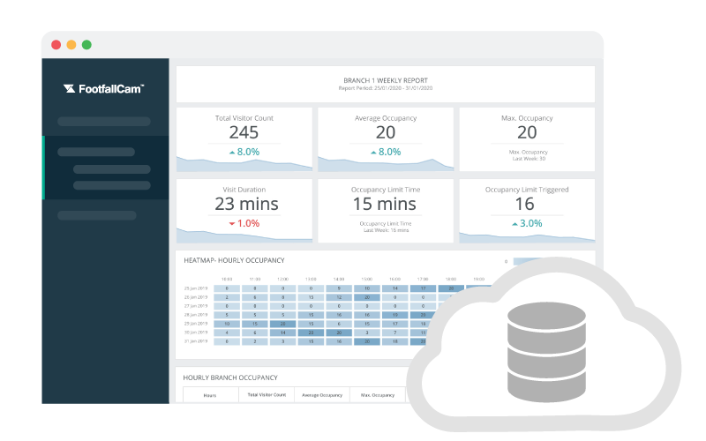
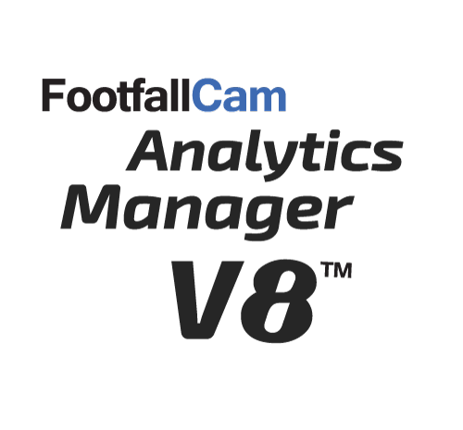
FootfallCam Products
FootfallCam provides a number of key products, specifically designed for fast food restaurants.
FootfallCam 3D MAXTM
FootfallCam CentroidTM
FootfallCam 3D MiniTM
3D Stereovision + WiFi Counting
Datasheet
2D Video Analytics
Datasheet
Time-of-Flight (ToF) Technology
Datasheet
FootfallCam
Analytics Manager V9TM
Utilisation SensorTM
FootfallCam WatchTM
Passive Infra-red (PiR) + Time-of-Flight (ToF)
Datasheet
Task Alert via Radio Frequency (RF)
Datasheet
Cloud-based Analytics Platform
Datasheet

Slide 5
#1: Queue Counting
Monitor your speed of service by managing queue time and length

Slide 6
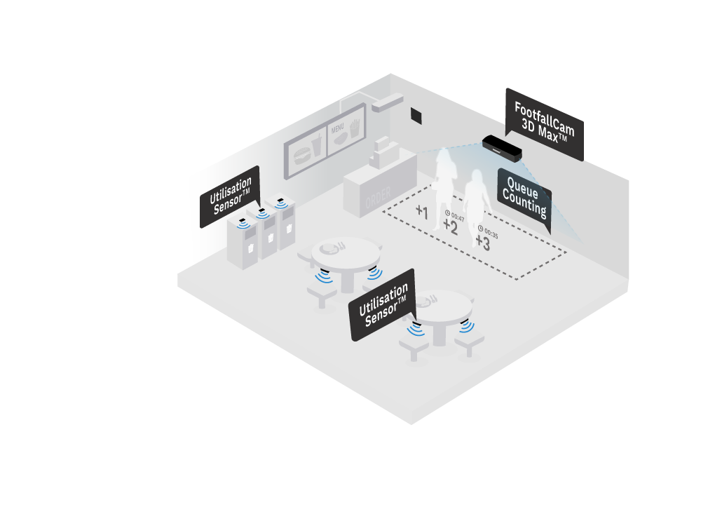
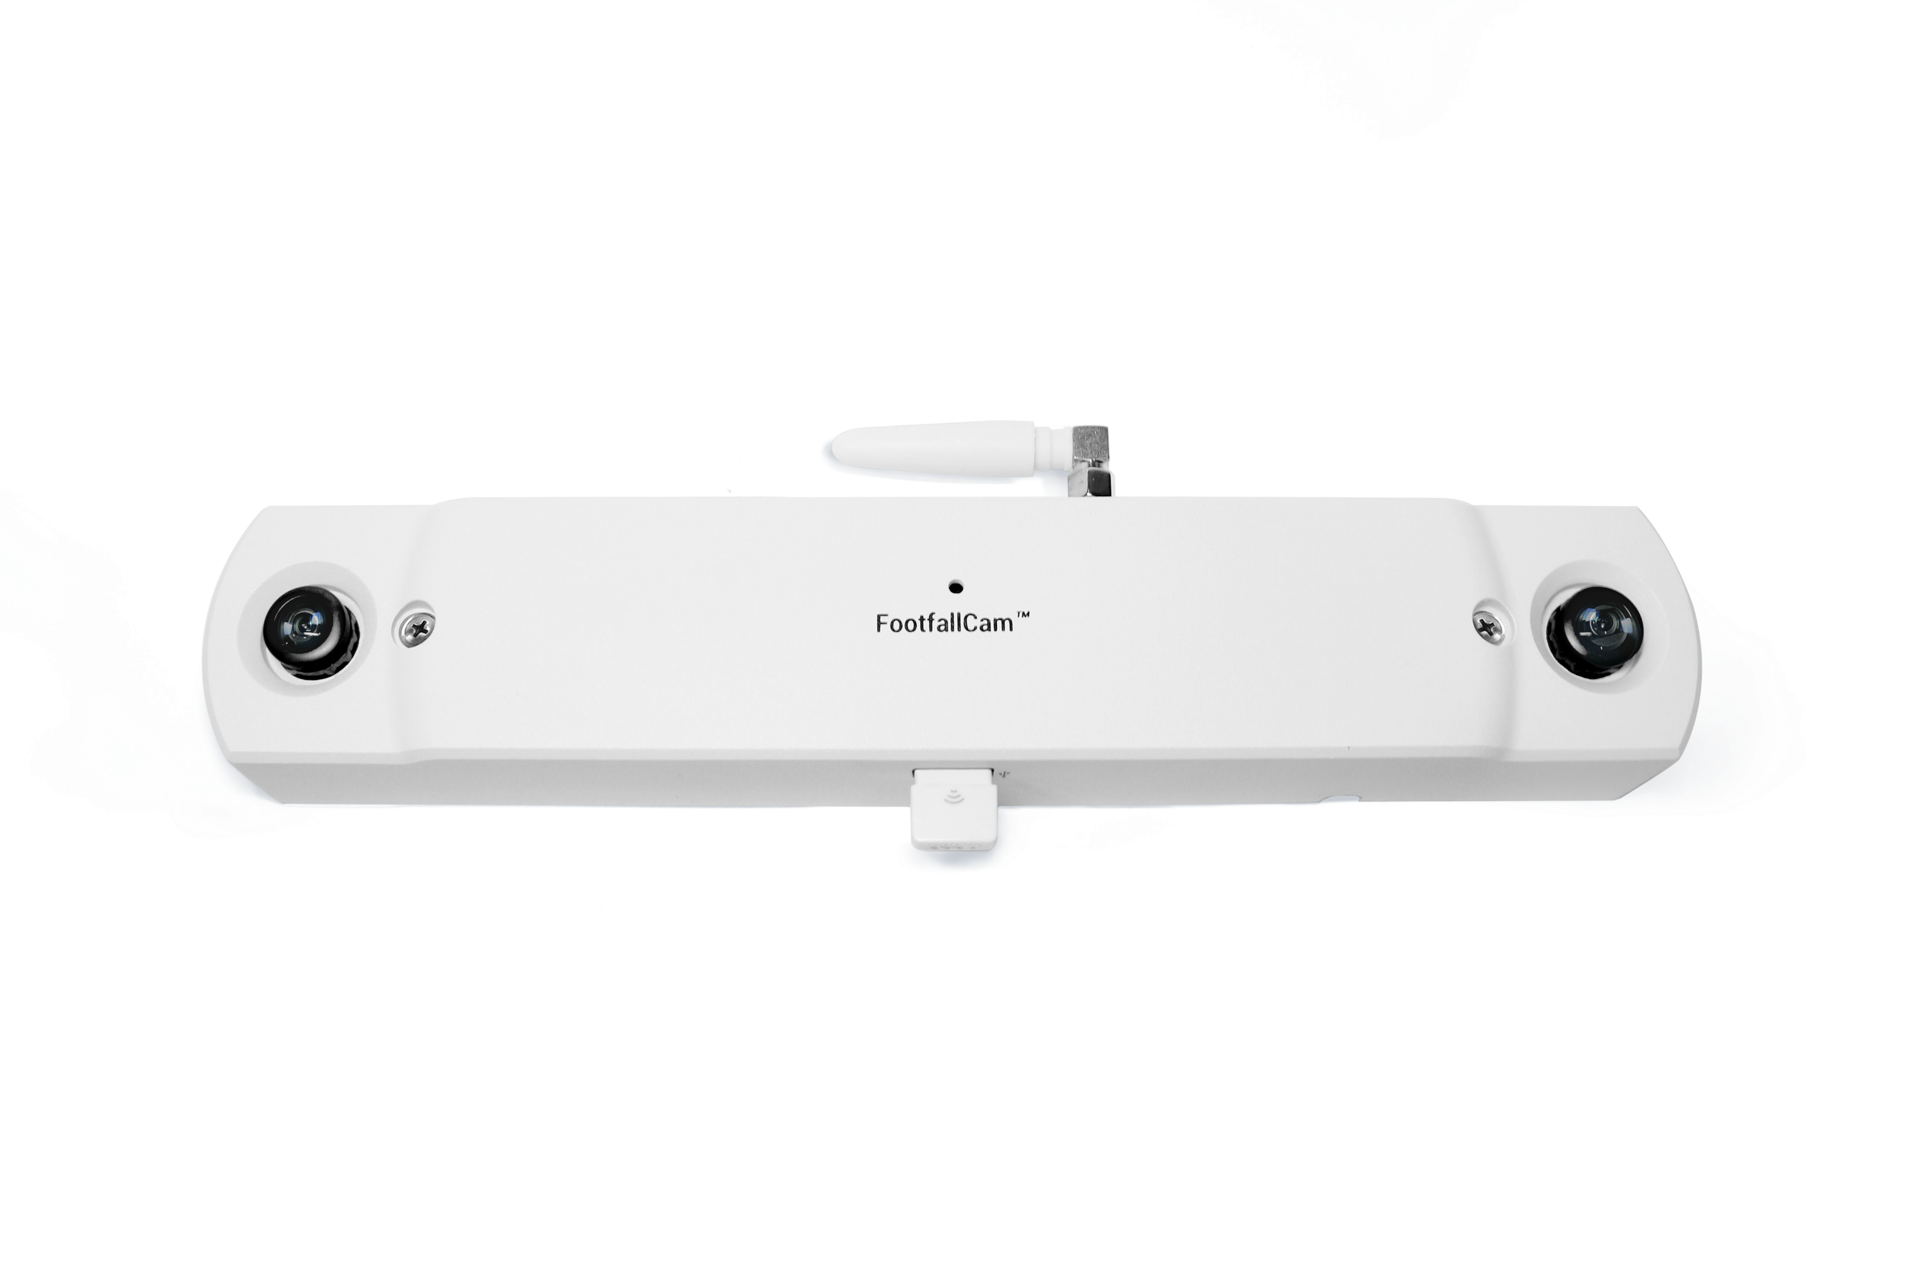
Queue Counting - Optimise Speed of Service
With queue counting detection and blob tracking technology, the FootfallCam 3D MAX™ will automatically detect any form of movement and register the queuing patterns.
Using 3D Stereo Vision technology and 2D video analytics
Highly accurate with video proof
Suitable for covering wide areas
Field of view (FOV): 120°
Proven deployment in KFC (Kentucky Fried Chicken), Applegreen, and more
YouTube Link: https://youtu.be/MFFJfvdylfY
FootfallCam 3D MAX™

Slide 7
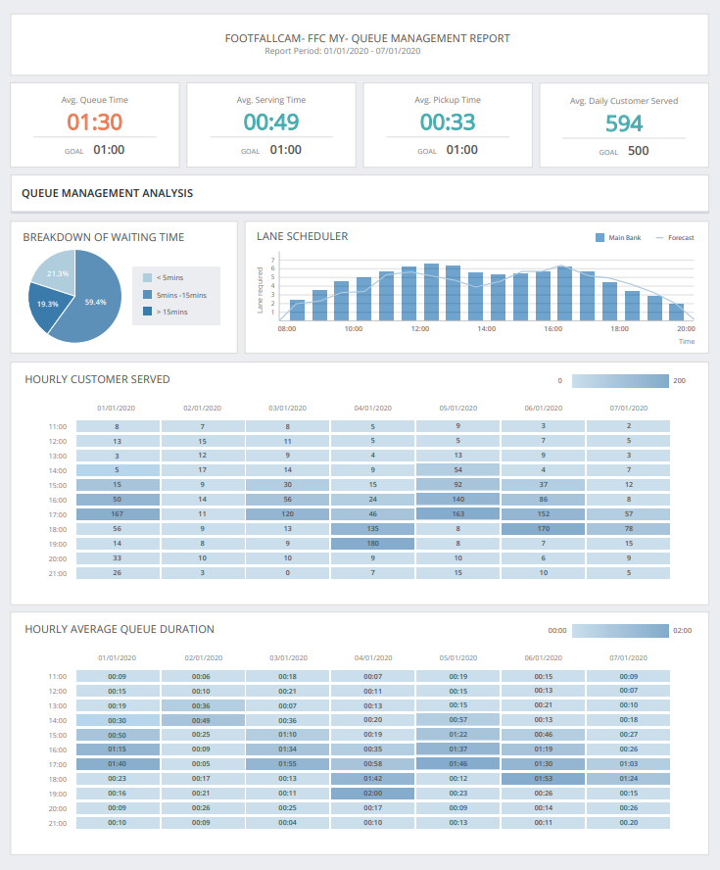
Queue Management Report
Enable Management to Answer Key Business Questions:
How long is the average queue length?
How long does a customer have to wait before they are served?
How long does a customer have to wait before picking up their food?
How many customer left due to long waiting time?
How many customers are served on a daily basis?
When should I open more counters to accommodate the increase in the number of customers?
View report here.
Notes:
- Add hyperlink

Slide 8
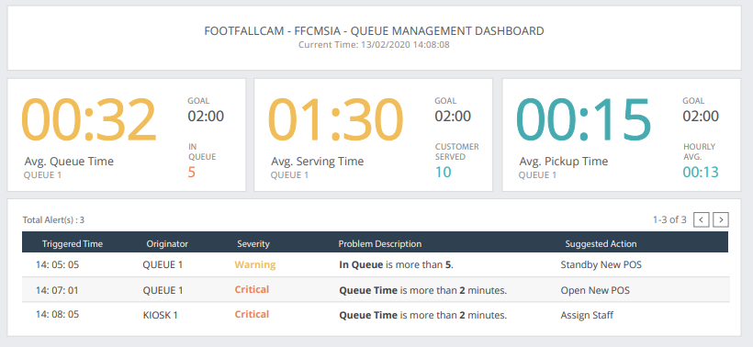
Queue Management Dashboard
Real-time queue monitoring
Instead of actively managing the queues, managers can use the Queue Management Dashboard to easily keep an eye on the queue length.
Automatic alert during slow customer serve time/long queue length
Enable managers to take actions by sending a notification before the severity of the queue reaches critical level.
Make proactive decisions on the spot
Make decisions based on the Suggested Action shown upon trigger alert, which considers the number of visitors in queue and the average serving time.

Slide 9
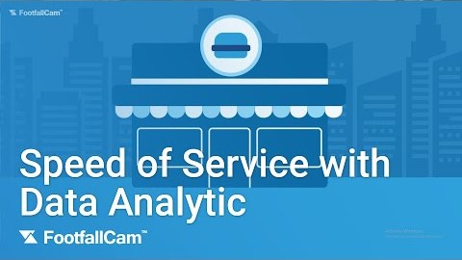
Measuring Speed of Service
YouTube Link: https://youtu.be/MFFJfvdylfY
Accurately track the speed of service
Ensure customer satisfaction
By utilizing queue counting detection and blob tracking technology, FootfallCam 3D MAXTM is able to precisely measure customer’s queue time and queue length.
Businesses lose 75% of customers due to long queue waiting time. By monitoring queue lengths, managements can reduce customer turnover and increase customer retention.

Slide 10
#2: Washroom Management
Demand-based washroom cleaning schedule

Slide 11
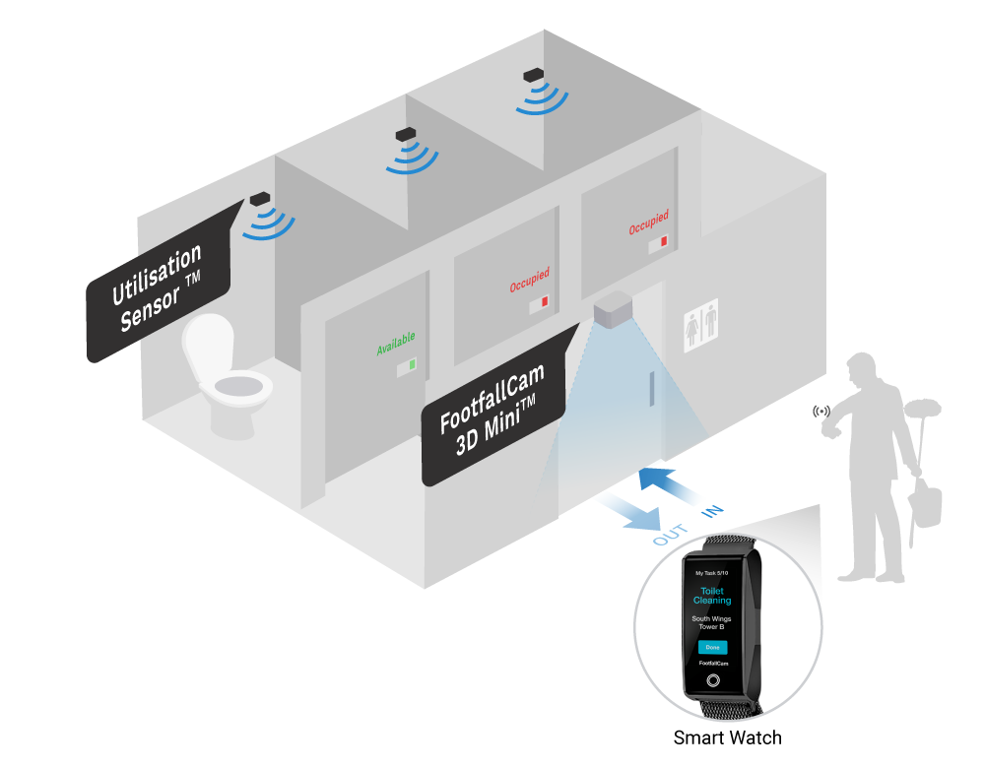
Washroom Management – Demand-based Cleaning Schedule
Washroom cleaning based on actual usage
Prevent under-cleaned or over-cleaned washrooms issues
Receive wireless alert via smart watch
Track SLA via cleaning service log
Reduce cost based on the most optimal SLA service
FootfallCam 3D MiniTM
FootfallCam Utilisation SensorTM
FootfallCam WatchTM

Slide 12
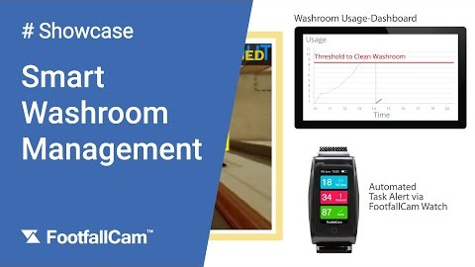
Washroom Management
YouTube Link: https://youtu.be/Qx4M-eQTHNM
Demand-based Cleaning
Crews get accurate information about cleaning needs via wireless cleaning notification alert which can lead to improve the efficiency for janitorial services.
Measure SLA and Auditable Cleaning Fee
Identify the cleaning service KPI with over-cleaned or under-cleaned which able to optimize the cost of maintenance.
Improve User Experience
A reliably serviced washroom facility is a more welcoming place for its users.

Slide 13
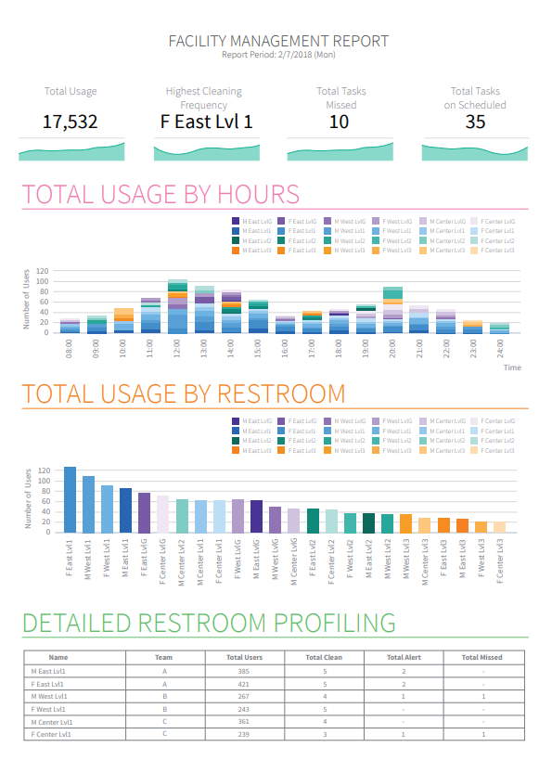

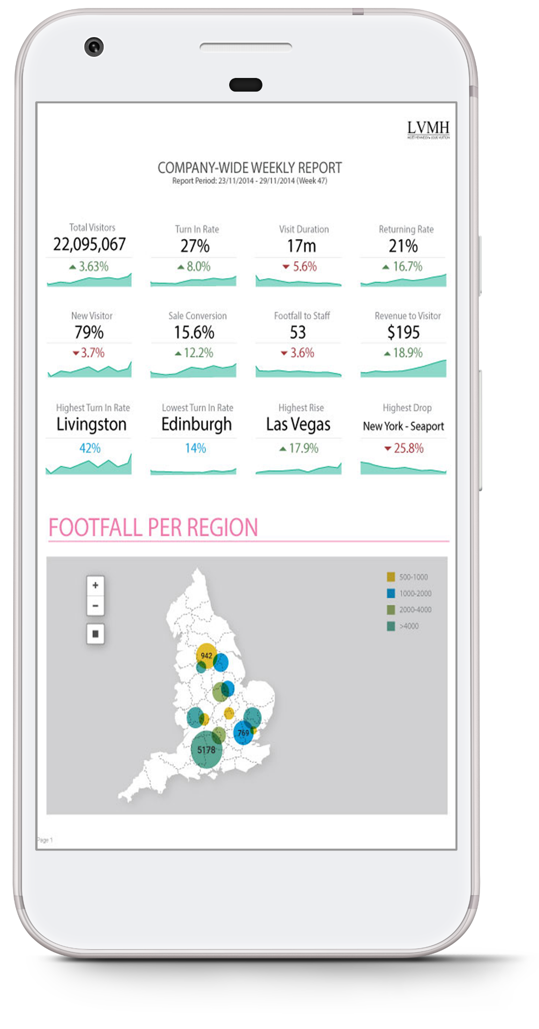
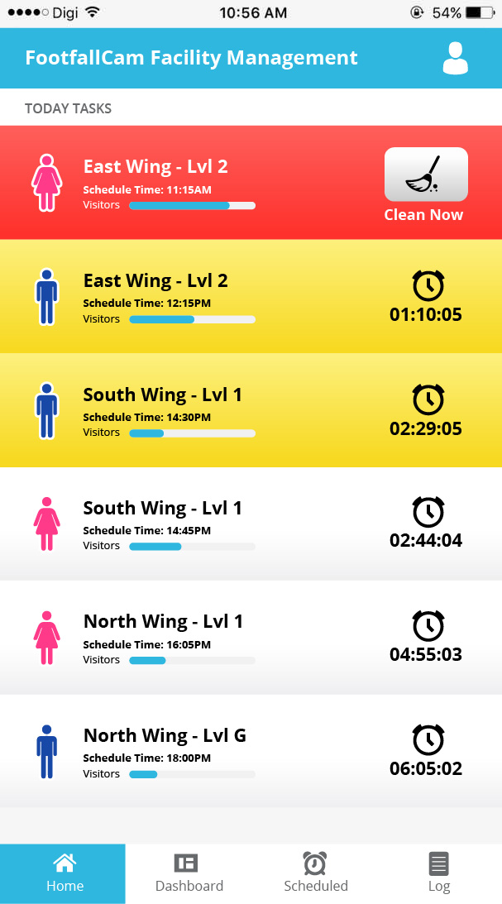
Washroom Management Report
Cleanliness Reassurance
Provide clear view on washrooms historical utilization rate
Forecast washroom demand usage from historical trend
Full transparency on cleaning staff performance.
Measurable KPI for cleaning staff performance review
Utilise available data and feedback to improve user experience
Cleaning Staff Optimization
Better allocation of cleaning staff based on historical trend
Cost saving on unnecessarily washroom cleaning.
Reduce burden and time saving eliminating scheduling work

Slide 14
#3 Desk Clearance and Seat Occupancy
Improving customer’s dining experience

Slide 15
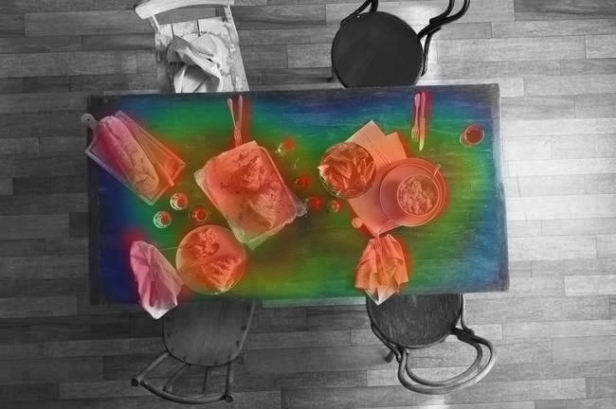
Desk Clearance
Desk cleanliness and usage can be measured by installing a FootfallCam 3D MAXTM integrated with FootfallCam CentroidTM above the desk.
Alternatively, the existing CCTV system can also be integrated with FootfallCam CentroidTM to detect the occupancy of the area.
Detect cleanliness in real time
Restaurant managements can easily have an overview of the cleanliness level of all desks via dashboard.
Measure staff efficiency
Monitor the time it takes for a staff to clean the desk and ensure that they are according to the restaurant KPI.
Table | Status | Duration
1 | Clean | 15 minutes
2 | Unclean | 1 minute
3 | Unclean | 2 minutes
4 | Occupied | 50 minutes
5 | Clean | 20 minutes
6 | Clean | 4 minutes
7 | Unclean | 6 minutes
FootfallCam 3D Max™
FootfallCam Centroid™

Slide 16
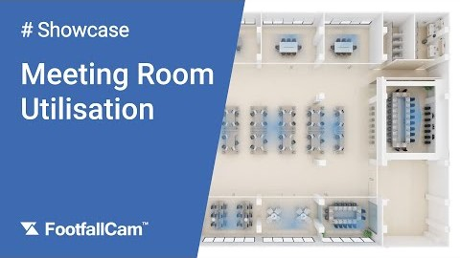
Space Utilisation – Measure Space Usage
YouTube Link: https://youtu.be/IIEiy8Xo28w
Clearer Insights into Customer’s Behaviour
Manage Energy Usage to Reduce Operating Cost
Measure the utilization of different areas of the restaurant especially if there are additional floors or mezzanine.
During off-peak hours, managements can minimize the energy usage in different areas of the restaurant to reduce the operation cost.

Slide 17
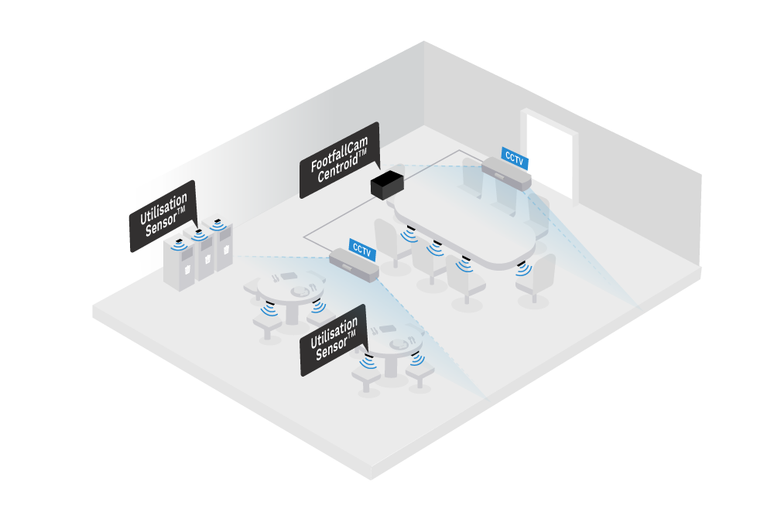
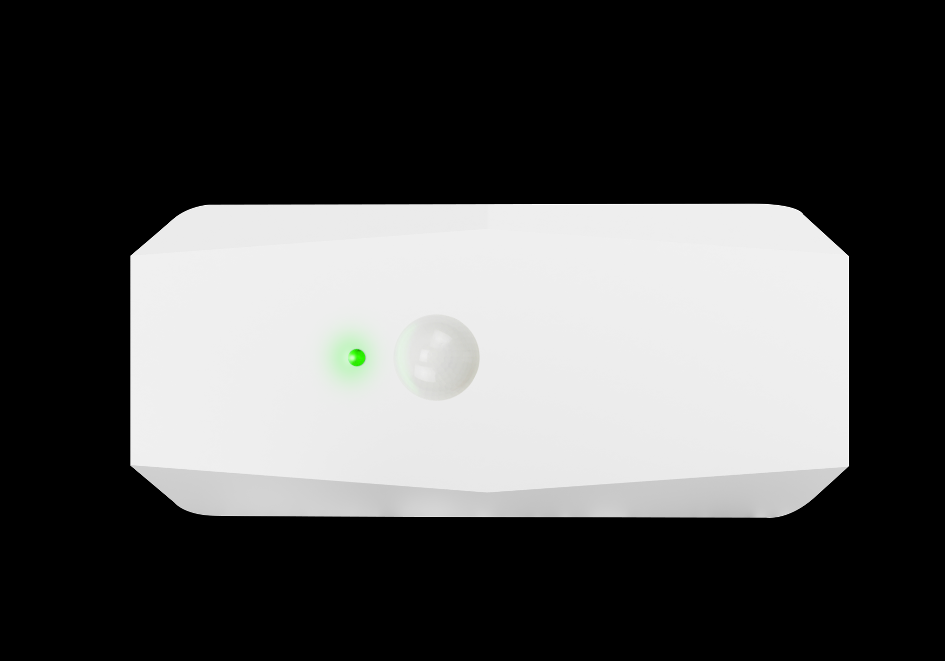
Seat Occupancy
The number of people sitting in the area can be detected by installing a Utilisation Sensor™ under each desk.
Alternatively, the FootfallCam Centroid™ can also integrate with existing CCTV system to detect the occupancy of the area.
Utilisation sensor for desks usage
Using Passive Infra-Red (PiR) or 2D Video Analytics
Suitable for open space or large area, e.g.: fast food restaurants, cafeteria, co-working space
Ease and scalability of its deployment
OR
Utilisation Sensor™
FootfallCam Centroid™

Slide 18
#4: Drive Thru SLA Tracker
Measuring the serving time at each of the counters in the drive thru

Slide 19
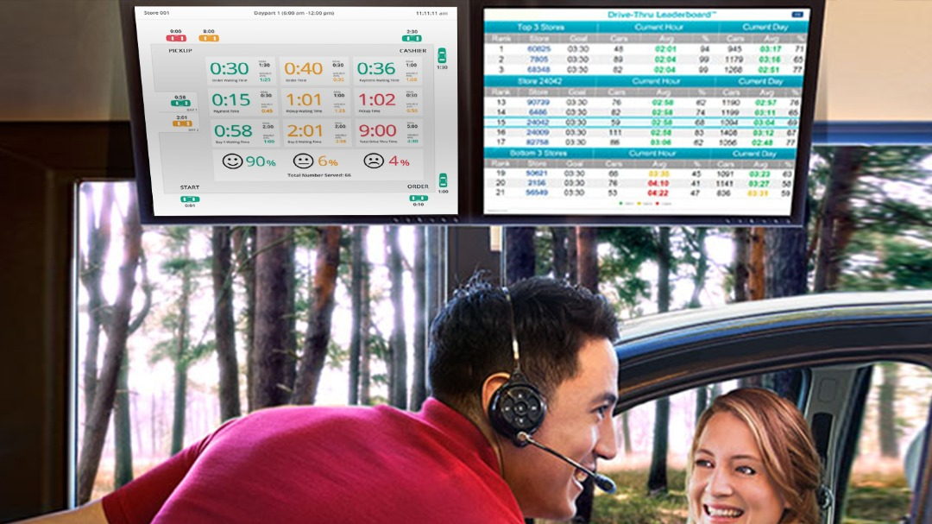
Drive Thru Timer – SLA Tracking System
FootfallCam CentroidTM connected to existing CCTV cameras in the drive thru area enables management to monitor serving time.
Easy to install, integrate, and maintain
Option to reuse your existing CCTV cameras
1x Centroid can support up to 8 CCTV cameras (via RTSP)
Intelligently track individual car plate number with image processing technology
Real-time display of waiting and serving time of different drive thru counters
FootfallCam Centroid™

Slide 20
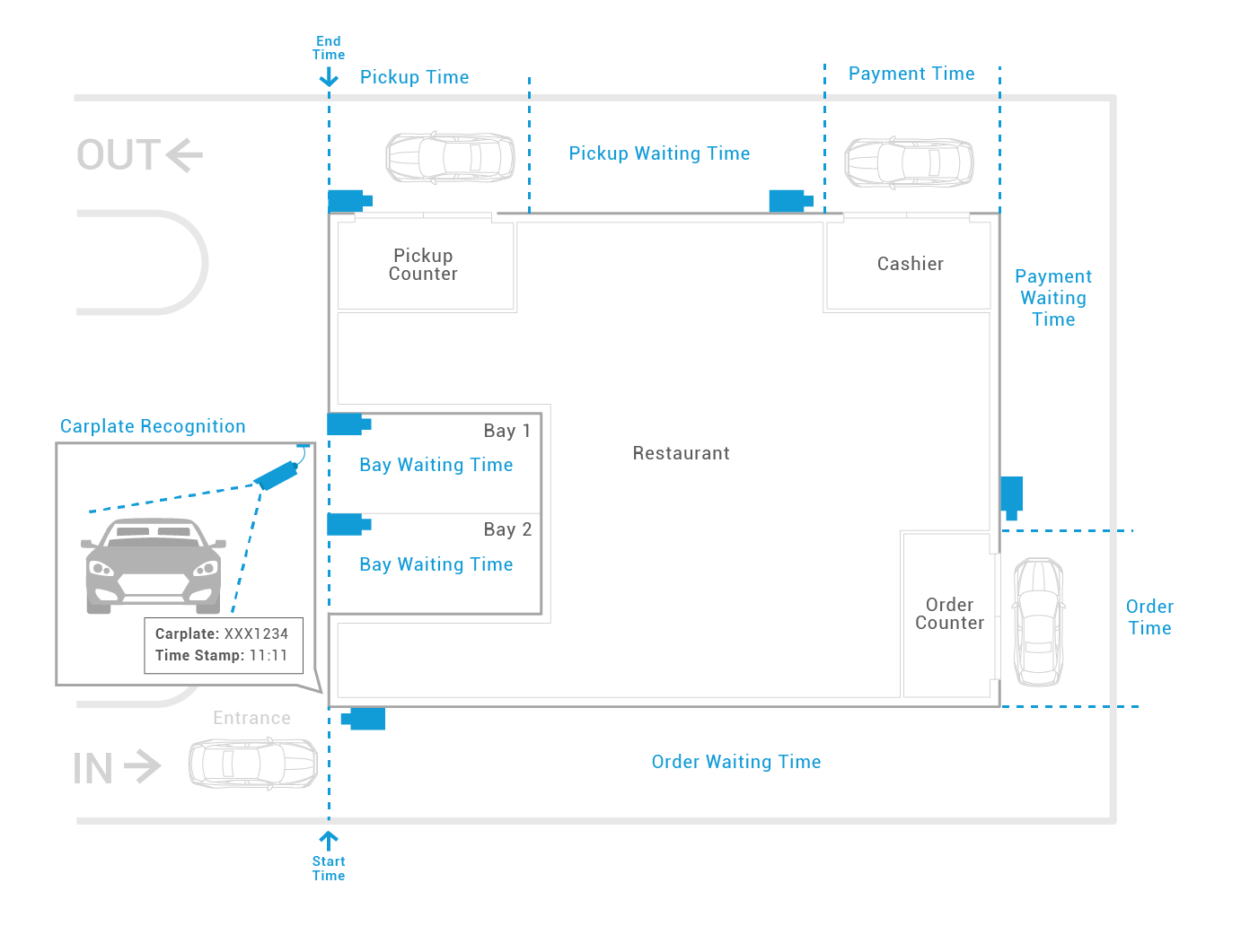
Drive Thru Timer – SLA Tracking System
How it works?
When a customer’s car reaches the drive thru, the car plate number and the time stamp is taken.
As the customer goes through different counters (order, cashier, pickup), the serving time is obtained.
Notes:
Replace the blue floorplan

Slide 21
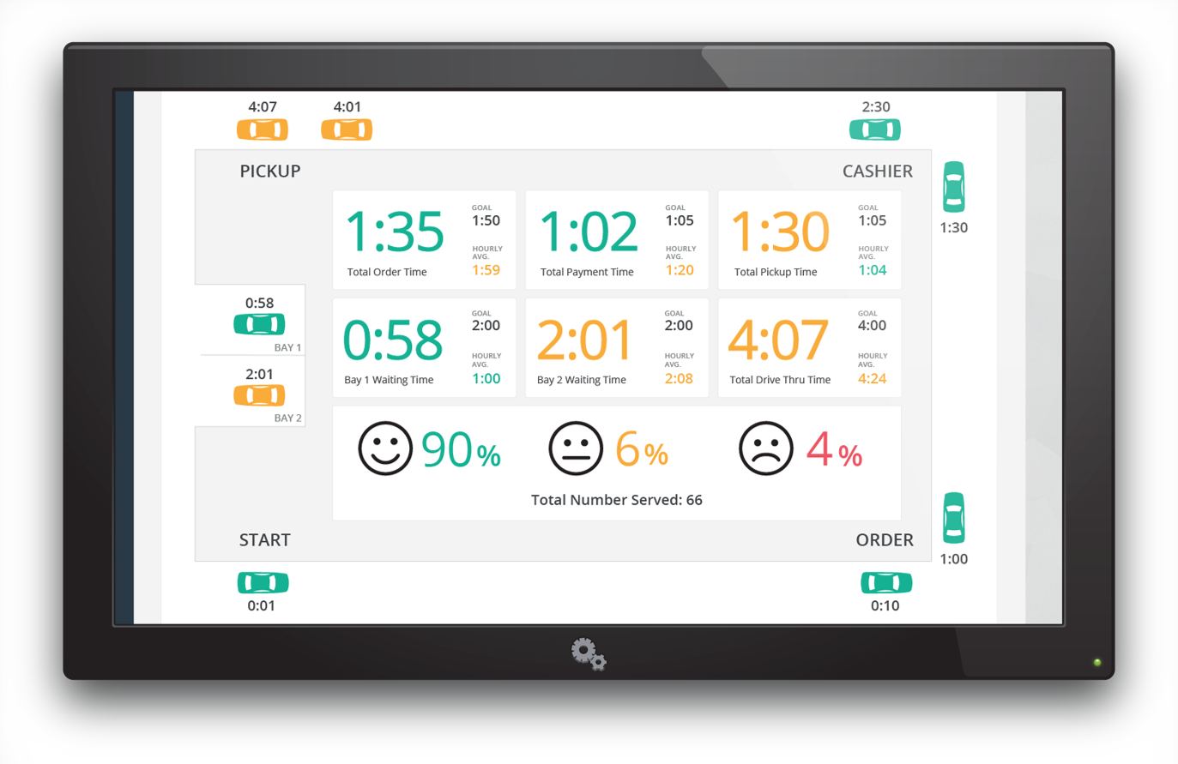
Live Dashboard for Drive Thru Operation
Optimize the Internal Operation
Identify the bottlenecks and provide correction measures
  Effective staff allocation based on demand
  Optimize the speed of service
  Cost-saving with higher ROI
Measure staff KPI and performance based on the data-driven reporting
Enhance Customer Experience
Reduce the waiting time and serving time in different service counters
Track service time on the live dashboard
  Ensure customers are served quickly and effectively to improve customer satisfaction
Improve returning customer rate

Slide 22
#5: Door Counting + WiFi Analytics
Accurate count on the number of visitors

Slide 23
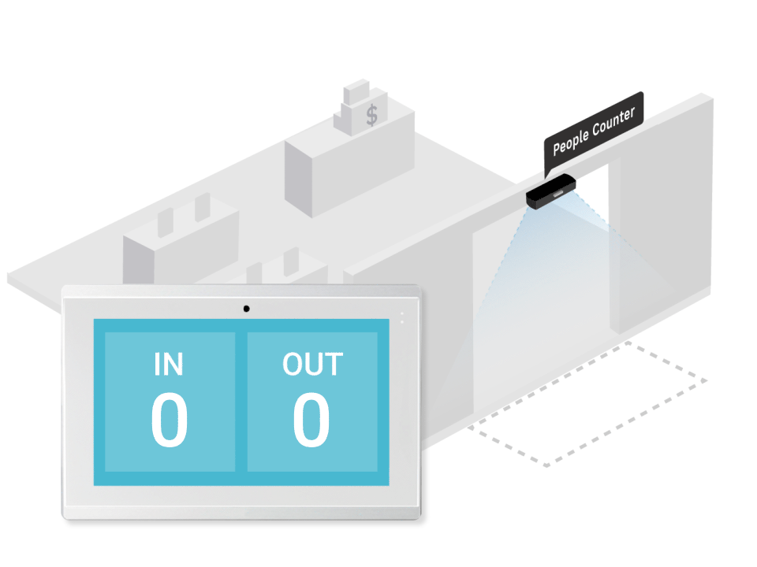
People Counting at Entrances
FootfallCam 3D MAX™ cameras installed at the entrances can detect the number of people entering and exiting the premise.
Using 3D Stereoscopic Counting
Bi-directional counting
Suitable for wide entrances
Highly accurate with 98% accuracy
Wi-Fi Counting and Analytics
Proven deployment in A.S. Watson, Fred Perry, Joules & etc.
High Traffic Counting: https://youtu.be/kSvj-BoCd6s
Children Counting and Object Exclusion: https://youtu.be/cyjo3d5nFdw
FootfallCam 3D MAX™

Slide 24
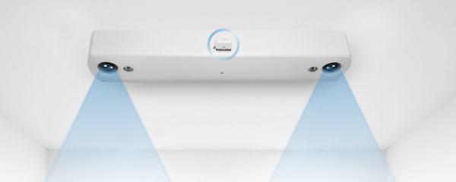
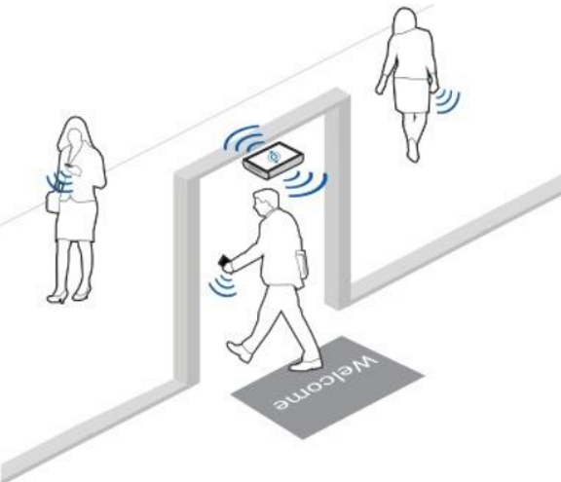
Wi-Fi Analytics
Combining the capabilities of both Wi-Fi analytics and video analytics to allow restaurant managers to drive data action insights and make impactful changes in their operations.
Track in-store customer behavior
Using Wi-Fi counting to track individual customer’s MAC ID
User privacy protected—Anonymised Data & GDPR Exemption
Track metrics such as:
    Returning customer
    How many customers are returning to your store?
    Customer dwell time
    How long does an average customer stay?
Use Case:
  Determine the success rate of a marketing campaign
  Measure store performance based on data-driven KPI

Slide 25
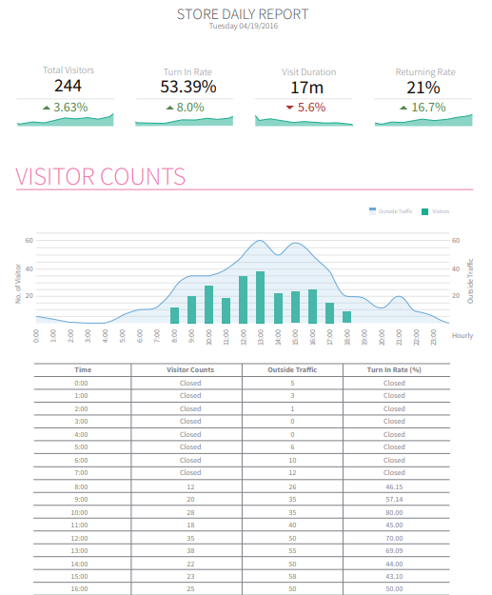
Store Daily Report
Monitoring the store performance using measurable visitor count data metric
What is the total number of customers visiting the restaurant?
How many percent of the visitor from the outside traffic turned into the store?
How long does an average customer stay in the store?
How many percent of the visitors are returning customers?
What is the trend of the visitor count over time?
View report here.

Slide 26
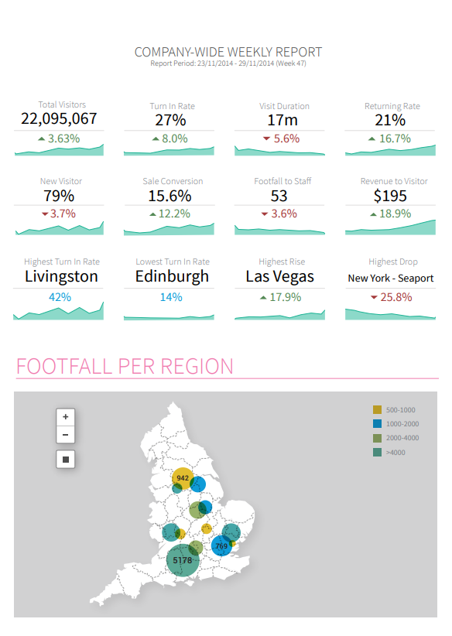
Company Weekly Report
Overview of key metrics for all restaurant chains within the company
What is the customer traffic profile (dwell time, visit frequency, etc.) of the stores in different regions?
Which region achieved higher ranking in retaining customer loyalty (returning customer)?
What is the average turn-in rate across all stores?
Which is the highest performing and lowest performing store?
What is the actual store performance when comparing the sales conversion?
View report here.

Slide 27
FootfallCam Analytics Manager V9TM

Slide 28
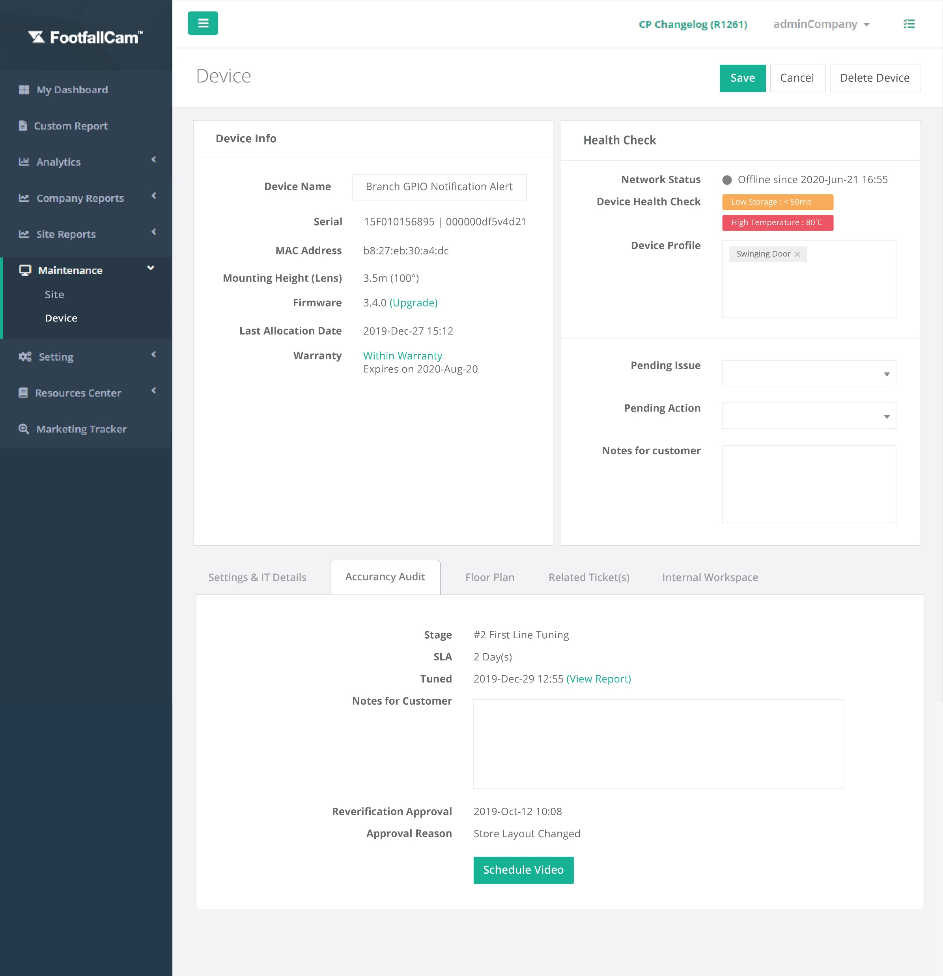
FootfallCam Device Management
Designed to manage large number of counters
Collects data from all counters and centralizes them in a single place
Fully manage FootfallCam sensors
Easily add and remove counters from your account
Edit configurations remotely without going on-site
  Branch ID
  Counter ID
  Number of sensors per branch,
  Operating hours
  Etc.
More details can be found here

Slide 29
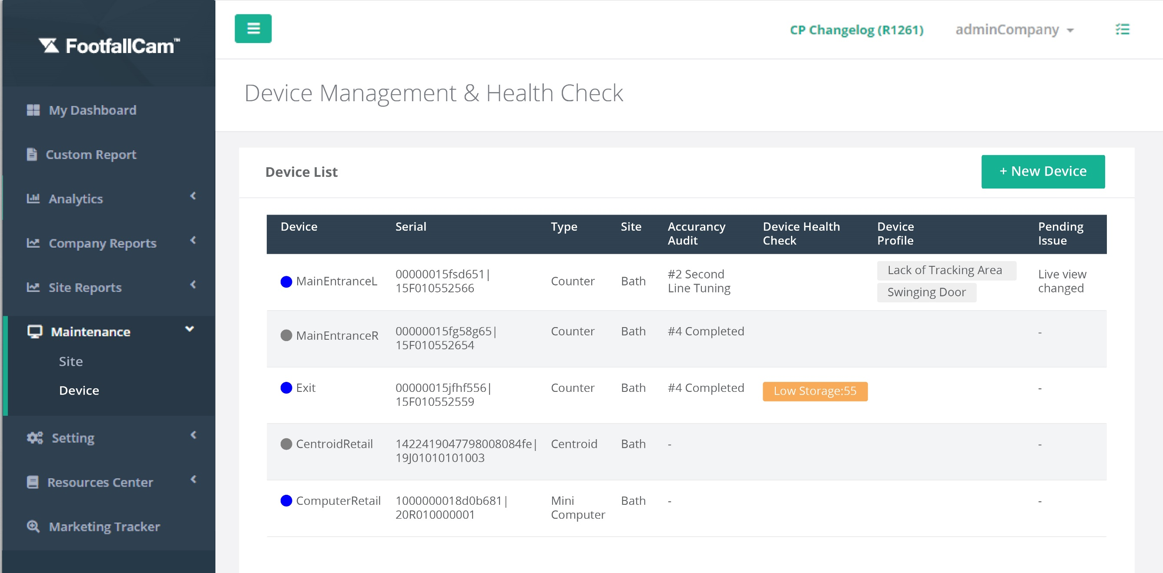
FootfallCam Health Check
Monitor if all sensors are connected and counting.
Scheduled daily checks at a pre-defined time
Display counters that are offline for more than 30 mins
Send automated email alert to person-in-charge detailing any faults found
Proactive yet manageable approach
Detects issues such as:
  Network issue or failures
  Abnormal data alert
  Counting data and Wi-Fi data upload checking

Slide 30
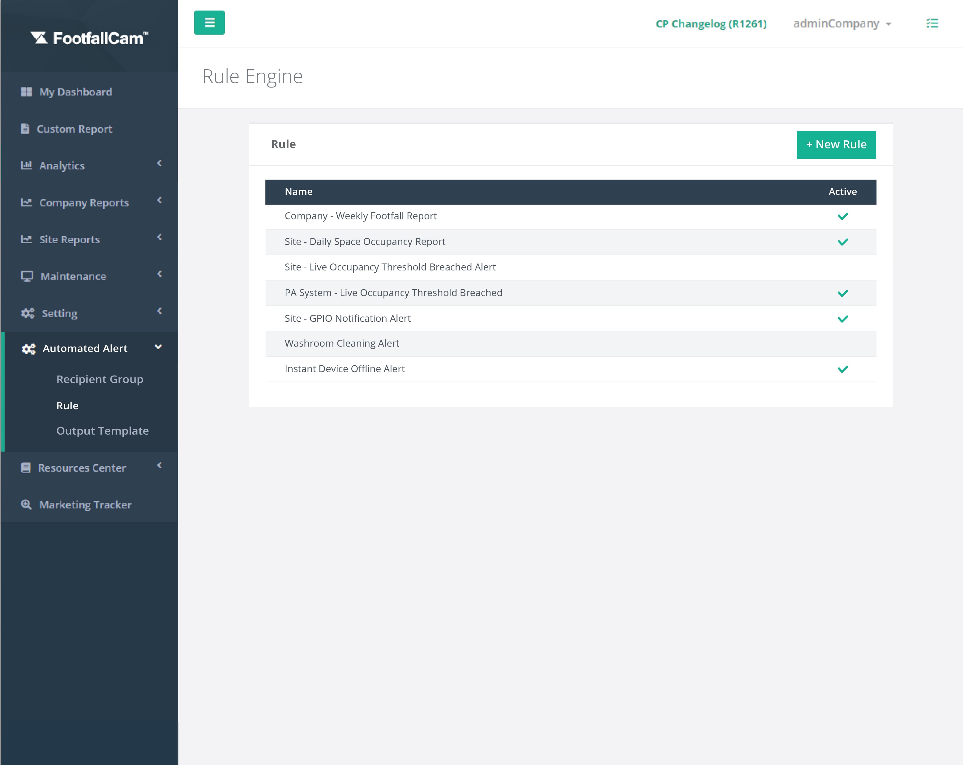
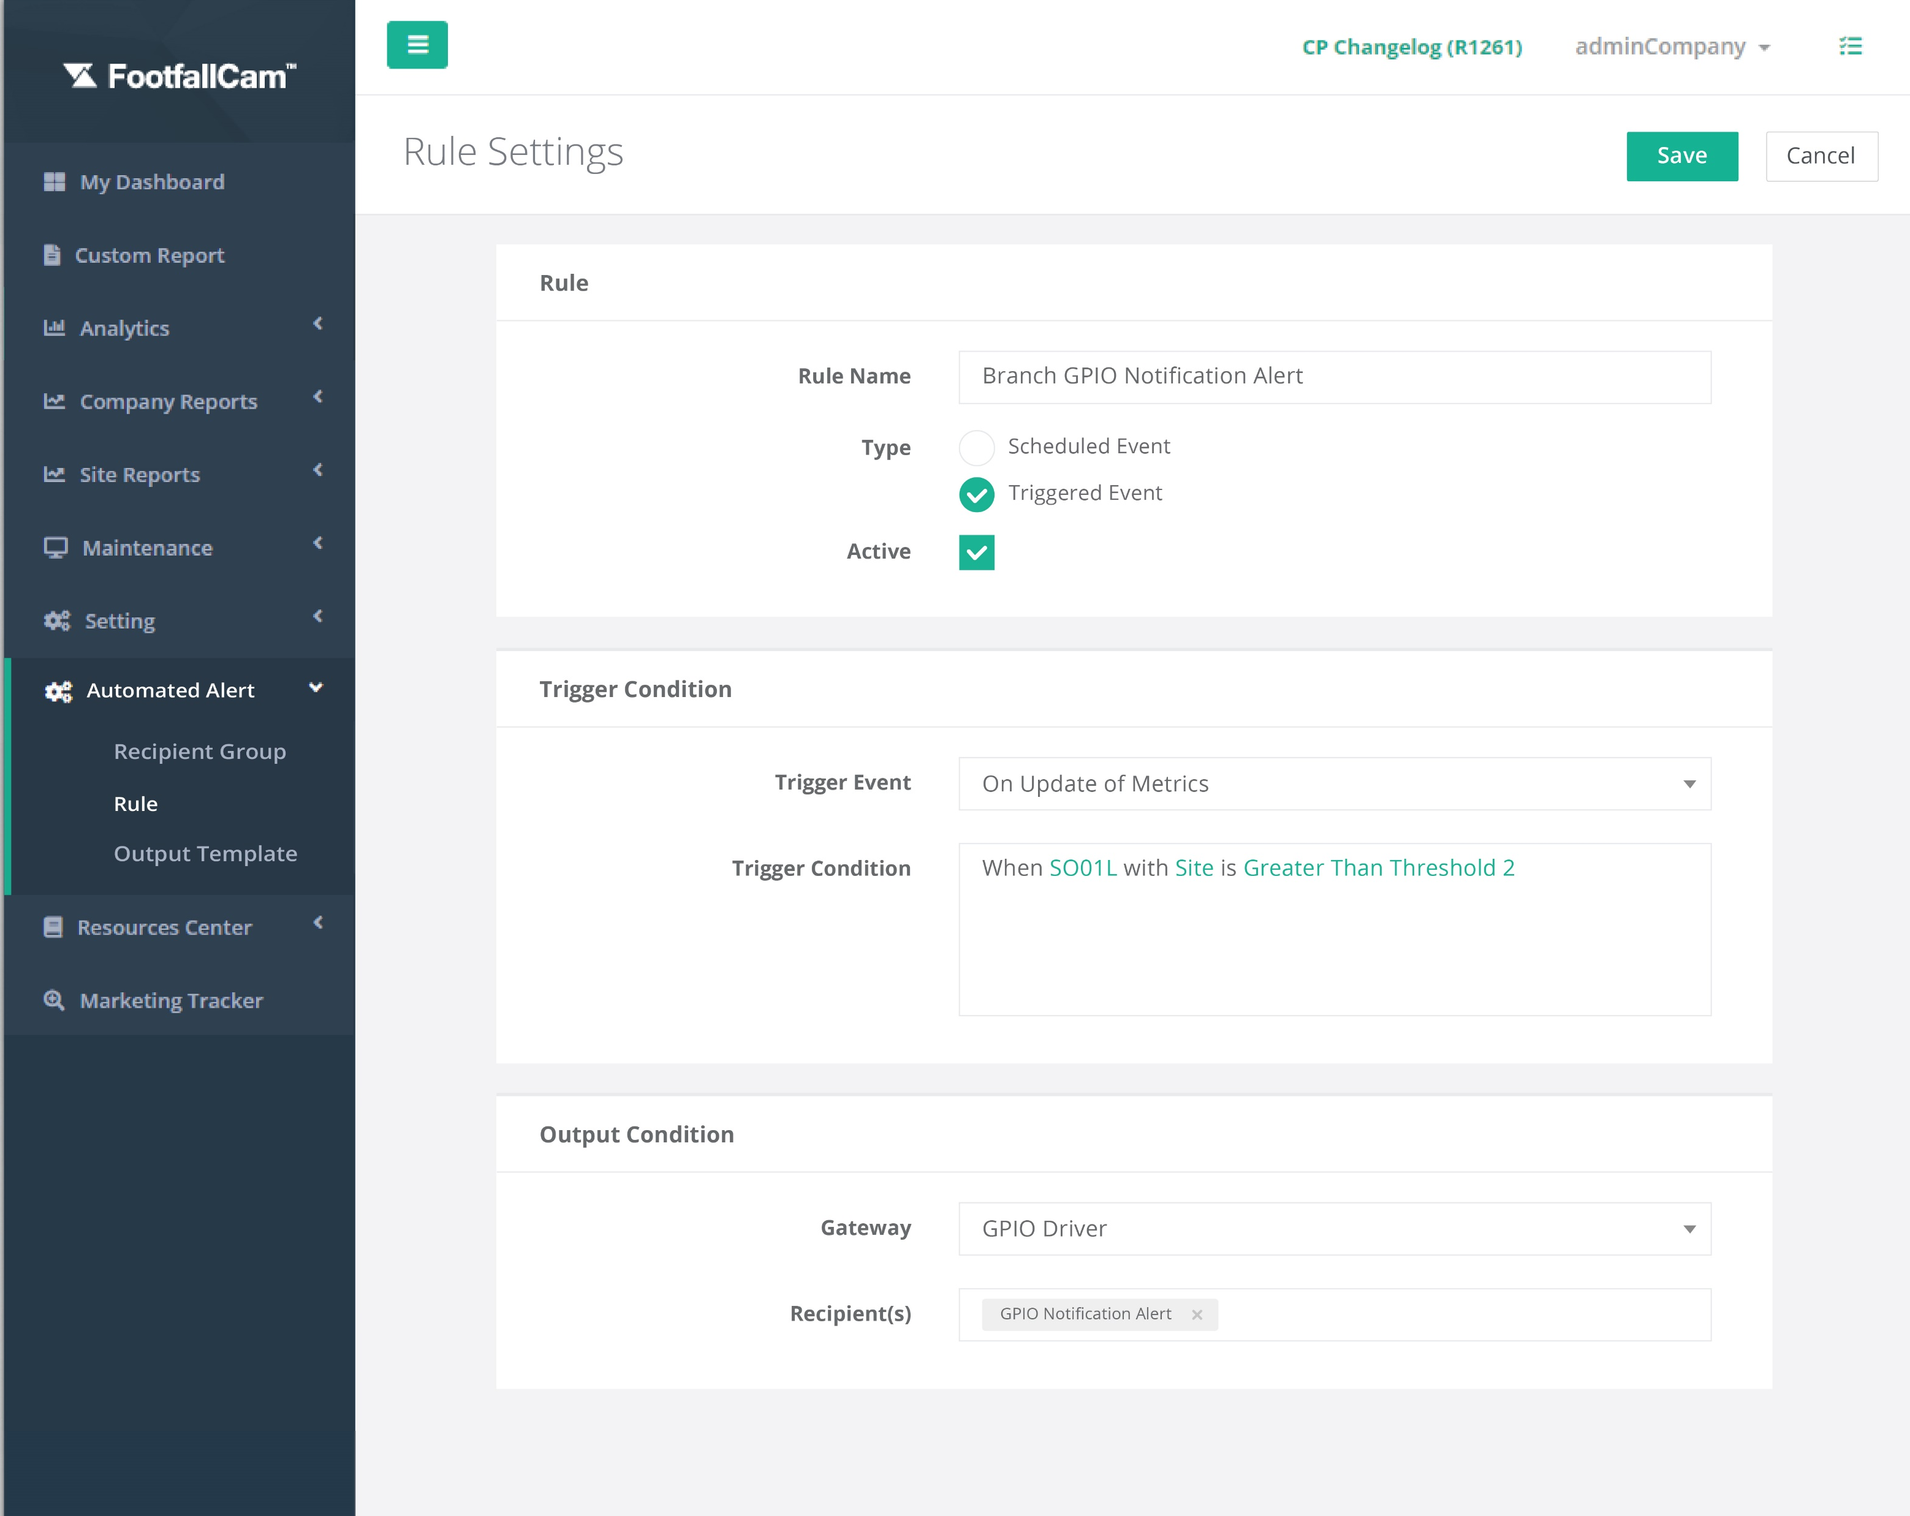
FootfallCam Rule Engine
FootfallCam Rule Engine - List View
FootfallCam Rule Engine - Settings
500+ different rule templates
Customised rules using Python, interface with:
  FootfallCam raw data, or
  Aggregated metrics
Automatic notification via SMS, Emails, FootfallCam Watch, Android and iOS Apps

Slide 31
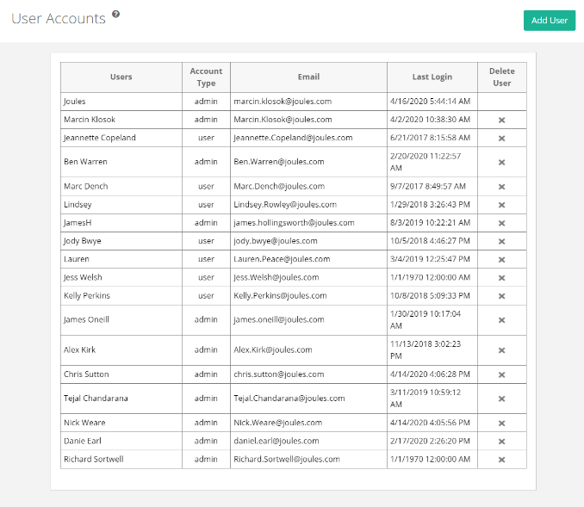
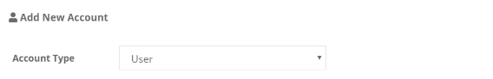
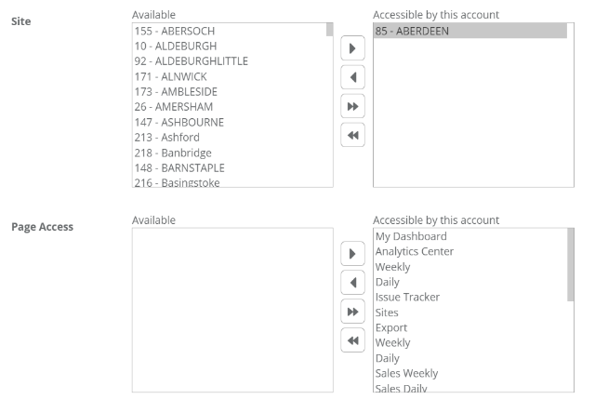
Account Management
Individual user accounts can be setup for team members and assign access rights accordingly.
Account Type | Description | Example
Admin | Can create more accounts and remove unwanted accounts. | CEOs are able to restrict the store managers’ access to certain data metrics.
User | Limited access in account creation and removal. | Store managers are only allowed access to their own store’s data.

Slide 32
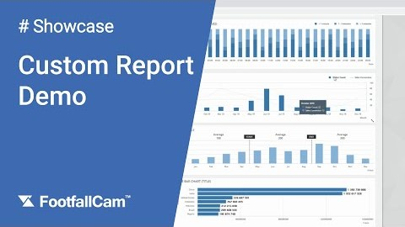
Customisable Dashboard and Reports
View Custom Report Demo here.
In addition to the 60+ readily available reports, FootfallCam has an array of widgets available which can be used to combine and make customised dashboards and reports to address your business requirements. Here are a few examples of the reporting formats available:
Line chart
Bar graphs
Monthly trends
Heatmap table
Floorplan

Slide 33
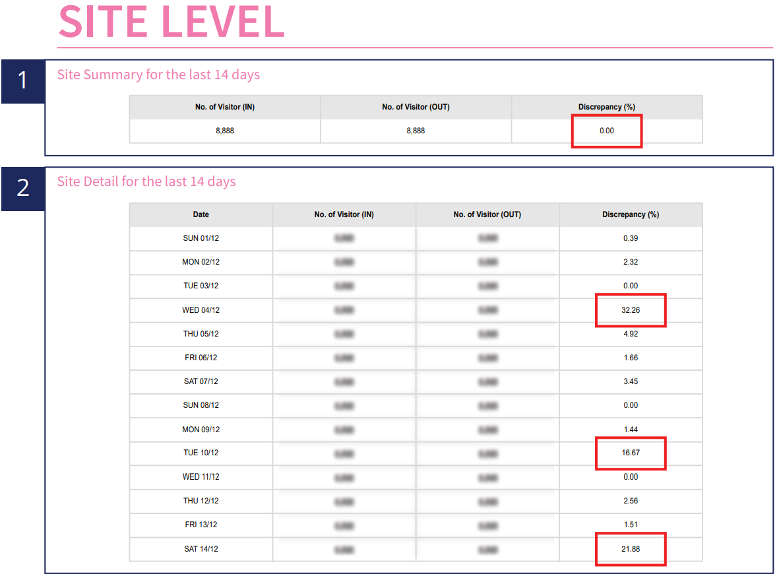
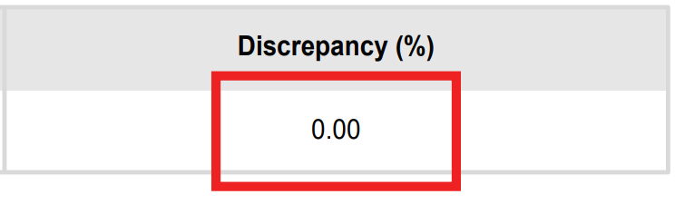

Maintaining Data Integrity
The Data Integrity Report allows users to monitor data discrepancies and site changes. For example:
0% in Discrepancy would mean that the counters are functioning ideally with high accuracy.
16.67% in Discrepancy would require sourcing out the root cause of this occurrence.
To recover the missing data, FootfallCam server will re-aggregate the raw data stored in counter level and store the re-aggregated data in the server. Hence, users can retrieve the missing daily or hourly data so that macro trends will not be affected.
More information can be found here.

Slide 34

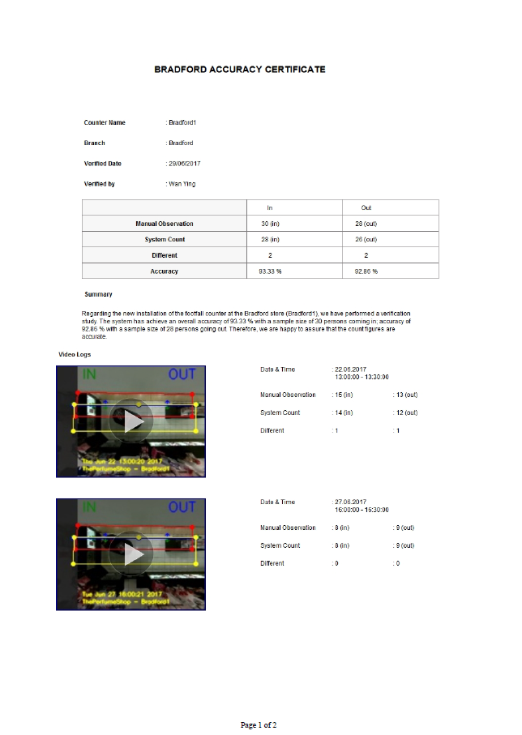
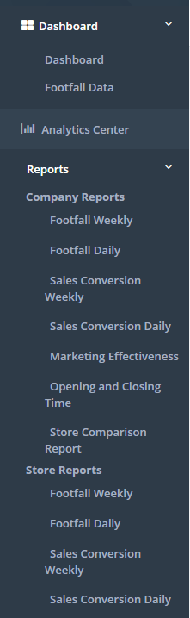
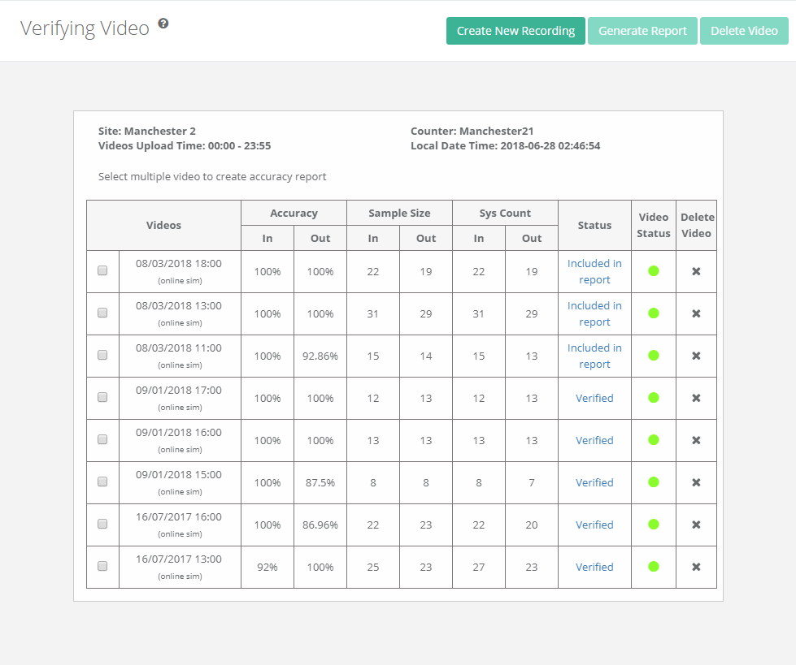
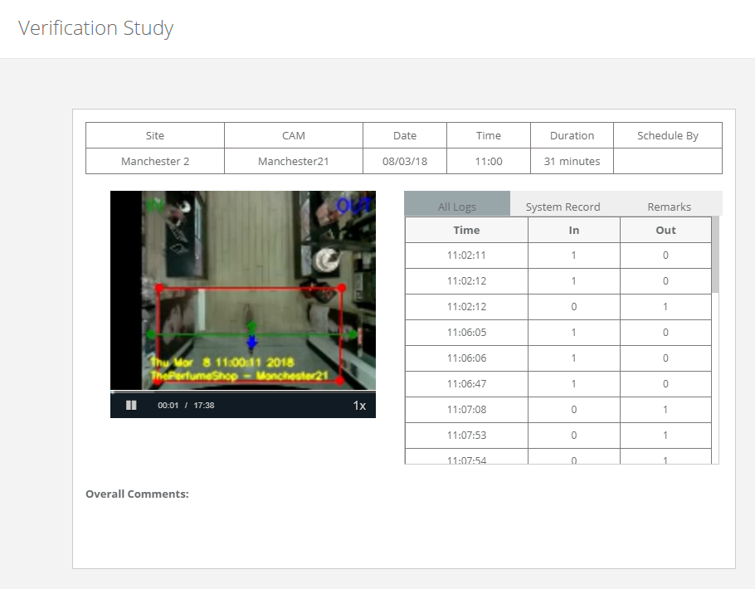
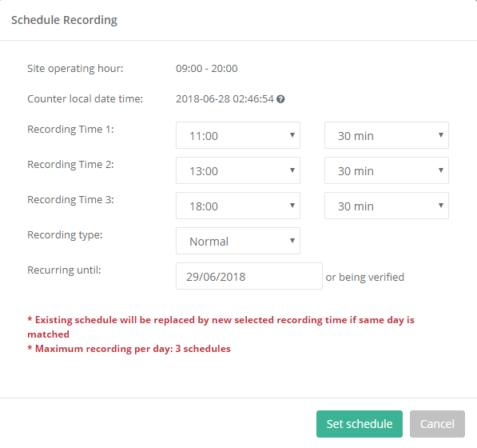
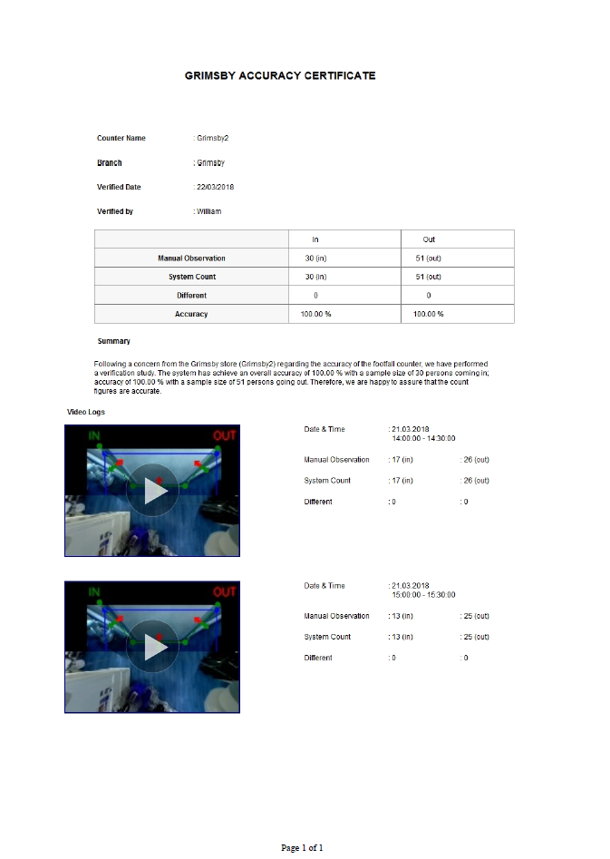
Accuracy Audit
How do we audit accuracy to ensure 95% and above counting accuracy?
Schedule video recordings
2
Compare system count and manual count
1
3
Generate verification report
Schedule video recordings of peak hours to ensure there is sufficient sample size (20 and above) for to audit the accuracy of the counter.
Compare the system count generated by the FootfallCam device against manual observations to determine the accuracy of the FootfallCam.
Once there is sufficient sample size and the accuracy is satisfactory, a verification report with the video proof used in manual observation will be generated.
(Verification report: Sample 1 & Sample 2)

Slide 35
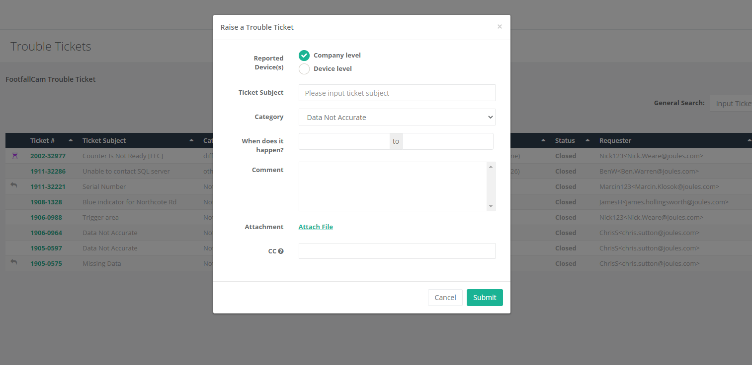
Built-in maintenance support portal
The one-stop support center for all FootfallCam Analytics Software users.
Any technical issues can be raised via the Support Portal and this will be assigned to a technical personnel accordingly.
Issues Detected
Network Connectivity
Data Discrepancy
Missing Data
Drastic Change in Data
Incorrect Network Configurations
More information can be found here.

Slide 36
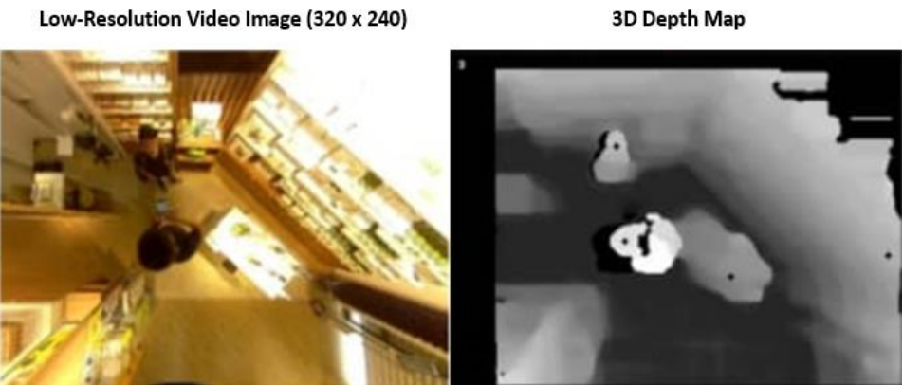
Data Privacy and GDPR Exemption
Counters installed downwards facing the ground – does not capture the customer’s identity & unable to pick up facial features.
Videos are recorded only for verification purposes and taken in low resolution. The videos will be deleted once verification is completed.
FootfallCam uses 3D depth map instead of video images for counting purposes – data collected are non-visual and are will not be able to be identify with any individuals.
FootfallCam is exempt from GDPR. More information can be found here.

Slide 37
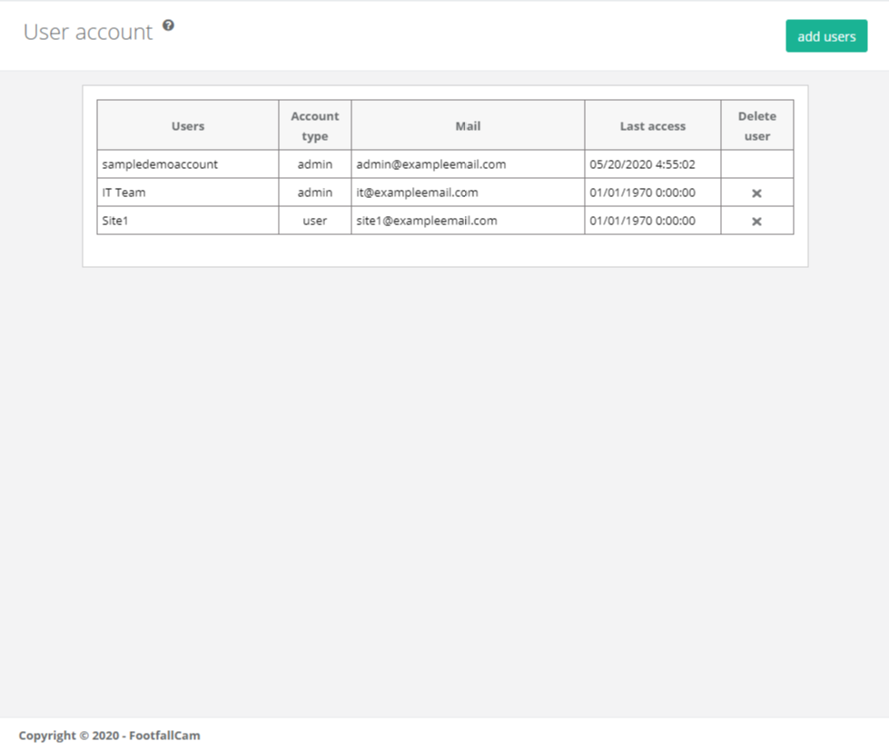
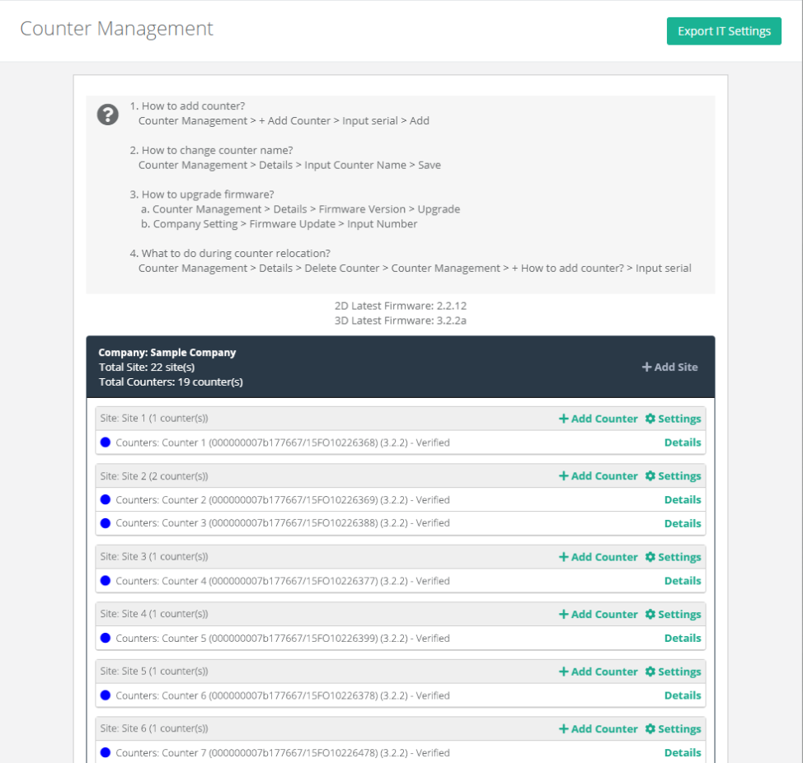






Management Control
User Control
Branch Control
Email Scheduler
Import/Export
Health Check and Maintenance Tools
Data Integrity
Company Data Integrity
Issue Tracker
Support Portal

Slide 38








Reporting Suite
Analytics Center
Company Weekly Report
Site Weekly Report
Marketing Effectiveness
Live Occupancy
Zone Analytics
Mecca Occupancy
Queue Counting

Slide 39
Solution Deployment

Slide 40


Deployment Process
More than 1,000 units in stock in our warehouse
Ready to ship out within 1-2 working days
Each installation should take approximately 1-2 working day
Data validation to be done within 3 days after each installation
Notes:
Add gantt chart
Change installation photos

Slide 41

Agile Framework: Scrum for Service Delivery
Sample Installation Gantt Chart
FootfallCam adopt Scrum Project Management for all service deliveries
Pre-installation, Installation and Post Installation Review are carried out in parallel

Slide 42
Case Study

Slide 43



Case Study #1 Yum! Brands
Yum! Brands Inc. is an American fast-food corporation with more than 50,000 restaurants including KFC, Pizza Hut, Taco Bell, and more worldwide.
People Counter
Measuring restaurant speed of service
Integration of their multichannel sales data, drive-thru data, kitchen food preparation data to FootfallCam
FootfallCam develops custom reporting to provide meaningful data insights based on KFC’s business nature:
  Queue management report – Identify the queue wait time, queue length, ordering time and order fulfilment time; to improve customer service and customer experience
  Queue dashboard – Send queueing information to a dashboard in real time to monitor and improve operational efficiency and customer service

Slide 44


Case Study #2 Applegreen
Applegreen is an Irish company that operates more than 250 petrol stations in Ireland, the UK and the US.
Optimising customer queue time
Need to ensure speedy service delivery as petrol stations have high visit rate and has a smaller space for operation compared to restaurants
Each petrol station has installed separate counters to monitor customer queue in different brands such as Burger King, Subway, Bakewell, and more.
Store managers use queue management dashboard to monitor the customer queue time, serving time, and pickup time

Slide 45



Case Study #3 Amway
Amway is an American multi-level marketing company in more than 100 countries and territories.
Facility Utilisation and Customer Experience
People Counter
Monitor occupancy in cafeteria by avoiding overcrowding during peak hours to optimize customer experience .
Social-distancing compliance and occupancy restriction to protect their Amway Business Owner (ABO).
Integrate people counting data with Magic Mirror display for real-time occupancy at entrance to control incoming traffic.
Space planning by identifying the facility usage with high flow intensity, low flow intensity, and that are most used, and least
People
Counter
Amway Grand Opening: https://youtu.be/Bjm8Y5jRiNs

Slide 46


Case Study #4 A.S. Watsons Group
A.S Watsons is the largest pharmaceutical retailer in the APAC region and a part of the CK Hutchinson Holdings group.
Global Rollout with Multi Geo-Region Server
Replaced their original people counting system and integrated existing data with FootfallCam software
Provided full installation support and training to their system integrators in 24x different countries
  Russia, Turkey, Singapore, Malaysia, Indonesia, Philippines, Thailand, Hong Kong, UK, Europe
Watsons analyses the performance of the company as a whole, we integrated footfall data into their centralised BI system via API
Also proceeded to upgrade their features to deploy FootfallCam’s real-time monitoring system to their stores to abide to social distancing regulations.
People Counter

Slide 47
FootfallCam Product

Slide 48


FootfallCam 3D MAX™
Key Features
Using 3D Stereo Vision technology and 2D video analytics
Highly accurate with video proof
Suitable for wide corridors, walkway or high traffic areas
Supports up to 25m ceiling height
Field of view (FOV): 120°
Proven deployment in Kentucky Fried Chicken
Camera | 2x 5MP resolutions
Frame Rate | 25 fps
RAM | 1GB
Illumination | Minimum 1 lux
IP Rating | IP 31
Power | Power over Ethernet: 47V DC, 0.12A (6W)
Casing Material | Aluminum oxide alloy, Water and dust resistant
Total Dimensions | 246 (W) x 46 (D) x 28 (H) mm
Click here to view Datasheet

Slide 49


FootfallCam 3D Mini™
Key Features
Anonymous ToF Counting for privacy purpose
Single door coverage
Work in low light or complete darkness environment
Made in UK; Manufactured by FootfallCam
Sensor | Time-of-Flight (ToF)
Emitter | Class 1 940nm invisible laser
Field-of-View (FoV) | 27°
Light Source | Class 1 940nm VCSEL
IP Rating | IP 31
Power Consumption | 200mW
Enclosure | Aluminum oxide alloy, Water and dust resistant
Total Dimensions | 94 (W) x 61 (D) x 45 (H) mm
Click here to view Datasheet

Slide 50

FootfallCam Utilisation Sensor™
Key Features
Anonymous counting for washroom usage
Using ST Micro ToF 16x16 Sensor
Field of view (FOV): 57°
Configurable cleaning threshold
Automated cleaning alert to Smart Watch via Radio Frequency (RF)
Proven deployment in Rentokil, Bank of America & etc.
Model | 64-bit Quad-core @ 1.43GHz
Sensor Type | Passive Infrared (PIR) + Time-of-flight (ToF)
Detection Range | Up to 3m
Chipset | Arm Cortex - M3 Processor
Transmission | Type - RF (Between Utilisation Sensor and Receiver) Range - 50m radius
Casing Material | ABS
Total Dimensions | 67.5 (W) x 12.4 (D) x 29.8 (H) mm
Click here to view Datasheet

Slide 51

FootfallCam Analytic Manager V9™
Software Specifications
Interface | Http; Https
Compatible Browser | IE7 or Later Mozilla Firefox or Later Chrome Version 4.0 or Later Safari
User Levels | 2 levels: Administrator, Standard User
Ethernet | 10/100 Mb Ethernet
Time | NTP, Adjustable time zone, automatic day light saving adjustments
Data Delivery | TCP/IP
Database Type | SQLite
Report format | csv, .xml, .txt
Data Storage | 5 Years storage with auto sync
Data Backup | Yes
Backup Frequency | Daily Full Backup of Data and Configuration Weekly Backup to Sub Server for Contingency Purpose
Software Version Upgrade | Auto Upgrade
Functions:
Staff alert if capacity limit is breached
Centralized Management Analytics Software
API Available for Data Integration
Pre-defined Report Set
Health Check Report
User Account Management
Automated Email Scheduler

Slide 52


Enterprise Class Software
Multi-language Interface
Different languages available such as:
English
Dutch
Spanish
French
Italian
German
Arabic
Japanese
Chinese
Customise dashboard design
FootfallCam will customize the language and images in the dashboard
Provide us with the translated text and graphics, then we will help you handle the configuration

Slide 53

The End
Contact Us
You need further information or have a question?
Please visit:
www.footfallcam.com
Subscribe to FootfallCam YouTube channel for more marketing and training videos:
©2002-2020 Footfall counter is trademark application of FootfallCam in various jurisdictions. We reserve the right to introduce modifications without notice. All other company names and products are trademarks of their respective companies.

