Slide 1
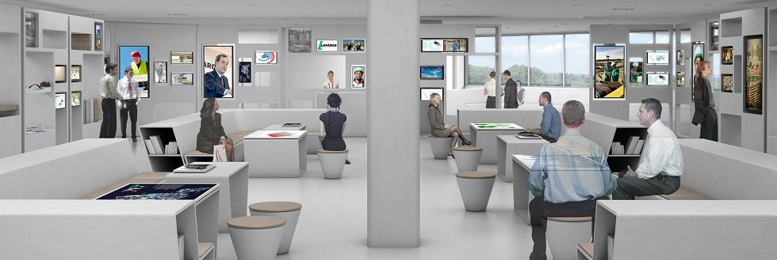
FootfallCam 3D PlusTM
For exhibitions
©2019 FootfallCam is trademark application of FootfallCam in various jurisdictions. We reserve the right to introduce modifications without notice. All other company names and products are trademarks of their respective companies.

Slide 2
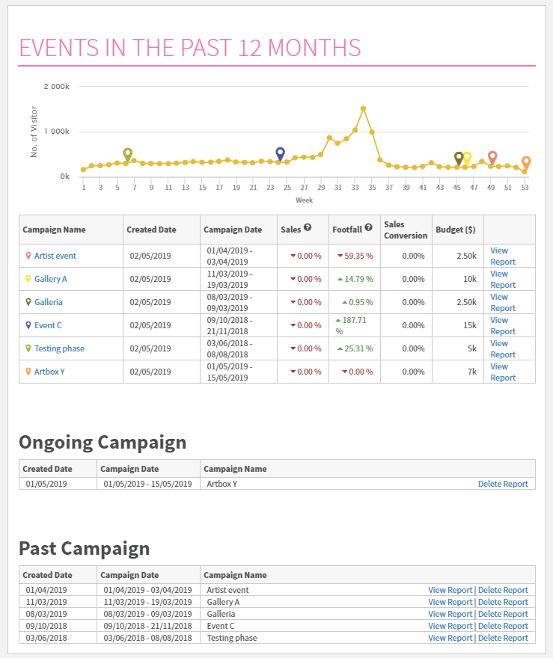
Usage dashboard
Artist event
Gallery A
Galleria
Event C
Testing
Artbox Y
Overview of past events
Each use of the event space will be listed on the reporting dashboard, further drill down into the data of each event by viewing individual reports

Slide 3
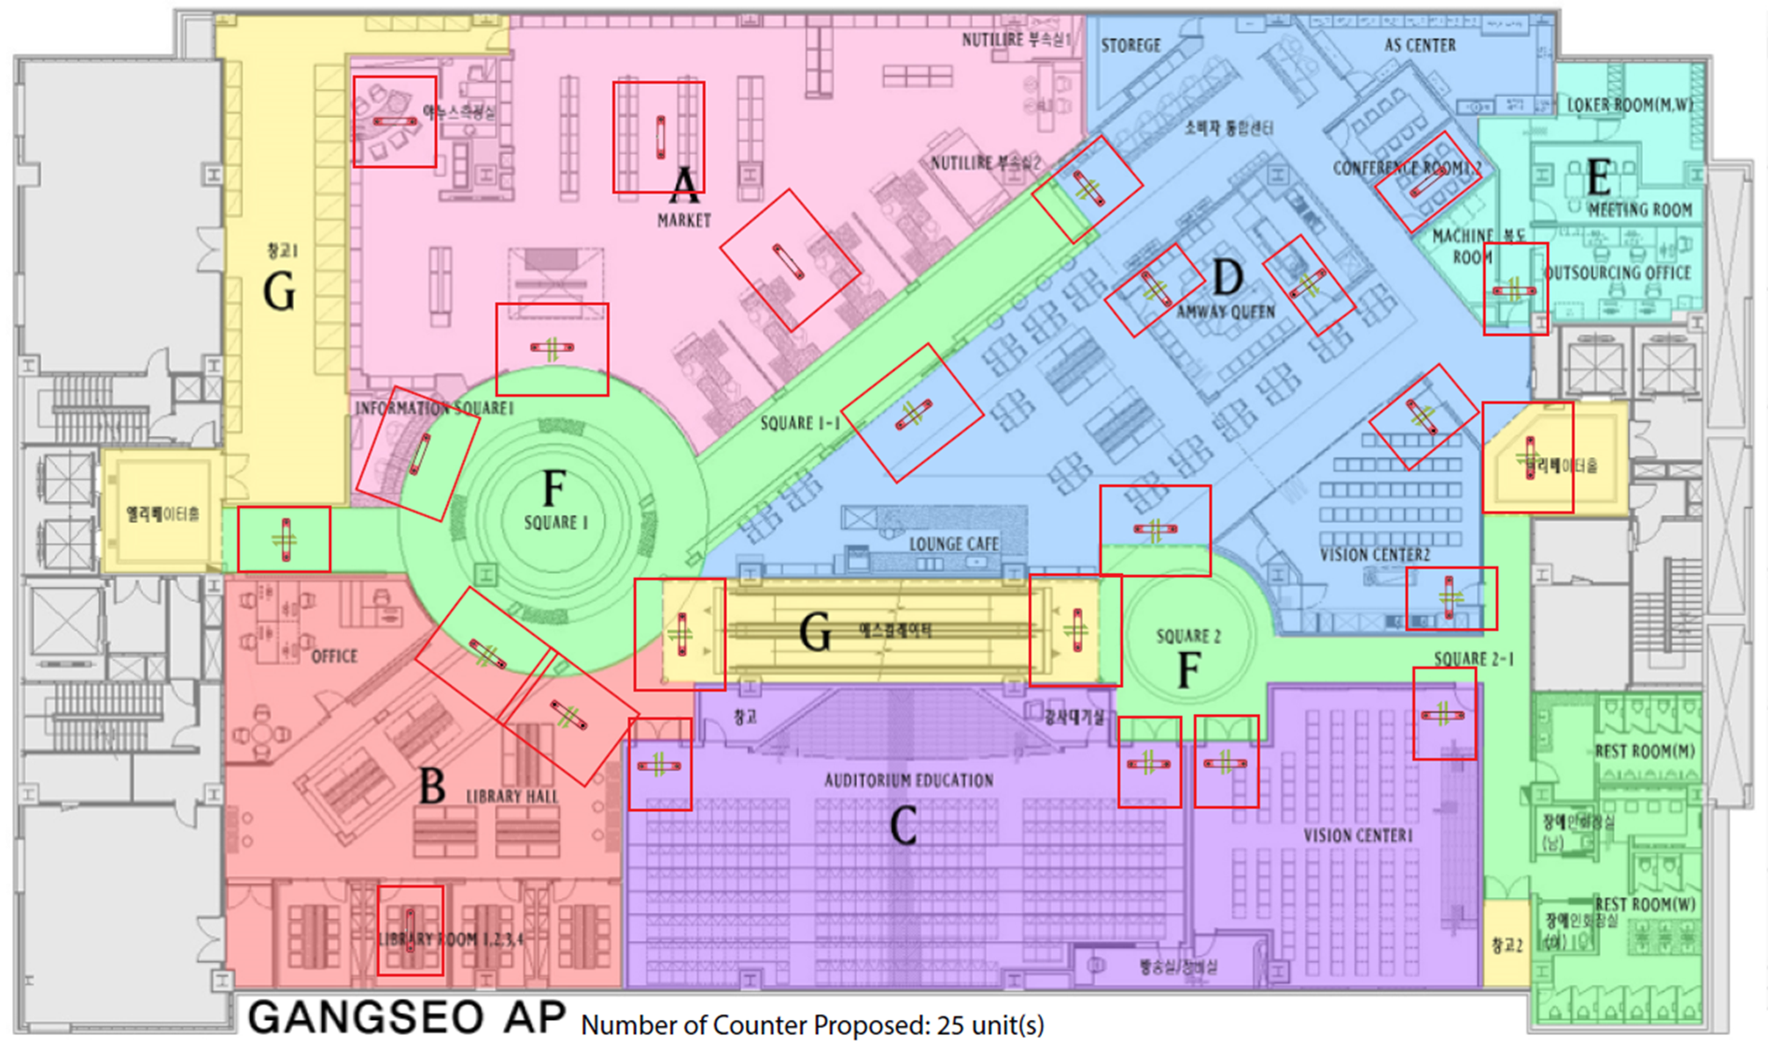
Solution #1: Quantify number of visitors
Total number of visitors
Quantify the total number of visitors that enter the exhibition site regardless of which entrance they used
Number of visitors in each area
By installing FootfallCam at the entrance of each self-assigned zones, quantify the number of visitors in each zones

Slide 4
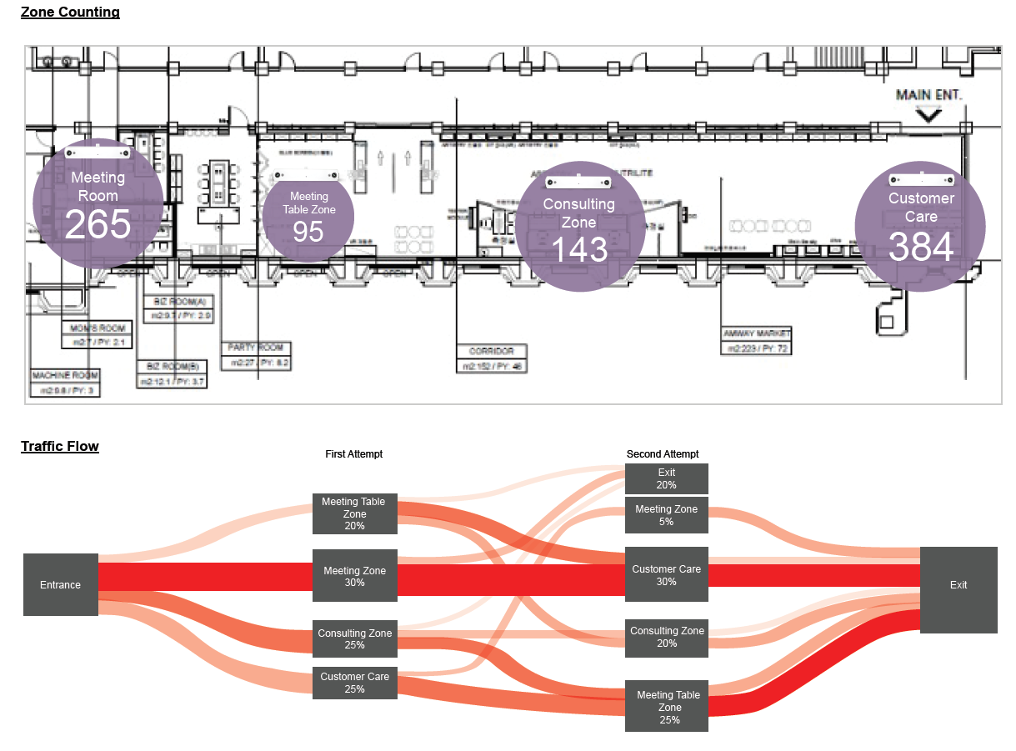
Solution #2: Visualise traffic flow of visitors
Traffic flow tracking
Continuously track the visitors and determine the path of visitors after leaving each zone
Colour significance
The more vivid the hue of colour is, the more popular the travel path is by visitors

Slide 5
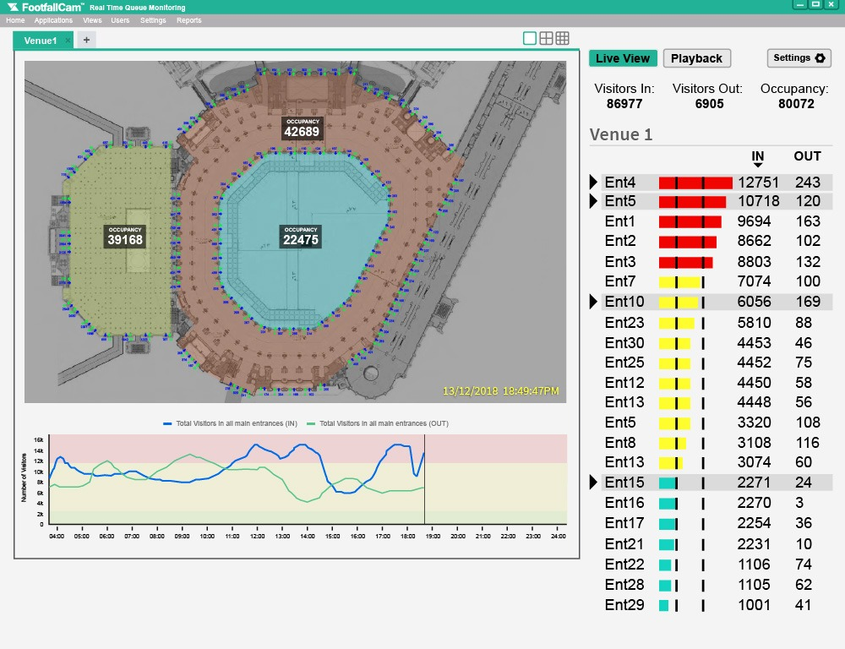
Solution #3: Monitor the occupancy in real time
Total area occupancy
Monitor the total number of visitors in the area in real time, and get alert when the venue is overcrowded
Area occupancy
Identify the number of visitors in each defined zone in real time to understand traffic count

Slide 6
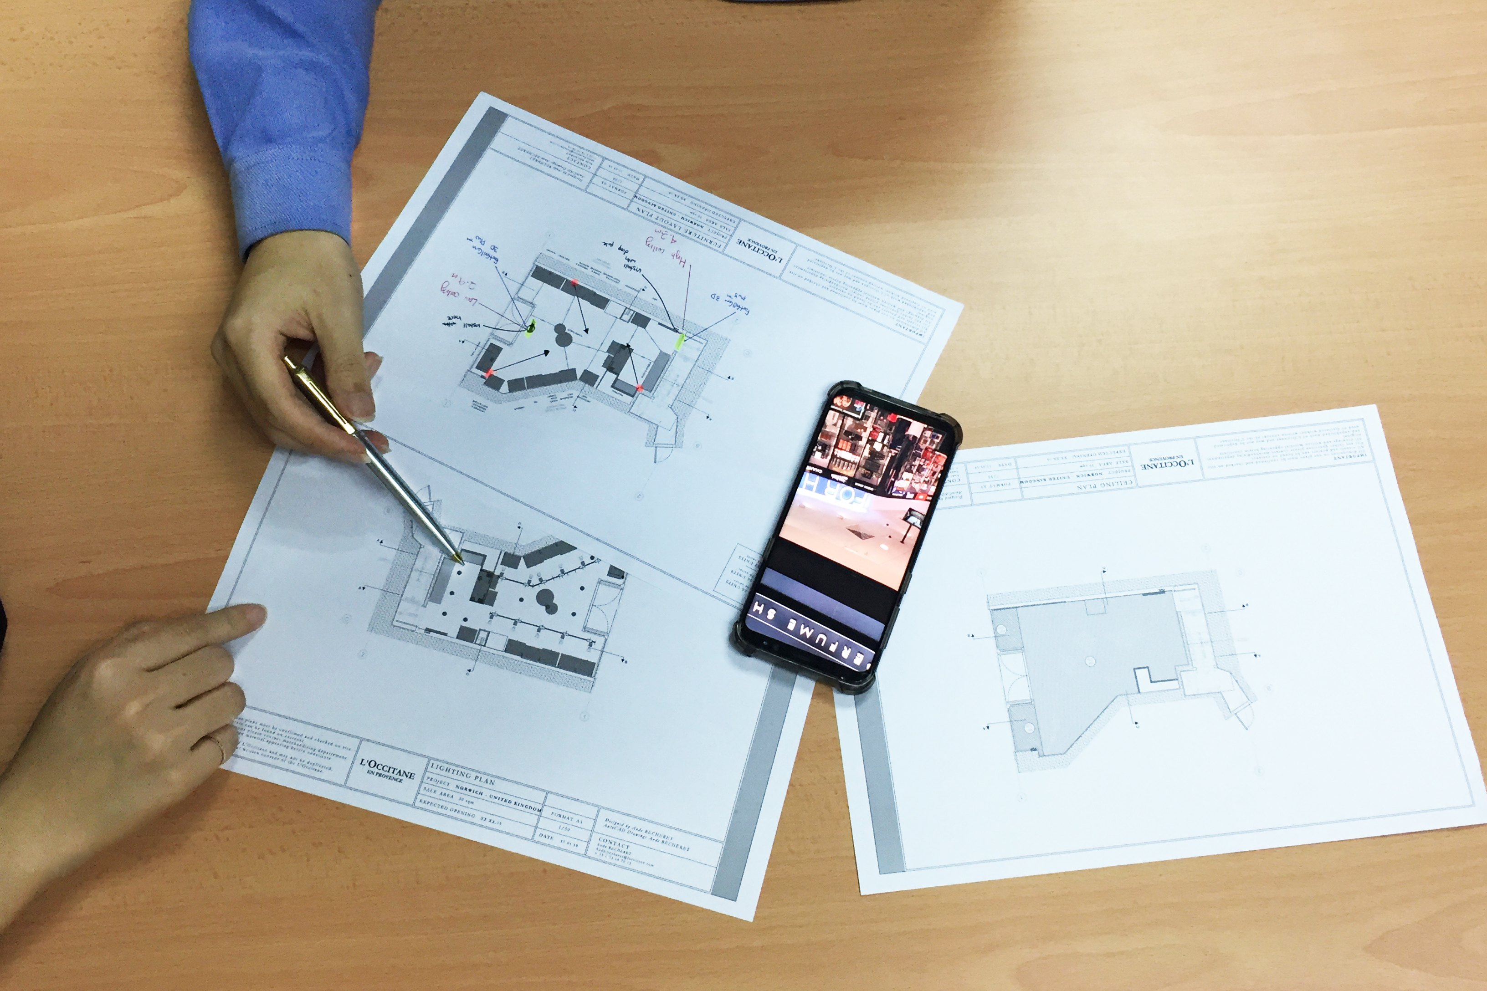
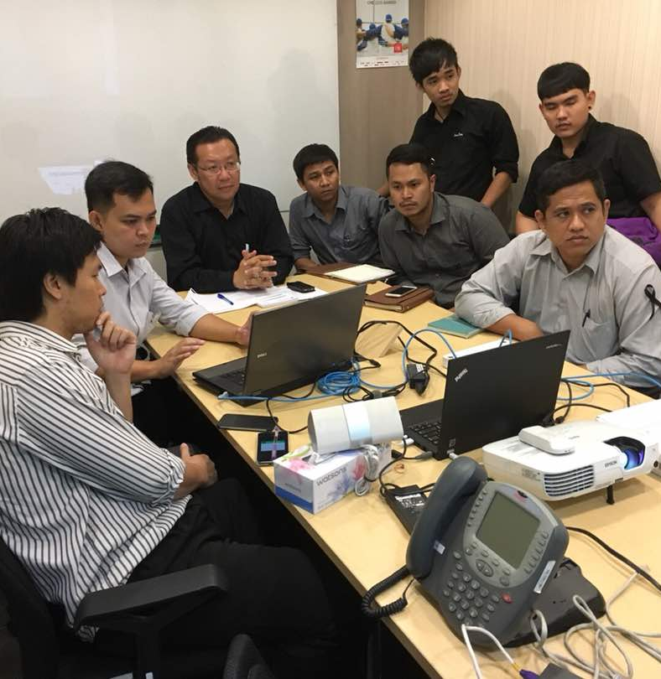
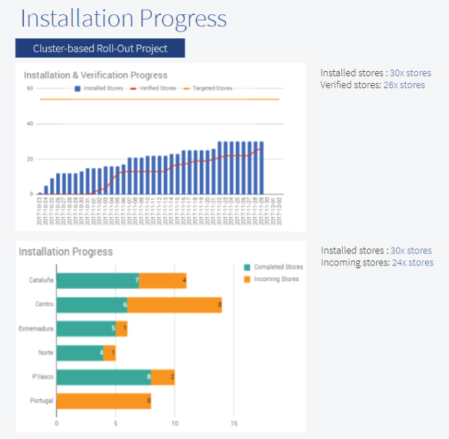
Image 1
Support services
Floor plan design
Determine where to position the device during each event to ensure no props are obscuring the live view of the device
Quick turnaround on accuracy audit
We will calibrate and verify the accuracy of the device with a turnaround time of 1 day, ensuring you will have accurate data during your event
Image 2
Image 3
Easy to dismantle and relocate
With only one cable to power the counter, relocation is hassle free. In conjunction to our around the clock support, installing has never been easier
Training installers at Watson Thailand

Slide 7
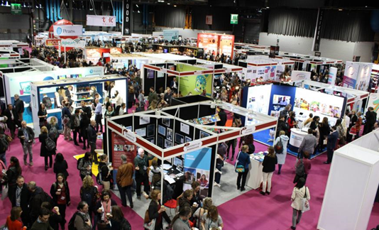
Special Package: Tuning for Exhibitions
Due to the nature of the deployment - last minute setup, we offer a special package for event organization. Our team will stand by and tune the FootfallCam for you.
When to notify us?
We would need 7 to 14 days notification prior to the actual event.
Service-Level Agreement
We will require 4 hours for the tuning that will be carried out the night before the event to achieve the industrial standard of accuracy.
Pricing
A special provider is needed for urgent support and verification, a fee of USD 55 will be charged per unit.

Slide 8
Contact Us
You need further information or have a question?
Please visit:
www.footfallcam.com
Headquarters
46 Abbotswood, Guildford
GU1 1UY,
United Kingdom
Asia Office
51-2, Jalan SL ¼,
Bandar Sungai Long,
43000 Kajang, Selangor Darul Ehsan, Malaysia
©2019 Footfall counter is trademark application of FootfallCam in various jurisdictions. We reserve the right to introduce modifications without notice. All other company names and products are trademarks of their respective companies.

