Slide 1
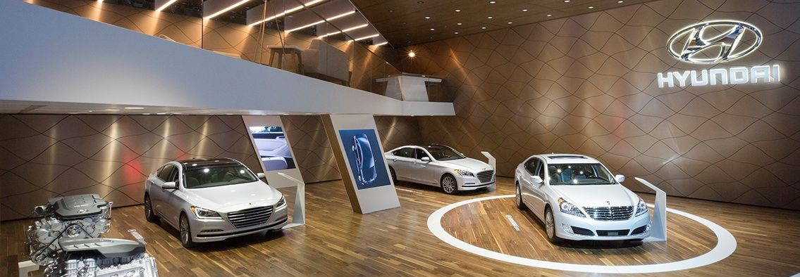
FootfallCam 3D PlusTM
Car Showroom
©2019 FootfallCam is trademark application of FootfallCam in various jurisdictions. We reserve the right to introduce modifications without notice. All other company names and products are trademarks of their respective companies.

Slide 2
Benefits of People counting solutions
for Car Showroom
1) Identify total number of visitors
Quantify the total number of visitors that enter the car showroom regardless of which entrance they used
2) Determine the returning customers and dwell time
Quantify the total number of visitors that enter the car showroom regardless of which entrance they used and how long they stay in the showroom
3) Evaluate the marketing effectiveness of the campaign
Analyse the budget and the impact on the growth of Footfall and Sales in each campaign. Determine the least effective campaign on the overall trend.
4) Analyse the engagement level of each car model
Using Video Heat Map to analyse engaged customer, passer-by and other customer behavior

Slide 3
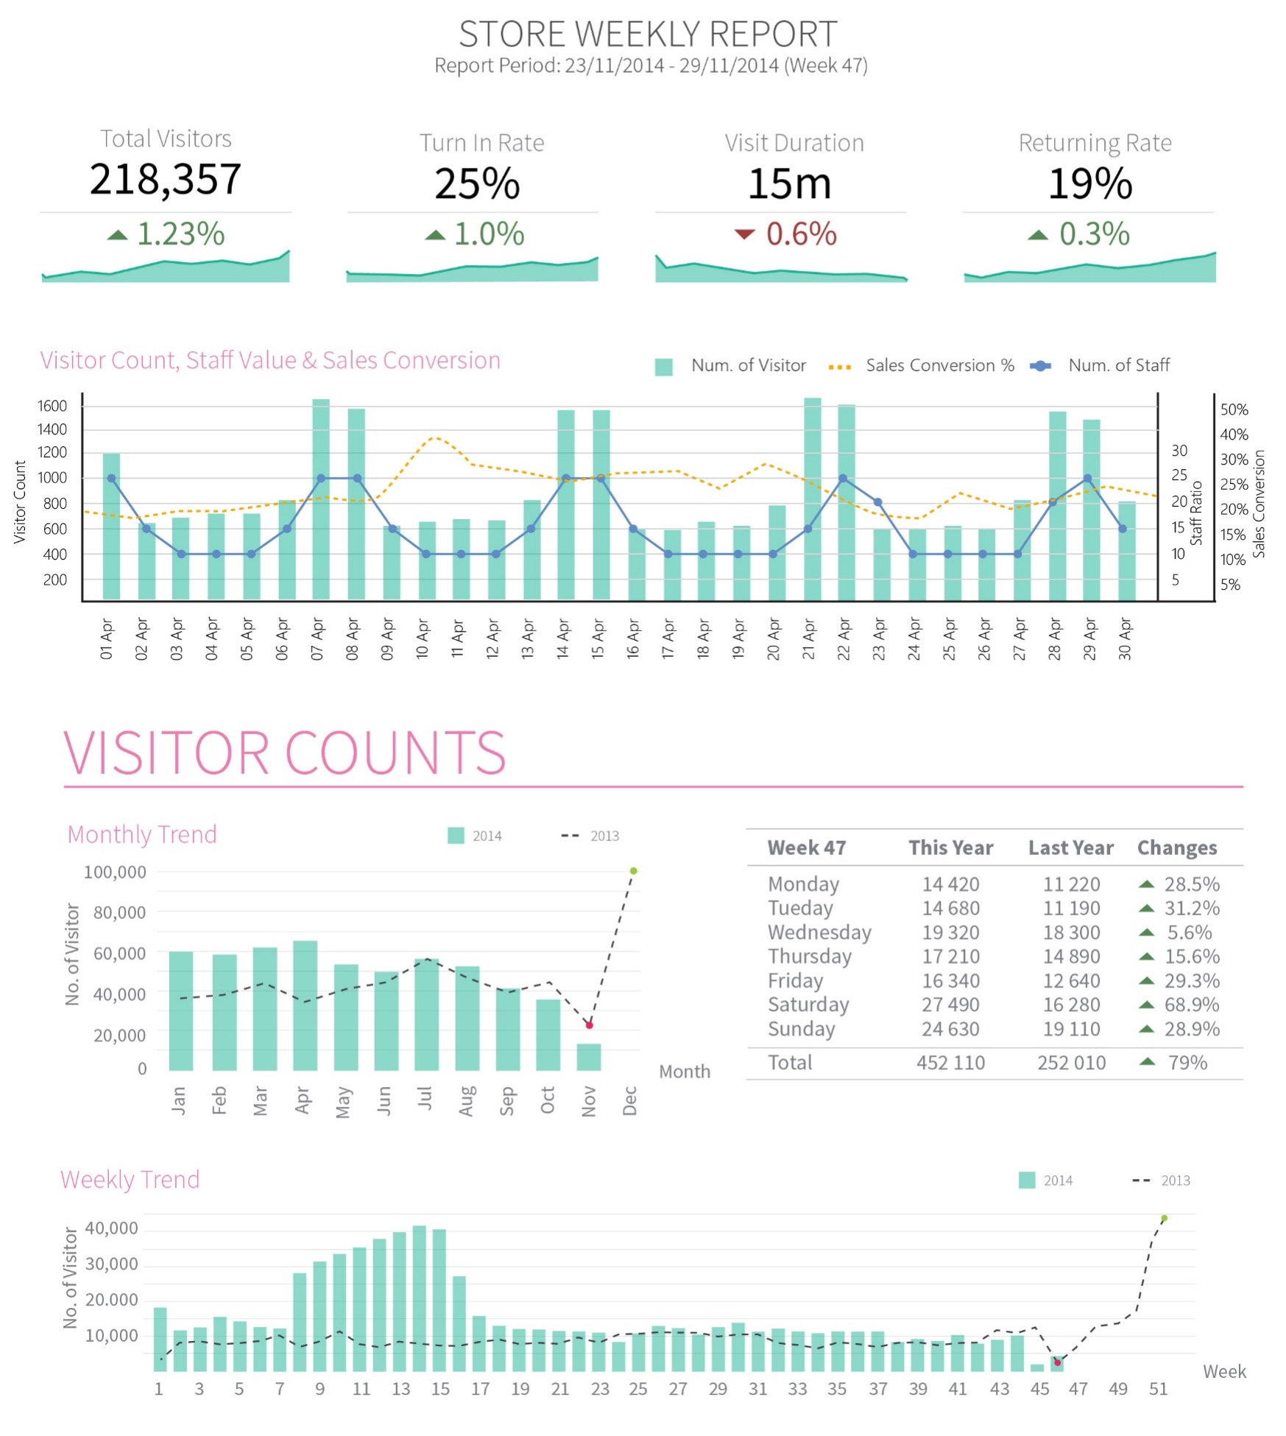
Car showroom Profiling
Understand Your Store Demographics
Combining footfall data with staff value and sales conversion data enables the store manager to view potential conversions and optimise your store performance.
Optimise Sales Conversion
With sales conversion rate, store manager can identify how much better their business can be and how to capitalise on the visitors that do not make a purchase.
When the store is having bad conversion, store manager should review staff performance, store display or product offering.
Review Staff Allocation
With staff value, store manager increase staff to customer ratio to improve on customer experience. Store manager should allocate enough staff to serve the customers.

Slide 4
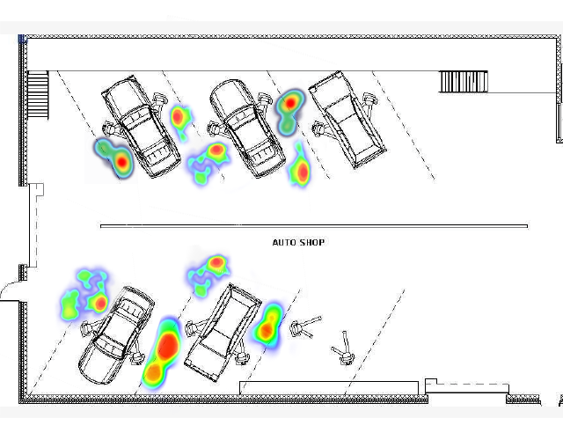
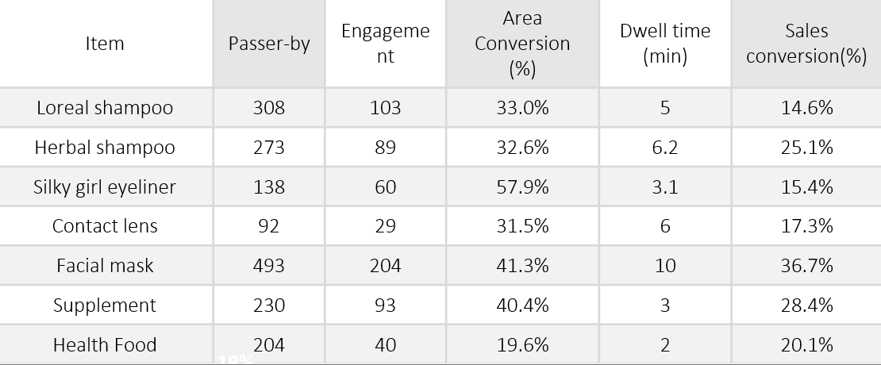
Heatmap analytics
Identifying car model engagement level
Determining which car model engagement are higher and the average time they are engaged to a specific product
Understanding customer in-store behavior
Identify how customer move around the car showroom and which areas are the most popular
Model A
Model B
Model C
Model D
Model E
Model F
Model G

Slide 5
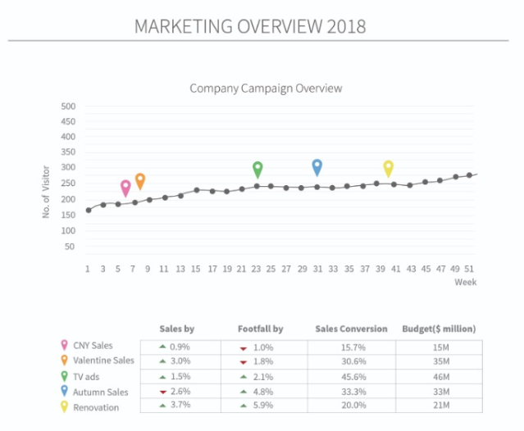
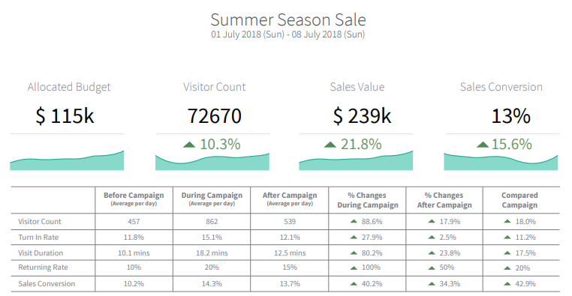
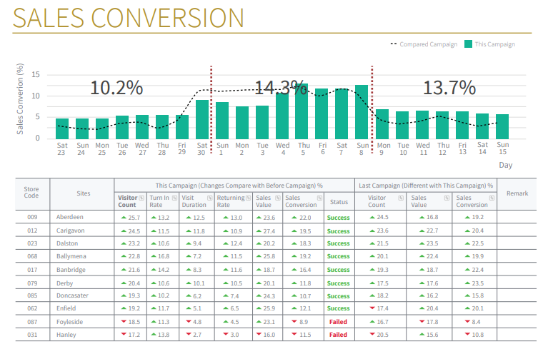
Marketing Effectiveness Tracker
Marketing evaluation on different campaign over the years
Analyse the budget and the impact on the growth of Footfall and Sales in each campaign. Determine the least effective campaign on the overall trend.

Slide 6
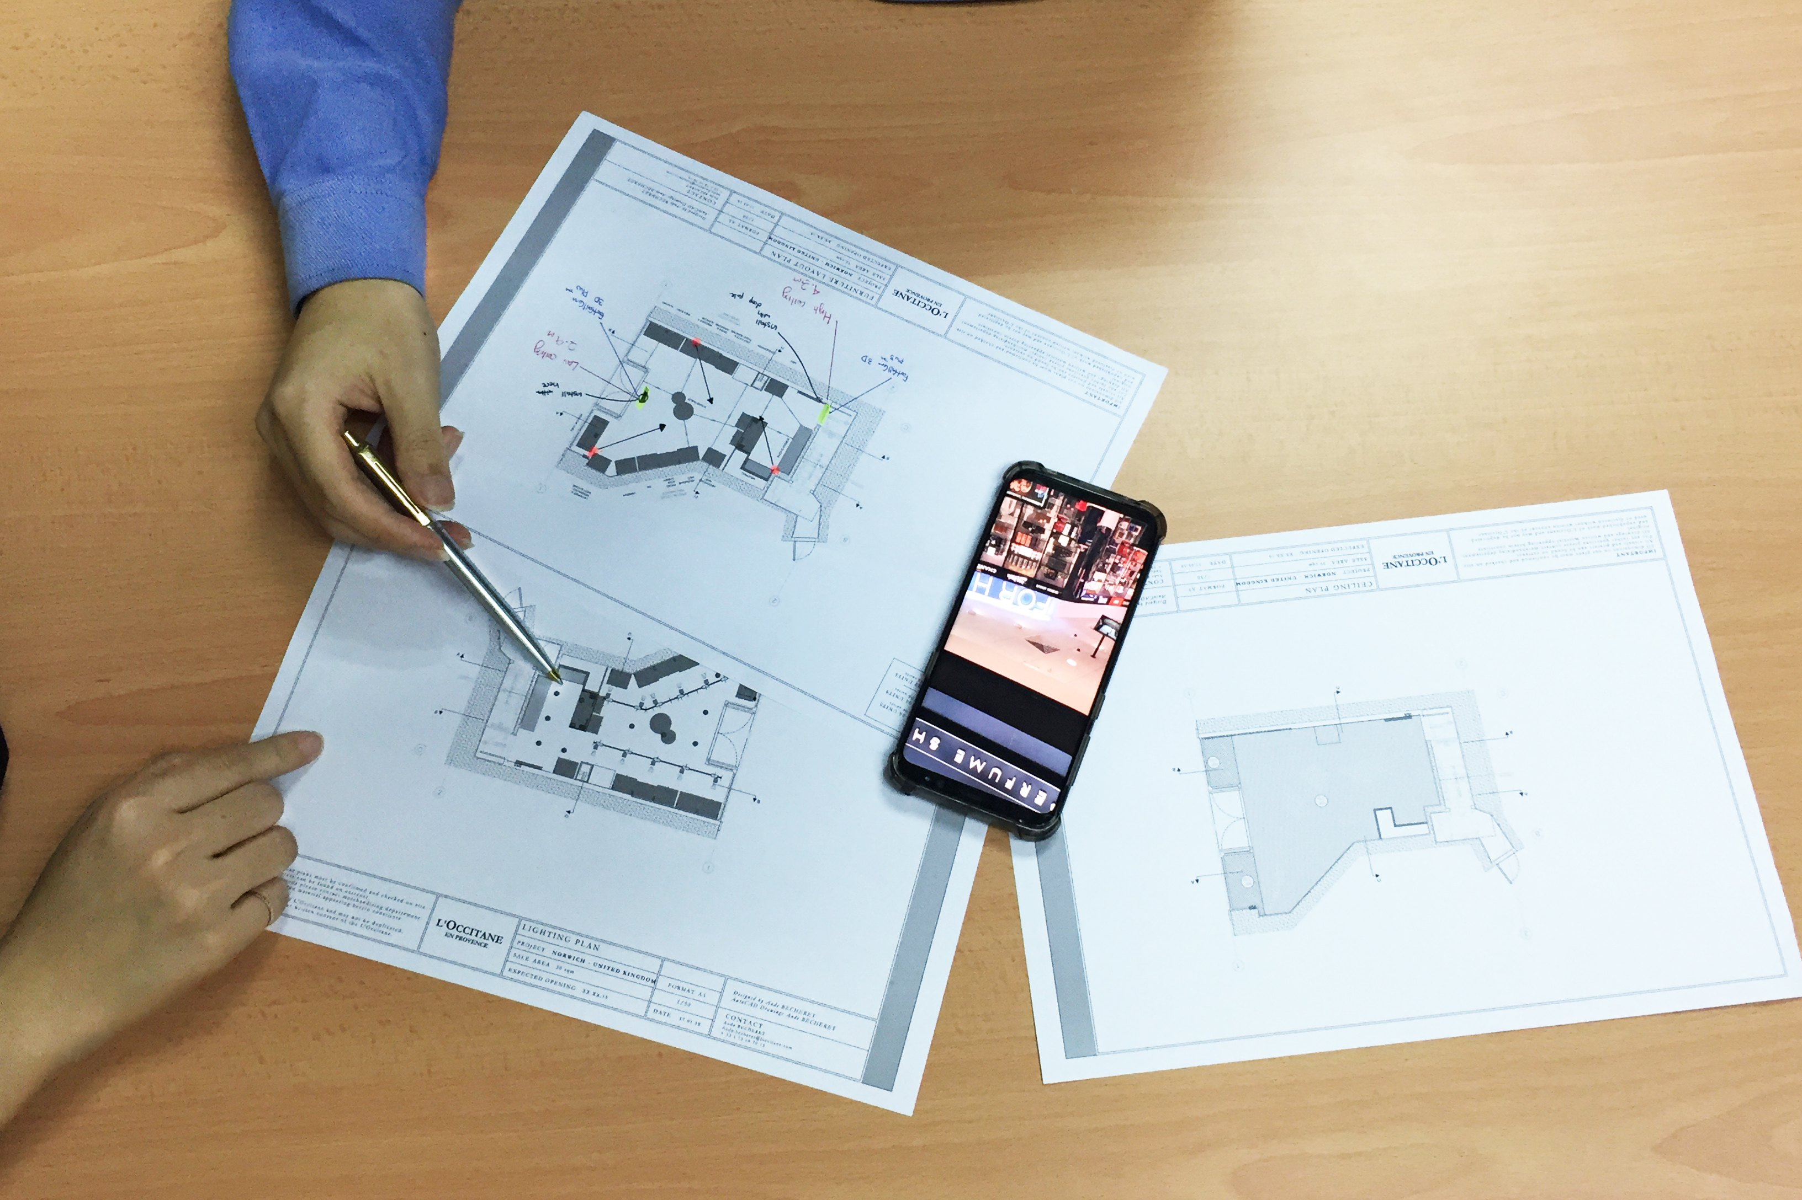
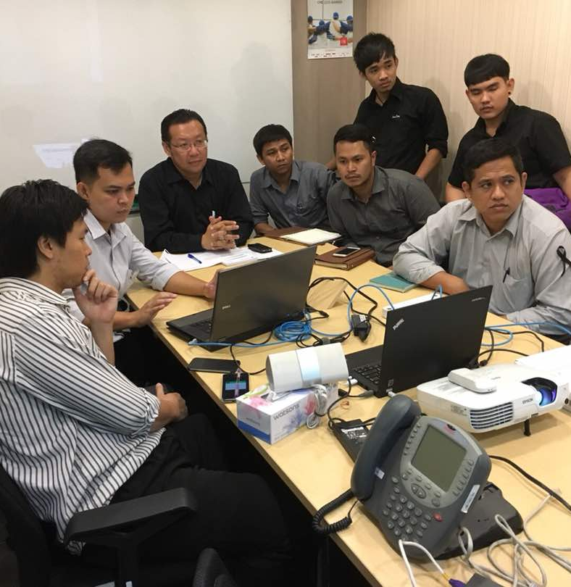
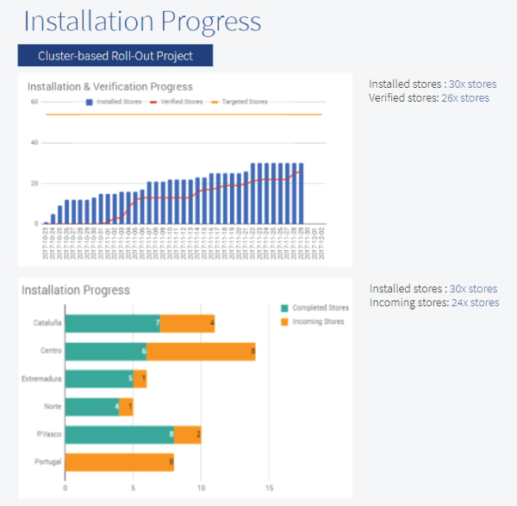
Image 1
Support services
Floor plan design
Determine where to position the device during each event to ensure no props are obscuring the live view of the device
Quick turnaround on accuracy audit
We will calibrate and verify the accuracy of the device with a turnaround time of 1 day, ensuring you will have accurate data during your event
Image 2
Image 3
Easy to dismantle and relocate
With only one cable to power the counter, relocation is hassle free. In conjunction to our around the clock support, installing has never been easier
Training installers at Watson Thailand

Slide 7
Contact Us
You need further information or have a question?
Please visit:
www.footfallcam.com
Headquarters
46 Abbotswood, Guildford
GU1 1UY,
United Kingdom
Asia Office
51-2, Jalan SL ¼,
Bandar Sungai Long,
43000 Kajang, Selangor Darul Ehsan, Malaysia
©2019 Footfall counter is trademark application of FootfallCam in various jurisdictions. We reserve the right to introduce modifications without notice. All other company names and products are trademarks of their respective companies.

