Slide 1

People Counting System for Libraries
Visibility on Patron’s Traffic Flow
©2002-2020 Footfall counter is trademark application of FootfallCam in various jurisdictions. We reserve the right to introduce modifications without notice. All other company names and products are trademarks of their respective companies.

Slide 2



About FootfallCam™
Global Leader in People Counting System
FootfallCam is the global leader in people counting solutions. Headquartered in the United Kingdom, FootfallCam started with a team of experienced engineers with the vision of creating the most advanced people counting system in the market. We are the manufacturer of both hardware and software; all the design and development are 100% in-house made.
FootfallCam is continuously reinvesting more than 24% revenue into research and development
In-house R&D team dedicated to the development of both hardware and software of FootfallCam
Combined over 100 years industry experiences in developing people counting solution
Serving multiple sectors varying from retail, fast food, restaurants, museums to smart buildings and airports.
Prior to the Covid-19 scenario, our research team predicted the demand for this solution ahead live occupancy we activated our R&D team to develop our Live Occupancy Control System
Notes:
Serve many industries
Many technologies – continuous investment in R&D
Latest focus is this solution to specifically cater for covid-19 occupancy control market demands, easy to install, economical to own the system

Slide 3
Topics of This Webinar:
  Potential Market for Libraries
  Overview of Smart Library System
  Key Feature #1 Visitor Count
  Key Feature #2 Children Counting
  Key Feature #3 Live Occupancy Monitoring System
  Key Feature #4 Area Utilisation
  Key Feature #5 Cross-Site Visit Tracking
  Key Feature #6 Marketing Effectiveness
  Key Feature #7 Staff Exclusion Tag
  Case Studies
About the Speaker
DR. MELISSA KAO BSc (Hons), PhD
Director of International Sales, FootfallCam UK Limited.
Connect on Linkedin

Slide 4
Potential Market for Libraries
Big market with strong urgency to transform
Up until year 2019, there are around 406,560 of public libraries worldwide.
With the introduction of eBooks and eReaders, public libraries are diversifying to offer more community services than just books borrowing.
Local councils would need to know the usage of their facilities and services so they can continue to provide funding to the relevant sites.
This creates a growing need for the implementation of people counters in public libraries.
  (Source: https://cclibrarians.org/outlook/december-2018/modern-traffic-counting-libraries)
Notes:
Yet libraries are provided by local councils, libraries need to provide other services (internet service, local communities events etc). Local councils are going into digital age, they would need to check the local usage of it so local council can ocntinue to provide funding to the relevant sites.
Hence growing markets.

Slide 5
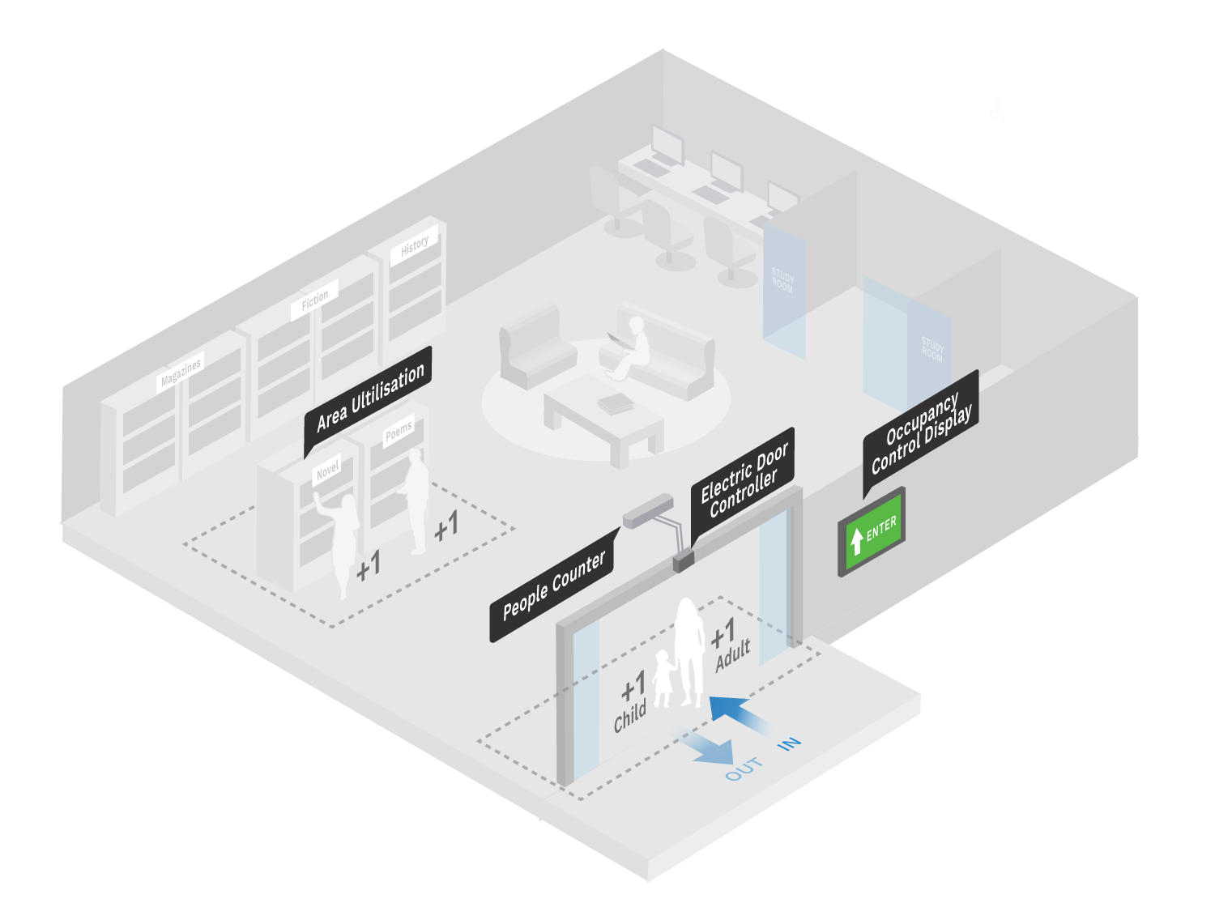
Overview of Smart Library System
“We need to have an accurate method of tracking our visitors across all the different resources we provide. We want to be able to gauge the usage of each facility and allocate our funding accordingly.”
Paul Smith, Head of Acquisitions – Chandler Library
Why do Libraries need People Counters?
Libraries do not generate much revenue - rely on government funding for additional resources.
They are faced with the challenge that they are unable to justify the necessity of the usage of their resources by the community to the government.
They have no method of determining the number of visitors that visit their library and are unable to quantify the usage of their facilities.
This creates the need for people counters as data provided by FootfallCam is able to quantify the usage of facilities and the necessity of resources to the community.

Slide 6
Requirements for Libraries
Here are some of the major issues faced by libraries:
“How often are our resources being used?”
“What is our most used and least used facility?”
“How can we make cases to administration for resources?”
“How can I automatically control the number of patrons to comply with social distancing guideline?”
Notes:
Critical delivery point: what the major things that has the biggest bang for their buck?
Next version: Use case studies for the problem statements

Slide 7
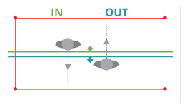
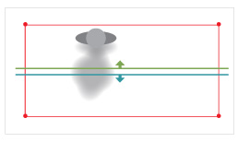
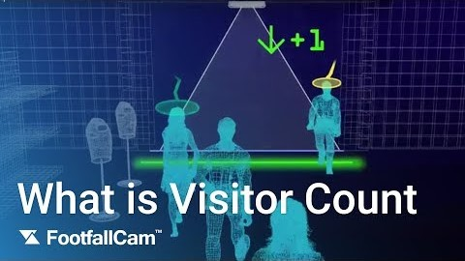
#1 Visitor Count
High Accuracy with 3D Stereoscopic Vision
Using 3D stereoscopic video technology, the number of patron traffic data can collected at an accuracy of >95%.
Libraries will be able to Identify the hourly trend and weekly trend for the number of patrons
Visitor numbers provides hard evidence for funding justification
View Visitor Count Report here.
Efficient Staffing Allocation
Reduce cost through optimum staff scheduling and resources management
Management can arrange the time for maintenance works to be carried out following non-peak seasons
View Staff Planning Report here.
Bi-directional count
3D Count: 1 in 1 out
Strong shadow
3D Count: 0
Watch how it works: https://youtu.be/wJkLeY2-TUI

Slide 8
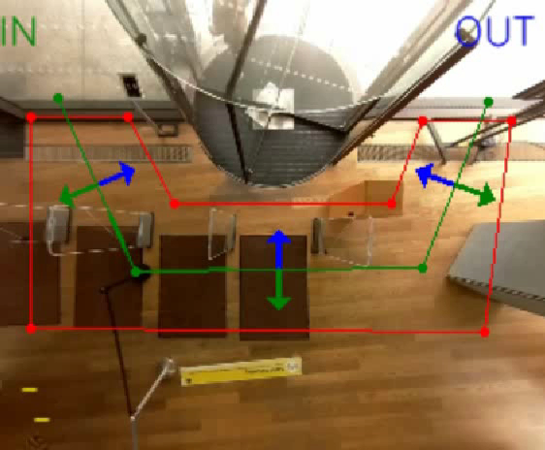
#2 Children Counting
View video here.
Uncompromised Data Accuracy with Children Counting
FootfallCam can accurately detect the height of visitors and will be able to filter out non-animate objects such as trolleys and baby carts.
However, the human height ratio can be manually configured to include counting of children, a feature that not commonly provided to retailers’ due to the lack of purchasing power from children.
FootfallCam Verification Specialist found the perfect balance and was able to maintain the accuracy around 90% - a solution that was capable of counting children and adults alike.

Slide 9
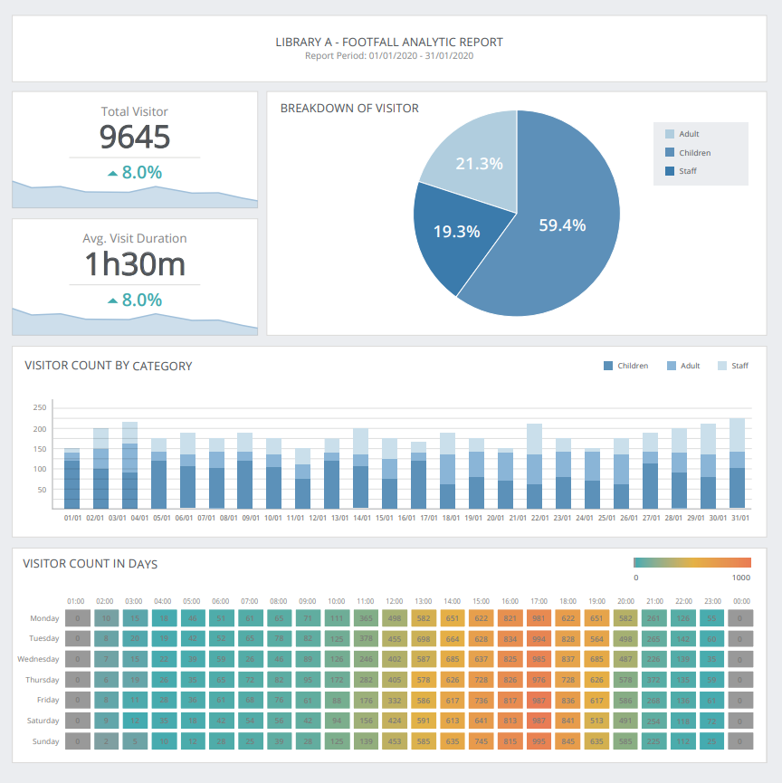
#2 Children Counting
Overview of the Patron’s Demographic Information
Counting of children is crucial for public facilities
Clear insight into the demographic information of the patrons
  How many proportion of the patrons are children?
Automated reports give the valid data and overview of their facility (e.g. visitor movement and peak time).
Replenish resources based on major patron’s interest: bringing In reading materials that are catered to the younger age group
Funding for implementation can be justified and maximized by provision.
Allocate funding for proper staffing and security to make sure the facility is safe for all areas, (e.g. for the library archive collection).
View Sample Report here.

Slide 10
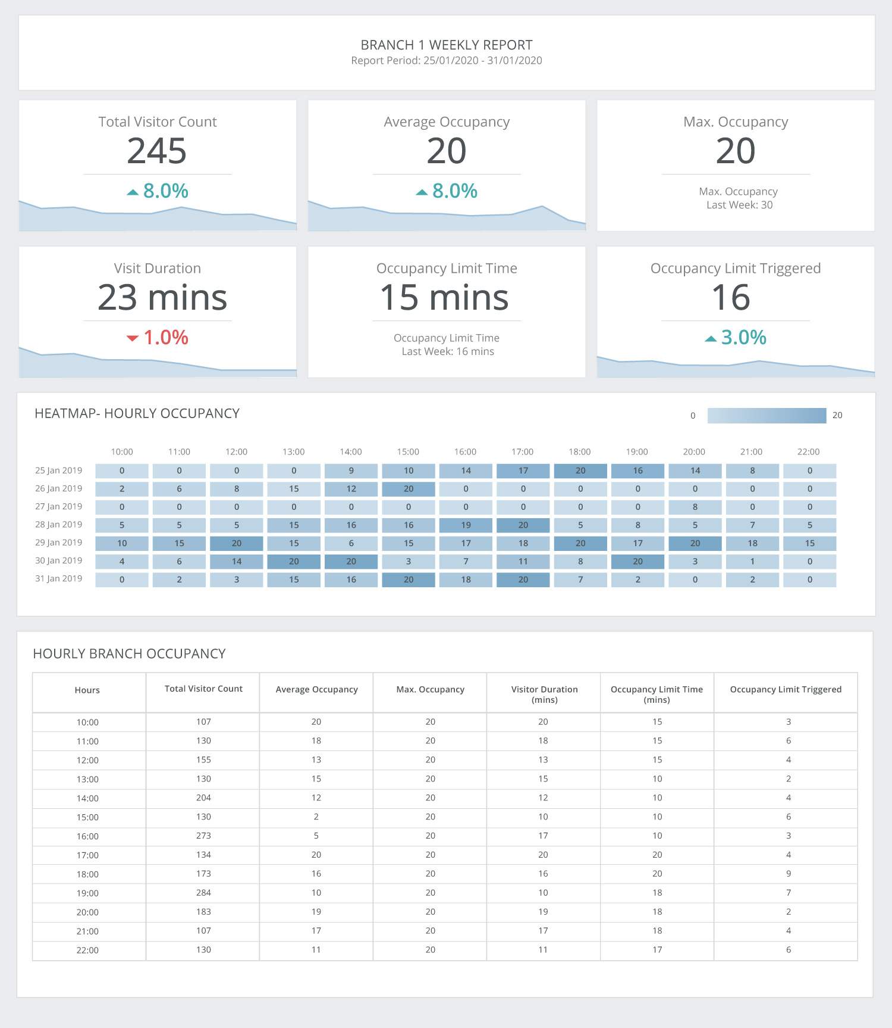
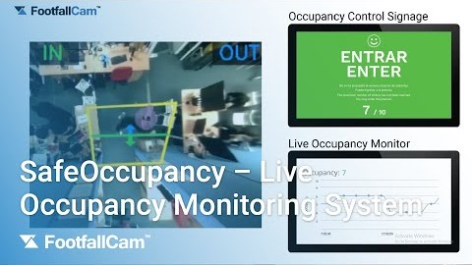
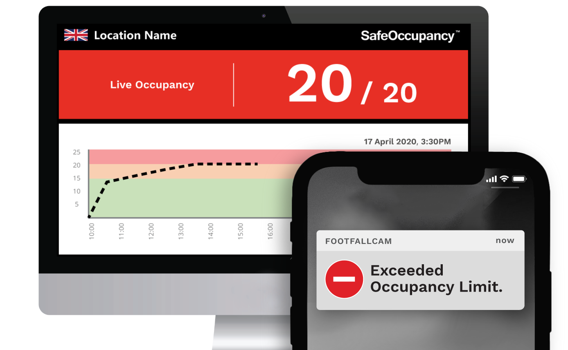
#3 Live Occupancy Monitoring System
Watch how it works: https://youtu.be/QYEa_EjPjP8
View report here.
Help Public Facilities to Comply with Social Distancing
Governments have imposed a social distancing regulation to contain the spread of the coronavirus.
  Businesses need to find ways to limit the number of people in the premises after resuming operations
Many resort to assigning security guards to control the customer traffic at their entrances
  Manual counting – costly, inaccurate and provide no evidence for compliance
FootfallCam Live Monitoring System helps to limit the maximum number of people within the confined premises
This can be integrated with electric doors via GPIO to automatically close the door when occupancy limit is breached.
Find out more by watching our COVID-19 live occupancy solution webinar here: https://youtu.be/0gydBh7V7XM
Notes:
- Headings

Slide 11
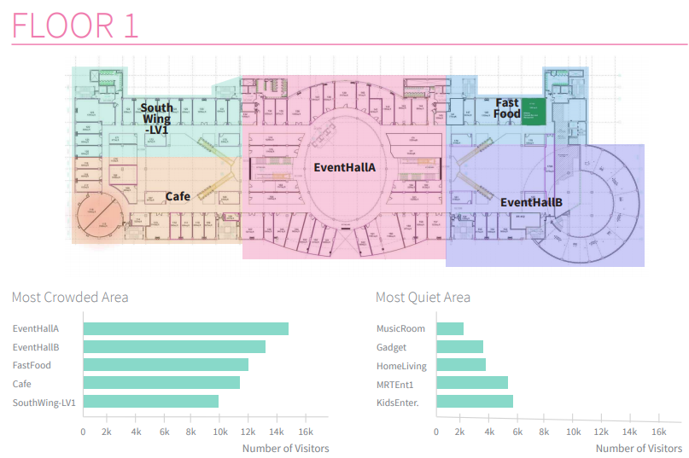
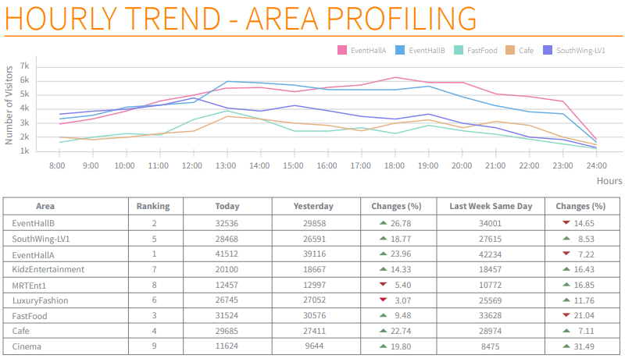
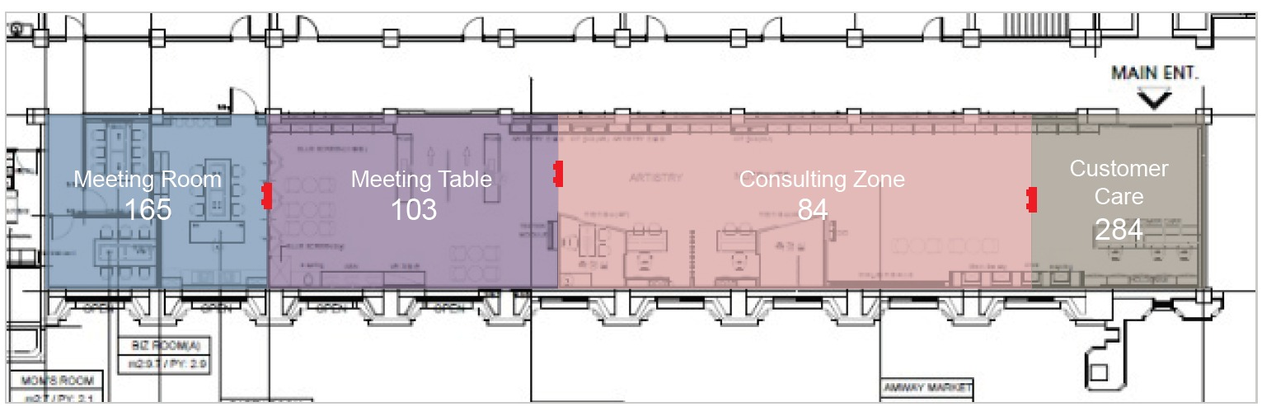
#4 Area Utilisation
Identify popular zones in the library
Get instant comparison for each zone.
Analyze patron’s behavior in different zone to gain more insight
Understand which facilities are most or least frequently used such as the quiet area and conference room
Know the best areas to place the invested resources at to make it accessible to patrons
Optimize funding allocations
Make informed decisions using sound evidence when allocating the funds
Determine which facility is most used by visitors and allocate their limited funding accordingly
i.e., Focusing the funding for maintenance for popular sections of the library, instead of least used areas
Justify the usage of resources by the public community when applying funds
View Sample Report here.

Slide 12
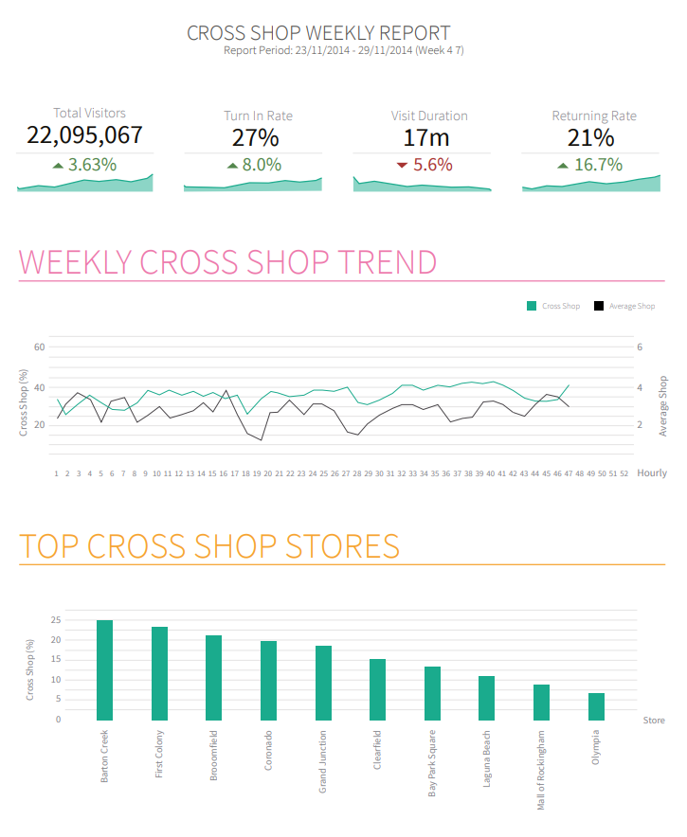
#5 Cross-Site Visit Tracking
Keep track of patron’s loyalty
Many have library branches that are located in different areas.
Track returning patron’s visit to different sites and generate cross-site visit tracking report.
The loyalty and engagement of the patrons can be tracked between the sites of the same library.
Understand returning visitor’s behaviour
Analyse what’s working across multiple sites that is attracting visitors to return
  Identify which areas needs improvement or refurbishment.
View Sample Report here.

Slide 13
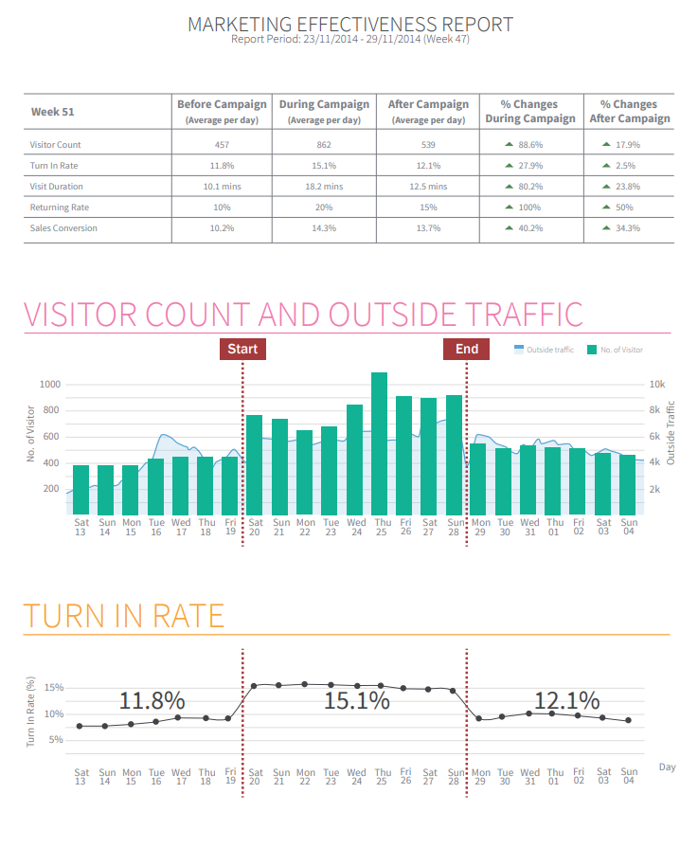
#6 Marketing Effectiveness
Evaluate effectiveness of all your Events
Libraries organise many events to attract new visitors and retain existing patrons
Book club meetings, new book launches, writing workshops, language classes, etc.
Compare the footfall data before and after an event was held
Measure effectiveness of special events and occasions
Quantify and compare results of different types of events
Identify the ROI for each Campaign based on allocated budget
Analyse the budget and the impact on the growth of footfall for each campaign
Use concrete data to justify the impact of the campaign investment
Select the best campaign to serve your library demographics
Determine the least effective campaign on the overall trend
Use resources wisely by allocating more budget to the most-achieving events
View Sample Report here.

Slide 14

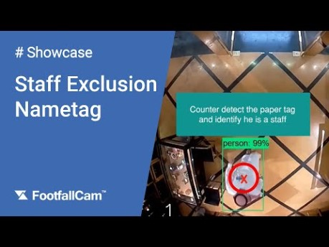
#7 Excluding Staffs from Counting
Ensure that no staffs are included in the counting
Present patron traffic data with confidence when requesting for government funding
  Ensuring that visitor traffic does not include staff, trolleys or hovering passers-by.
With the latest AI recognition built-in, staffs can be easily excluded from counting just by clipping the Staff Exclusion Tag on the shirt
Staff is identified by the stripe patterns on the tag and excluded from counting automatically
No more special lanyards or expensive staff tags needed.
  No infrared or any emission involved, and no battery required.
Watch how it works: https://youtu.be/7dqUT89BvNs
5
FootfallCam 3D Plus TM
Notes:
Marketing Effectiveness – Book launch, book club, story-telling
SafeOccupancy
Clean system – library specific functions
Where do people stay in specific area?
- University students want to know which area they can go for study

Slide 15
Enterprise Class Software

Slide 16
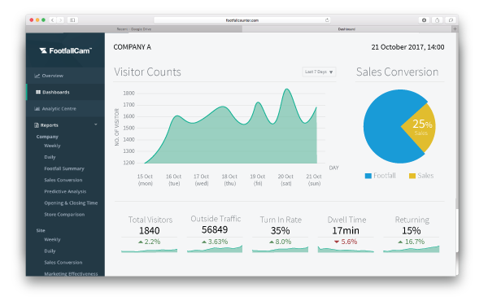
FootfallCam Analytic Manager V8™
Software Specifications
Interface | Http; Https
Compatible Browser | IE7 or Later Mozilla Firefox or Later Chrome Version 4.0 or Later Safari
User Levels | 2 levels: Administrator, Standard User
Ethernet | 10/100 Mb Ethernet
Time | NTP, Adjustable time zone, automatic day light saving adjustments
Data Delivery | TCP/IP
Database Type | SQLite
Report format | csv, .xml, .txt
Data Storage | 5 Years storage with auto sync
Data Backup | Yes
Backup Frequency | Daily Full Backup of Data and Configuration Weekly Backup to Sub Server for Contingency Purpose
Software Version Upgrade | Auto Upgrade
Functions:
Staff alert if capacity limit is breached
Centralized Management Analytics Software
API Available for Data Integration
Pre-defined Report Set
Health Check Report
User Account Management
Automated Email Scheduler

Slide 17
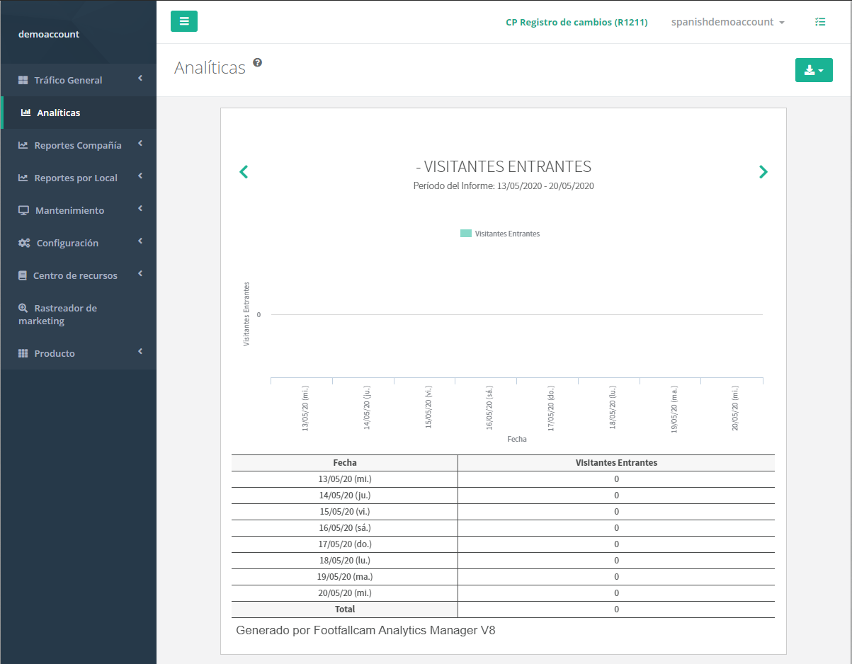
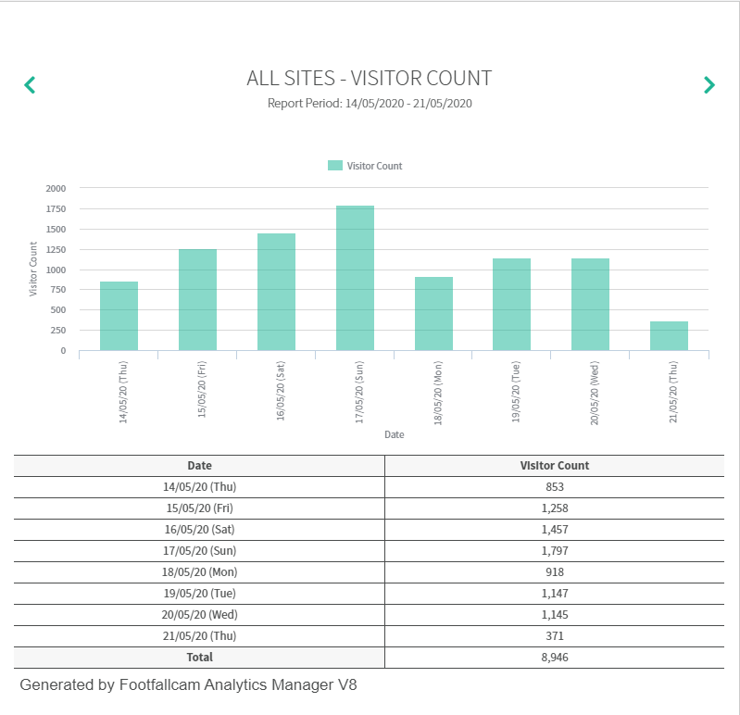
#1: Enterprise Class Software
Multi-language Interface
Different languages available such as:
English
Dutch
Spanish
French
Italian
German
Arabic
Japanese
Chinese
Customise dashboard design
FootfallCam will customize the language and images in the dashboard
Provide us with the translated text and graphics, then we will help you handle the configuration

Slide 18
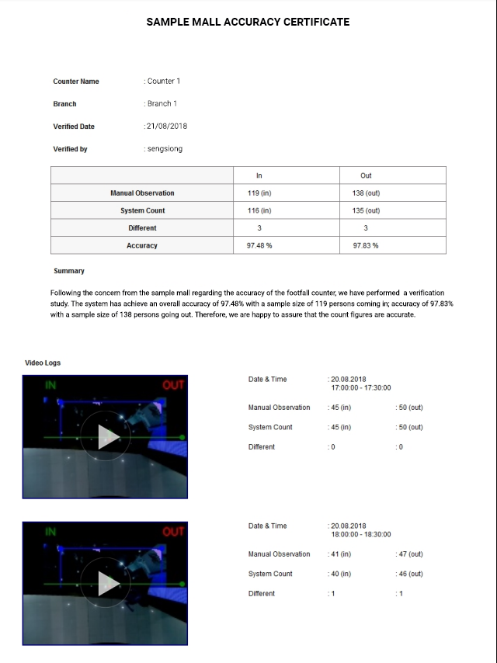
#2: Video Proof
Ensure 95% and above data accuracy
After installation, FootfallCam’s in-house verification specialist will remotely access the counter to perform accuracy audit
They will schedule video recordings to collect a sample size of 20 and above
After that, they will configure the counter to ensure that it is able to detect the visitors in the video recording
Once it is completed, the team will generate an Accuracy Certificate which will showcase the counter accuracy and summarize their finding
(Verification report: Sample 1 & Sample 2)

Slide 19
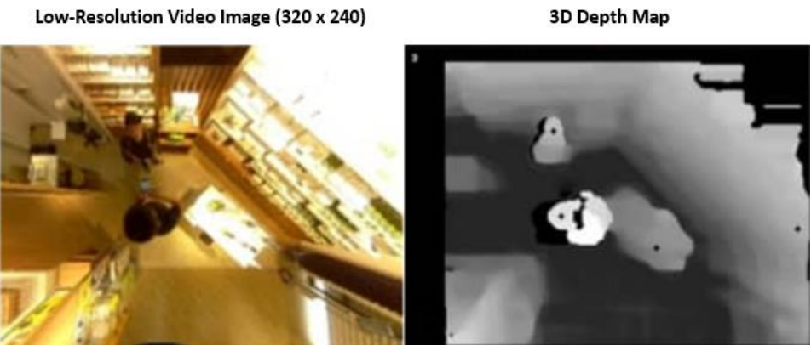
#3: Data Privacy and GDPR Exemption
Counters installed downwards facing the ground – does not capture the entirety of the customer & unable to pick up facial features.
Videos are recorded only for verification purposes and taken in low resolution. The videos will be deleted once verification is completed.
FootfallCam uses 3D depth map instead of video images for counting purposes – data collected are non-visual and are will not be able to be identify with any individuals.
FootfallCam is exempt from GDPR. More information can be found here.

Slide 20
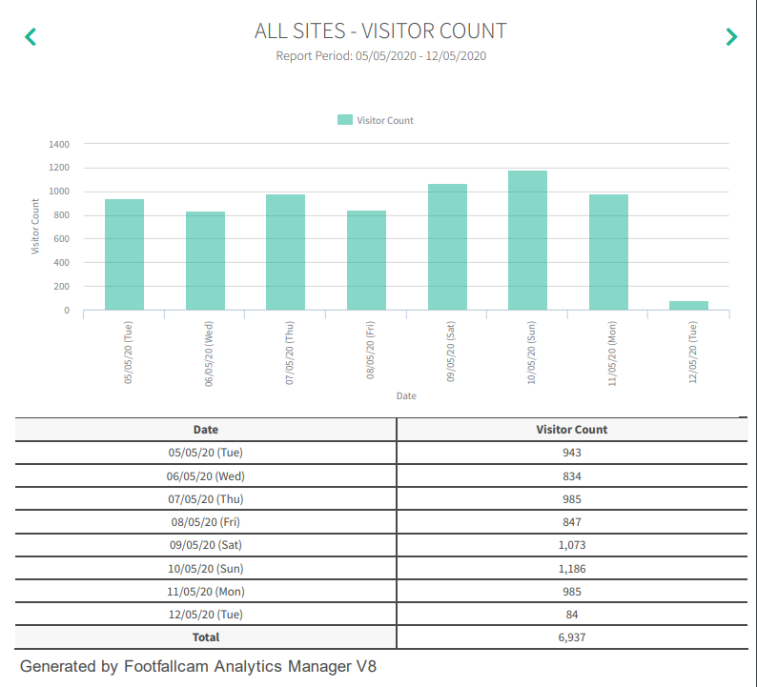
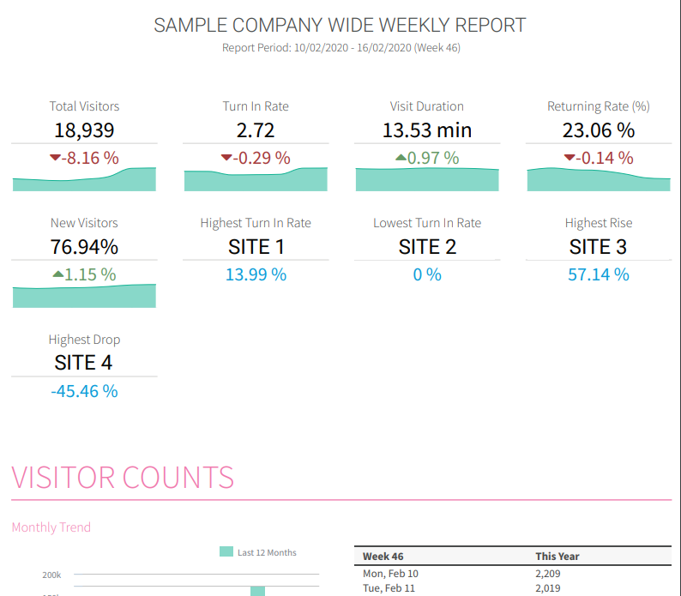
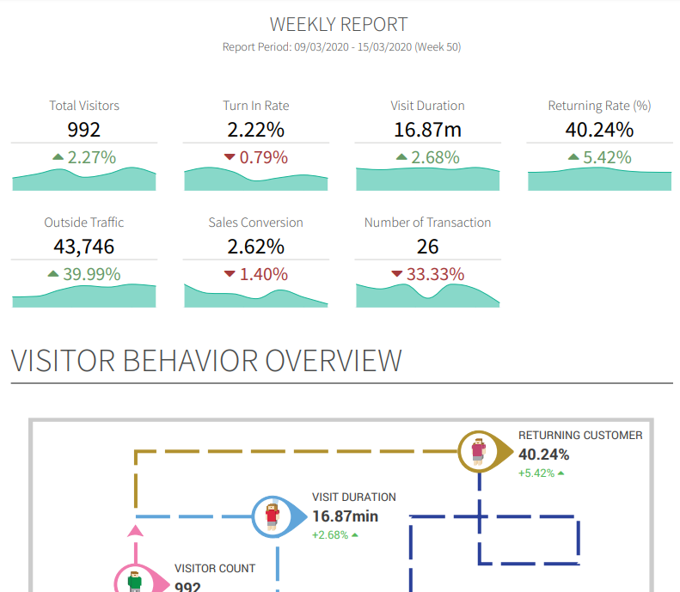
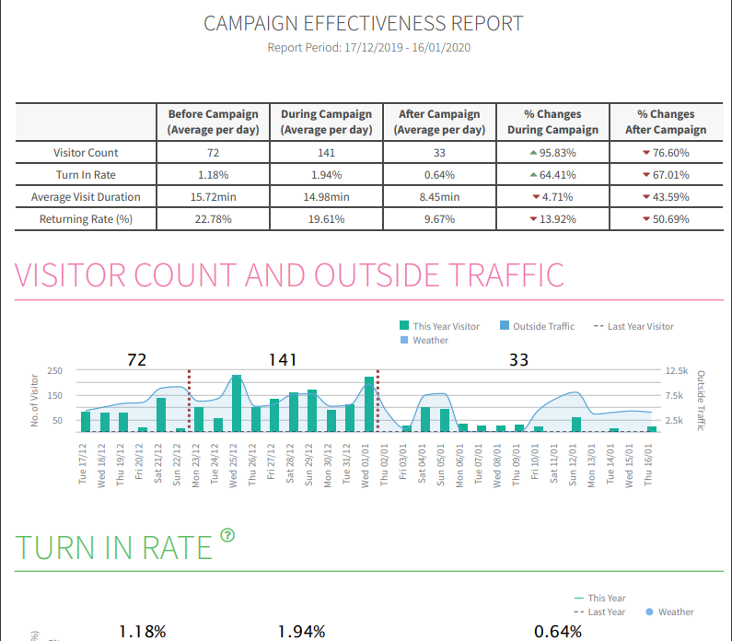
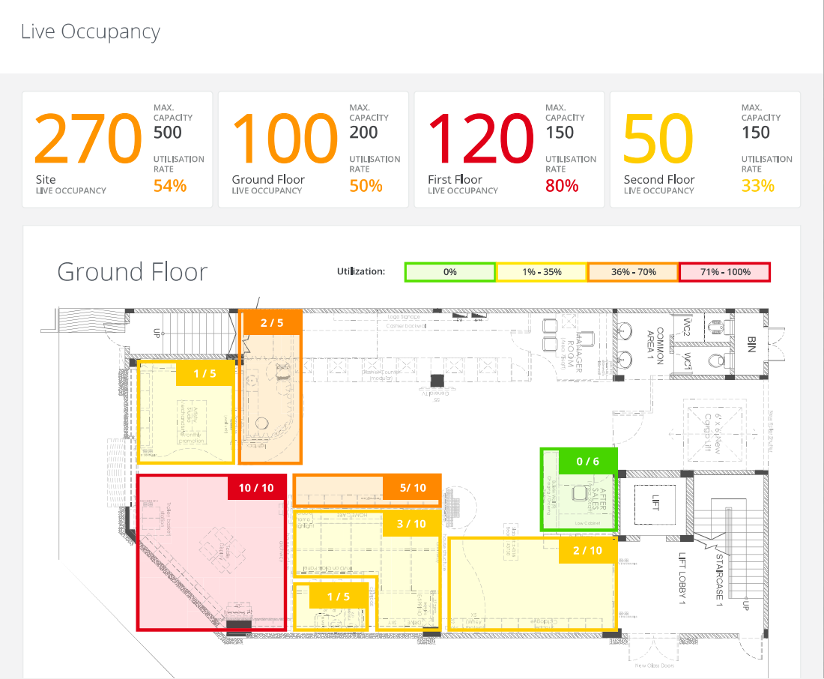
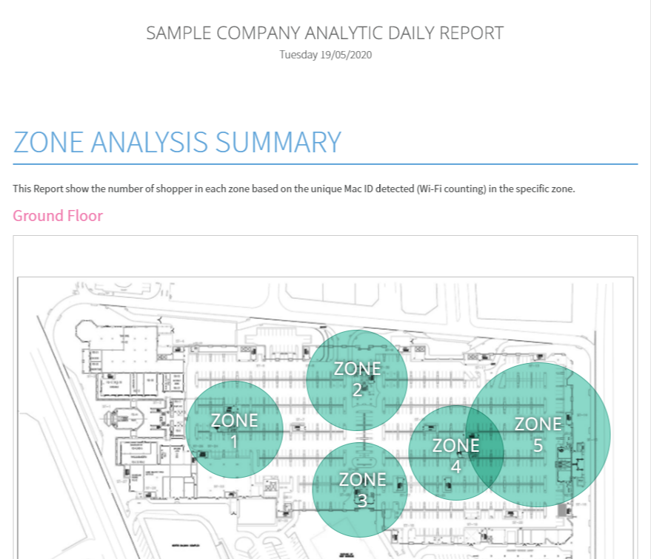
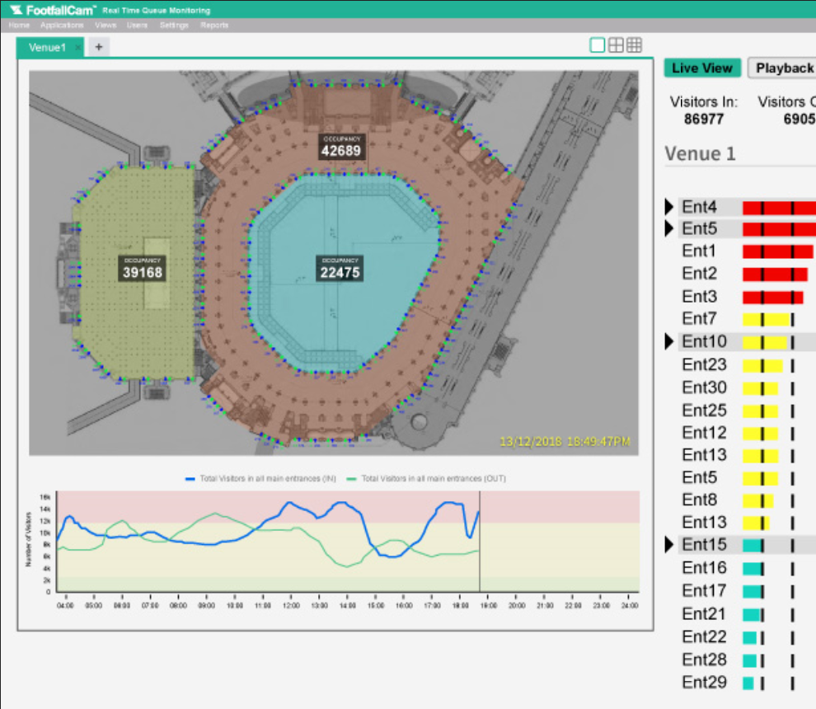
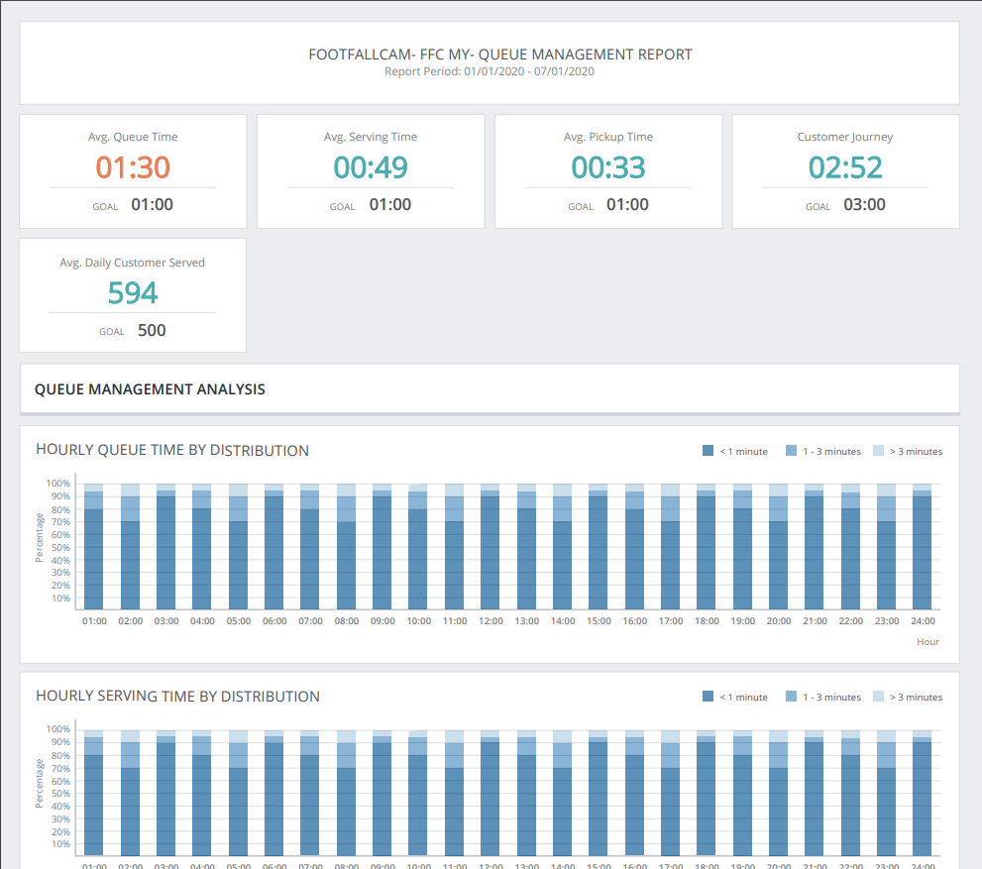
Reporting Suite
Analytics Center
Company Weekly Report
Site Weekly Report
Marketing Effectiveness
Live Occupancy
Zone Analytics
Mecca Occupancy
Queue Counting

Slide 21
Case Studies

Slide 22
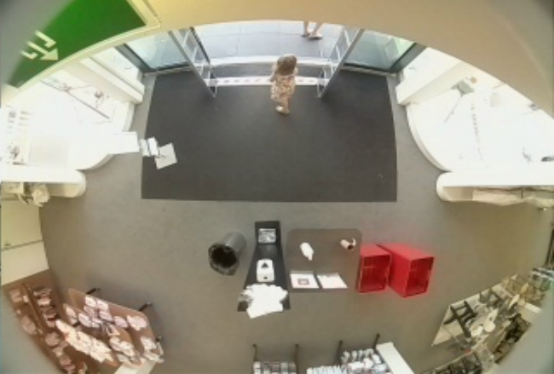
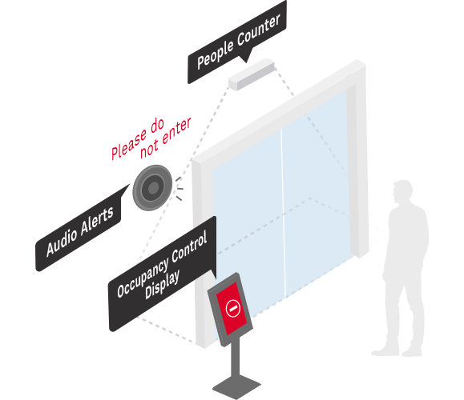
#1: Libraries in University of Oxford
Oldest university in the English-speaking world.
Requirements:
Large venue, high traffic
Need to give peace of mind to students
Limited staffs, automation required
FootfallCam Solutions:
Highly accurate, real-time centralized data, adjustable occupancy limit
Automated display of occupancy limit
Automated audio alert of occupancy threshold

Slide 23

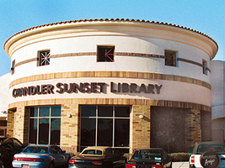
#2: Chandler Public Library
Local library in Chandler Downtown, United States.
Chandler Library wanted to providing valuable resources and requesting government funding for the latest technologies to attract members of the community
Faced difficulty as they had no method of determining the number of visitors that visit their library
With the help of FootfallCam, they were able to make cases to administration:
    Traffic data: Request for additional staff members by proving that more labour is required using traffic data
    Facility usage: Show that patrons have been using the in-house digital resources and request additional technology
    Resource planning: Place the invested resources at the most frequently visited areas
  More information can be found here.

Slide 24
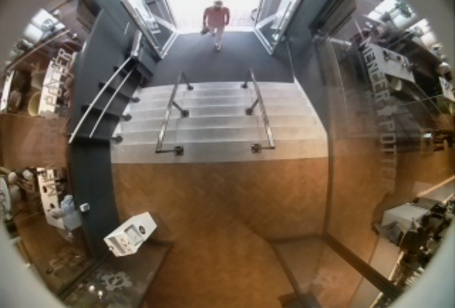
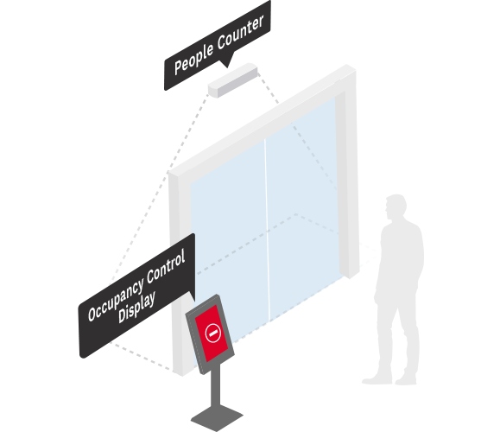
#3: Otis Library
Local library in Connecticut, United States.
Requirements:
Small venue, limited occupancy
Need to give peace of mind to visitors
Limited staffs, automation required
FootfallCam Solutions:
Highly accurate, real-time data, adjustable occupancy limit
Automated display of occupancy limit
Automated staff alert
Live Occupancy Tracker widget

Slide 25

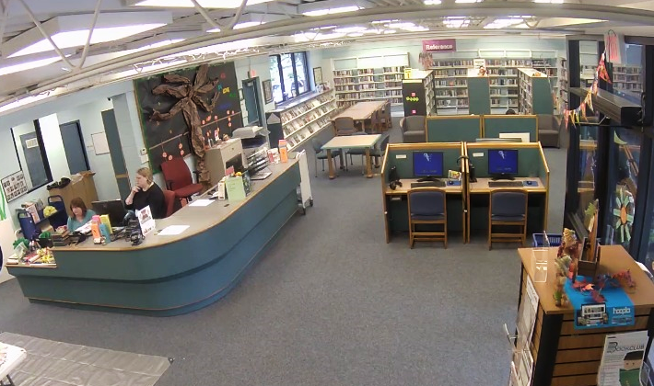
#4: Haringey Libraries
Local library in London, United Kingdom.
8 libraries of Haringey Libraries were undergoing refurbishment – calls for the need of people counting system.
Among other competitors, FootfallCam was selected with the awarded marks of 100 (full marks) on product pricing and quality.
To ease the application process for funds and additional resources (eBooks: computers, iPads), they needed solid data on:
    Traffic flow (how many people are coming in)
    Facility utilisation (lounge, quiet areas, study rooms)
    Cross-site tracking (track the engagement levels of patrons)

Slide 26
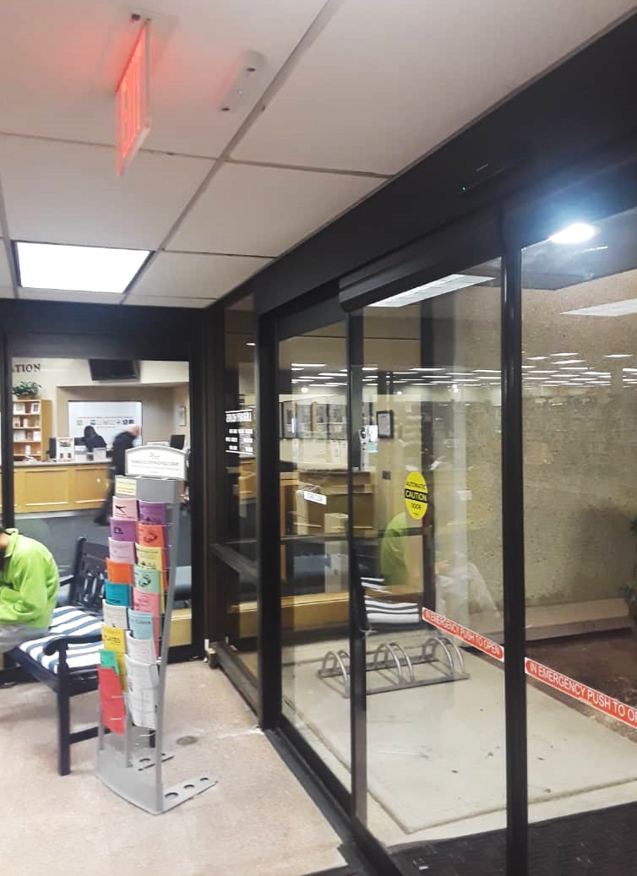

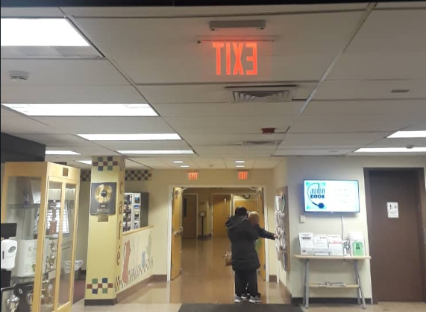
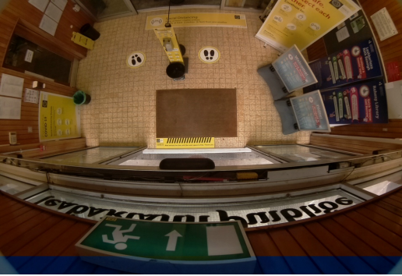
Other Library Case Studies
Installed locations:
Calcasieu Parish Public Library (United States)
Plainview-Old Bethpage Public Library (United States)
Leicester Library (United States)
Raheny Library (Ireland)
Dundrum Library (Ireland)
Dun Laoghaire Rathdown Library (Ireland)
East Achterhoek library (Netherlands)
Utrecht Library (Netherlands)
Gooi en Meer Library (Netherlands)
People Counter
People Counter

Slide 27
Key Selling Points when Approaching Libraries
Designed specifically for Libraries at a competitive price
Technology “lagger” – libraries use technology only when they have to.
Seeking for off-the-shelf, ready-to-use solution – something widely used and tested in all other industries.
Industry specific solution – focusing on how they will use it.
Competitively priced – libraries provide community based services, not profit making.
Notes:
Critical delivery point: what the major things that has the biggest bang for their buck?
Next version: Use case studies for the problem statements

Slide 28

Q&A Session
Contact Us
You need further information or have a question?
Please visit:
www.footfallcam.com
Subscribe to FootfallCam YouTube channel for more marketing and training videos:
©2002-2020 Footfall counter is trademark application of FootfallCam in various jurisdictions. We reserve the right to introduce modifications without notice. All other company names and products are trademarks of their respective companies.

